Slide 1
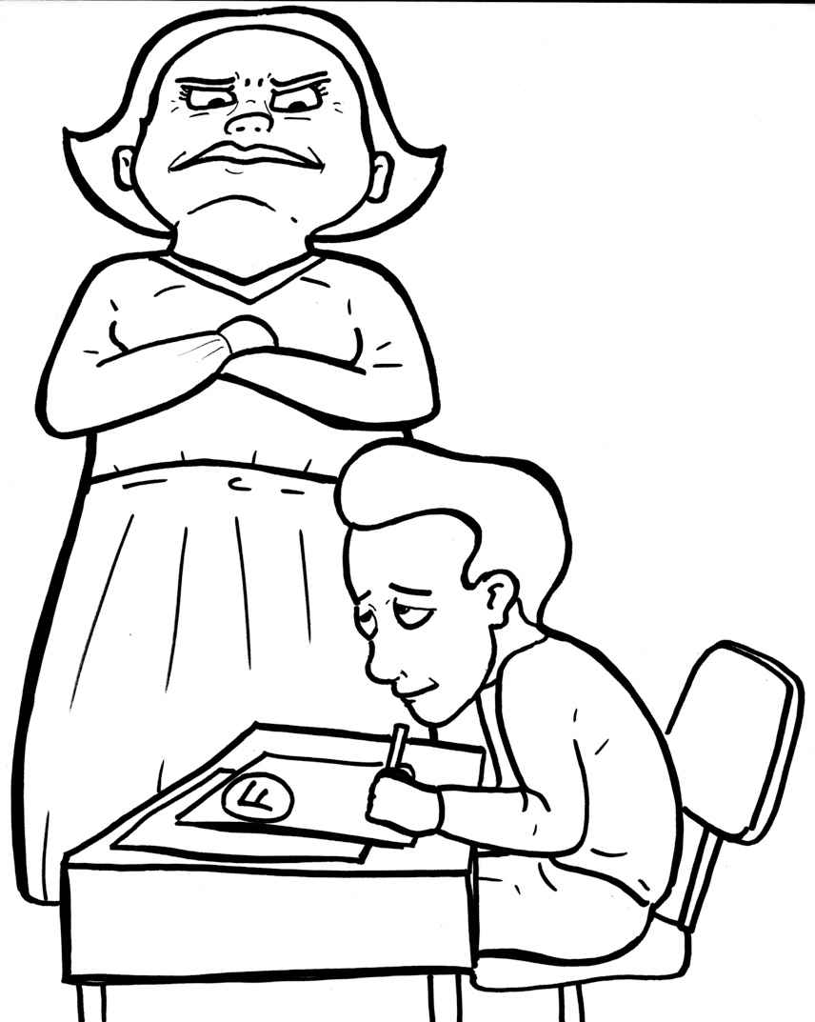
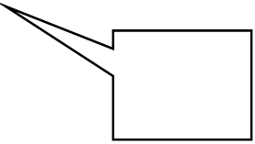
Part 1
46. First, the Bad News
– Sin Separates
Syllable Charts
You cheated!

Slide 2
Words in Syllable Types

Slide 3
Closed – Short Vowel
A closed syllable has one vowel
followed by one or more consonants,
and the vowel is short.
st
o
p
˘

Slide 4
bad
that

Slide 5
ev-
-ken
sep-
-ven

Slide 6
self-
-lem
fresh
yell

Slide 7
sis-
dis-
will
-ship
with
-ish

Slide 8
on
not
prob-
God

Slide 9
but
ug-
pun-

Slide 10
Open – Long Vowel
An open syllable has one vowel
with no consonant after it,
and the vowel is long.
−
go

Slide 11
we
e ven
be cause

Slide 12
go
Ro mans
no
bro ken
ho ly
o bey

Slide 13
glor y
ug ly
ever y
ho ly
heaven ly

Slide 14
Silent e – Long Vowel
A silent e syllable has one vowel,
followed by one consonant
and a silent e at the end.
The vowel is long.
−
ca
e
v

Slide 15
made
sep a rates

Slide 16
these

Slide 17
like
times

Slide 18
huge

Slide 19
Vowel Teams – Long Vowel
Many vowel teams follow this rule:
When two vowels get together,
the first one names its letter.
So the first vowel will make its long sound,
and the second vowel is silent.
−
e
a
t

Slide 20
al ways

Slide 21
o bey

Slide 22
need
sweet

Slide 23
read
mean
clean

Slide 24
lied

Slide 25
news

Slide 26
Vowel Teams – Other Sounds
Sometimes vowel teams make other sounds.
oil

Slide 27
all
fall
call

Slide 28
our
out
a bout

Slide 29
now

Slide 30
book
look
good

Slide 31
dis ap point

Slide 32
be cause

Slide 33
aw ful

Slide 34
heav en

Slide 35
R - Controlled
R-controlled syllables have one or more vowels
followed by an “r.”
The “r” changes the sound of the vowel.
o
r
ange

Slide 36
start

Slide 37
per fect
sis ter
for ev er
ev ery

Slide 38
hurt

Slide 39
first

Slide 40
for give
short
for ever
glory

Slide 41
worse
words
world

Slide 42
warm

Slide 43
par ents

Slide 44
Consonant – l-e
When you see consonant l-e at the end of a word,
count back three.
The “l-e” makes the /–le/ sound.
pur
p
l
e

Slide 45
peo ple

Slide 46
trou ble

Slide 47
Other Sounds – Long Vowel
These syllables or words are closed,
so the vowel should be short,
but the vowel is long.
−
cold

Slide 48
told

Slide 49
Other Sounds – -nk/-ng
The “-nk” and “-ng”
change the sound of the vowel.
bank
thing

Slide 50
wrongs

Slide 51
Other Sounds – schwa
The schwa syllable has an “a” that sounds
like the /u/ in banana.
The banana is even shaped like a short u.
ba nan a

Slide 52
a bout

Slide 53
dis ap point
Romans
sep a rates

