Slide 1
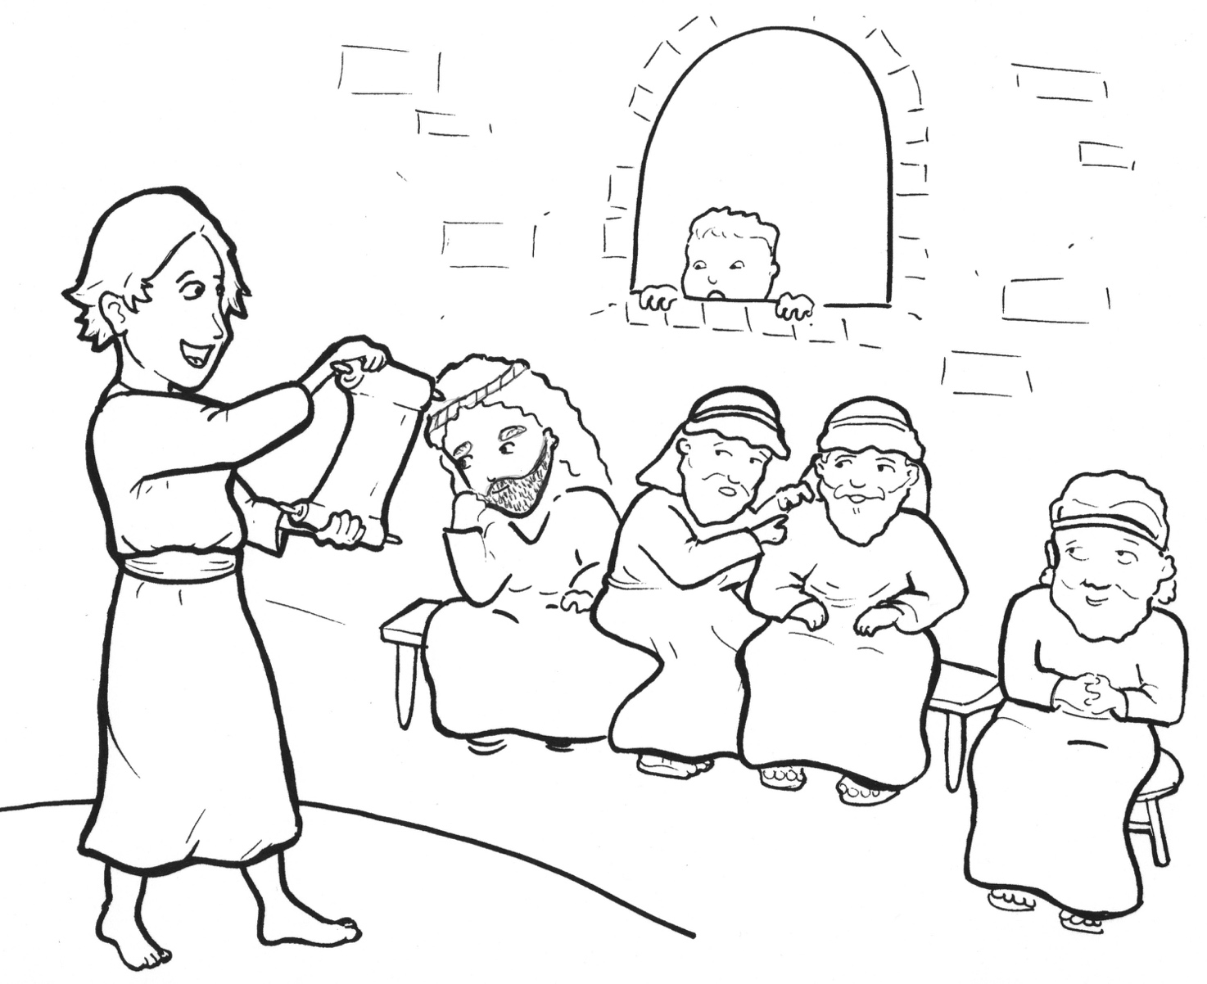
7. Jesus Gets Lost!
Part 4
Story in Easy Read English
Questions
Story in Phrases

Slide 2
Each year, Mary and Joseph went to Jerusalem to worship God.

Slide 3
When Jesus was 12 years old, he got to go along!

Slide 4
What a big city for a small boy.

Slide 5
It was crowded with people from many lands.

Slide 6
A few days later, his family packed wagons and camels to go home.

Slide 7
They traveled for a day.

Slide 8
“Where is Jesus?” Mary asked Joseph.

Slide 9
Joseph said, “Is he not with you?”

Slide 10
Jesus was missing!

Slide 11
They returned to the city.

Slide 12
They looked everywhere for Jesus.

Slide 13
Finally, they found him.

Slide 14
Jesus was in the temple, the house of God.

Slide 15
He was teaching the teachers.

Slide 16
These old, wise men were amazed.

Slide 17
How did this young boy know all about God?

Slide 18
How did he know the Scriptures so well?

Slide 19
“Son,” Mary said, “we have been looking for you for three days!”

Slide 20
“Why?” Jesus said. “Didn’t you know I had to be in my Father’s house?”

Slide 21
They did not understand.

Slide 22
Jesus went home with his mother and father to Nazareth.

Slide 23
He obeyed them.

Slide 24
Question 1
Where was Jesus when his parents missed him?

Slide 25
Question 2
Why did Jesus feel that he had to be in the temple?

Slide 26
Question 3
Do you have a burning wish to be in God’s house? Where is God’s house for you?

Slide 27
Question 4
How can you get to church each week?

Slide 28
Prayer
Dear Jesus,
I have to be in your house. I want to go to church. Please help me to grow up in the house of God. Help my family and I to be there each week.
Amen

Slide 29
Jesus Gets Lost!
Phrased for Fluency

Slide 30
Each year,
Mary and Joseph
went to Jerusalem
to worship God.

Slide 31
When Jesus
was 12 years old,
he got
to go along!

Slide 32
What a big city
for a small boy.

Slide 33
It was crowded
with people
from many lands.

Slide 34
A few days later,
his family
packed wagons and camels
to go home.

Slide 35
They traveled
for a day.

Slide 36
“Where is Jesus?”
Mary asked Joseph.

Slide 37
Joseph said,
“Is he not with you?”

Slide 38
Jesus
was missing!

Slide 39
They returned
to the city.

Slide 40
They looked
everywhere
for Jesus.

Slide 41
Finally,
they found him.

Slide 42
Jesus
was in the temple,
the house of God.

Slide 43
He was teaching
the teachers.

Slide 44
These old, wise men
were amazed.

Slide 45
How did this young boy
know
all about God?

Slide 46
How did he know
the Scriptures
so well?

Slide 47
“Son,”
Mary said,
“we have been
looking for you
for three days!”

Slide 48
“Why?”
Jesus said.

Slide 49
“Didn’t you know
I had to be
in my Father’s house?”

Slide 50
They
did not understand .

Slide 51
Jesus
went home
with his mother and father
to Nazareth.

Slide 52
He
obeyed them.

