Slide 1
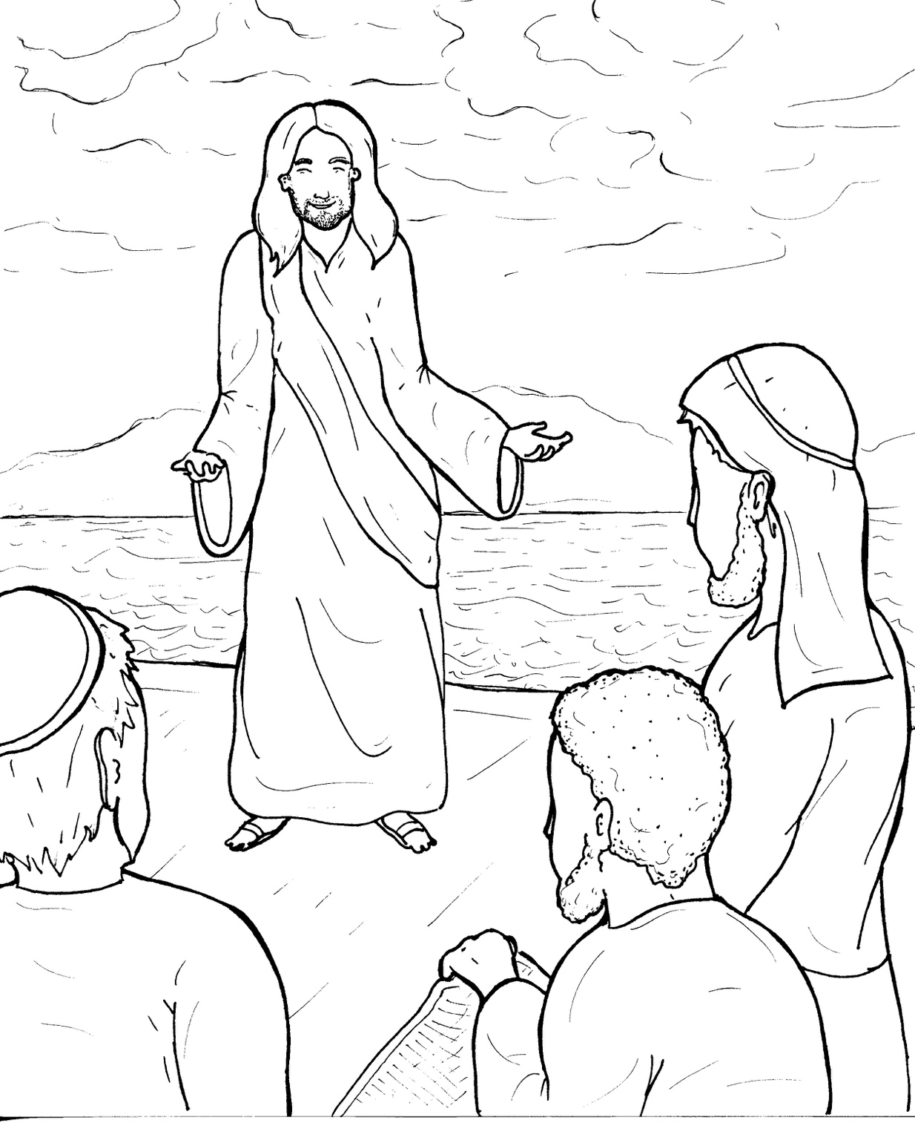
10. Jesus Calls Followers
Part 5
Vocabulary
Original Bible Story

Slide 2
Vocabulary

Slide 3
cast
(cast):
to throw

Slide 4
immediately
(im -
ME -
di -
ate -
ly):
right away

Slide 5
mend
(mend):
to fix

Slide 6
appoint
POINT):
(ap -
to choose someone
for a special job

Slide 7
authority
(au -
THOR -
it -
y):
power to make decisions

Slide 8
demons
mons):
(DE -
evil spirits

Slide 9
Jesus Calls Followers
Mark 1:16 -20; Mark 3:13 -18
World English Bible (WEB)

Slide 10
Passing along by the sea of Galilee, he saw Simon and Andrew, the brother of Simon, casting a net into the sea, for they were fishermen.

Slide 11
Jesus said to them, “Come after me, and I will make you into fishers for men.”

Slide 12
Immediately, they left their nets, and followed him.

Slide 13
Going on a little further from there, he saw James the son of Zebedee, and John, his brother, who were also in the boat mending the nets.

Slide 14
Immediately, he called them, and they left their father, Zebedee, in the boat with the hired servants, and went after him.

Slide 15
Jesus went up into the mountain, and called to himself those whom he wanted, and they went to him.

Slide 16
He appointed twelve, that they might be with him, and that he might send them out to preach, and to have authority to heal sicknesses and to cast out demons.

Slide 17
Simon (to whom he gave the name Peter);
James the son of Zebedee; and John, the brother of James, (whom he called Boanerges, which means, Sons of Thunder);

Slide 18
Andrew; Philip; Bartholomew; Matthew; Thomas; James, the son of Alphaeus; Thaddaeus; Simon the Zealot; and Judas Iscariot, who also betrayed him.

