Slide 1
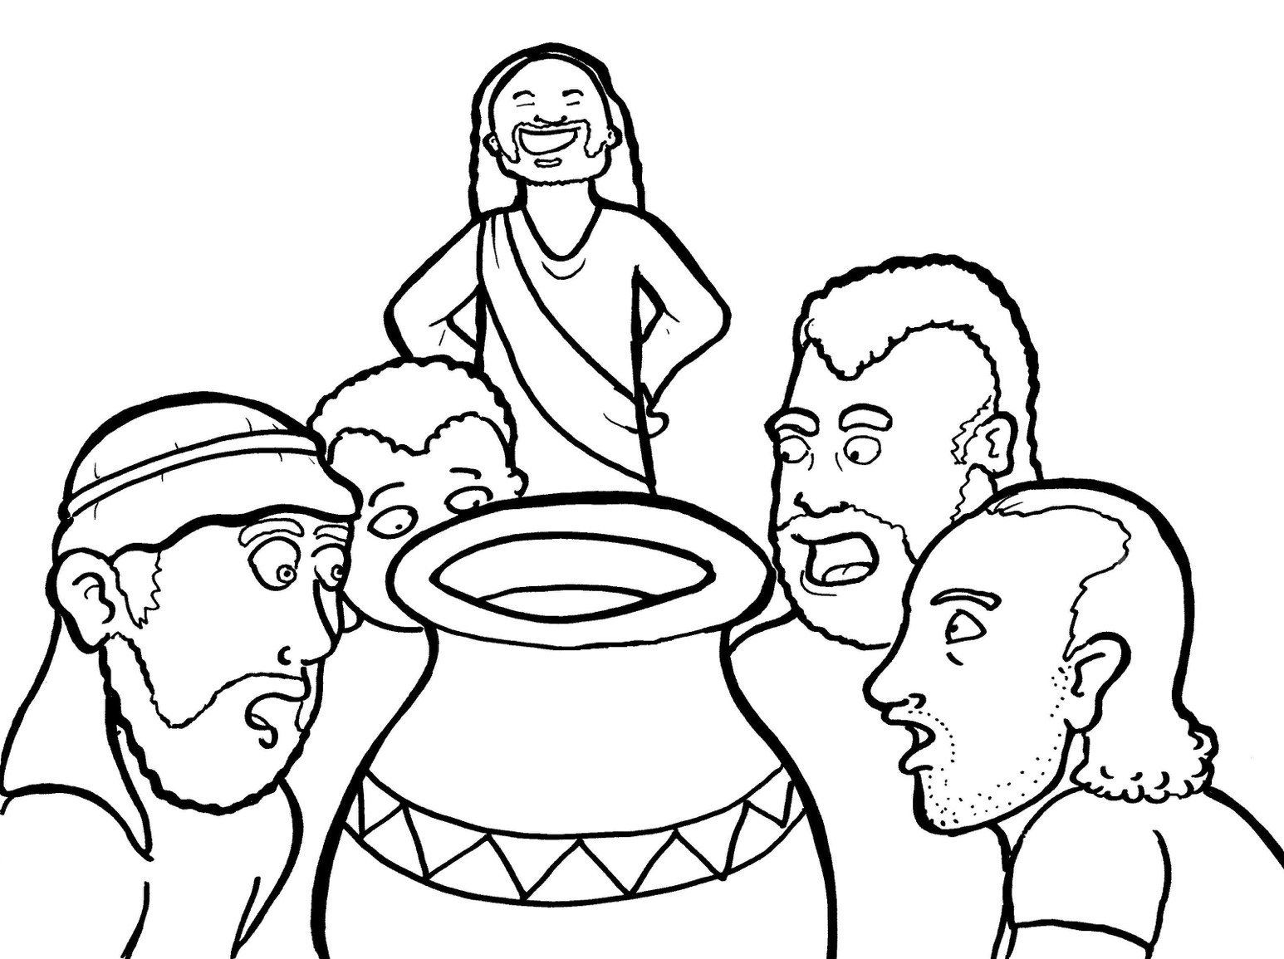
15. Jesus Saves a Wedding
Part 4
Story in Easy Read English
Questions
Story in Phrases

Slide 2
Jesus loved the fun at the wedding in Cana.

Slide 3
His mother Mary and his disciples came too.

Slide 4
Torches lit the night with glowing fire.

Slide 5
Happy music filled the air.

Slide 6
The bride and groom danced with joy.

Slide 7
Children ran around
and played.

Slide 8
Everyone ate and ate.

Slide 9
And they drank wine, lots of wine.

Slide 10
Uh oh! The wine ran out!

Slide 11
What would happen to the party?

Slide 12
People would go home.

Slide 13
“Jesus,” Mary said, “there is no more wine.”

Slide 14
Jesus said to her softly, “It is not yet my time.”

Slide 15
Still, Mary said to the servants, “Do what he tells you.”

Slide 16
Six big, stone jars sat empty.

Slide 17
"Fill the jars with water,” Jesus said.

Slide 18
The servants obeyed.

Slide 19
“Now, take some to the person in charge,” Jesus said.

Slide 20
The person in charge took a sip.

Slide 21
“Mmmm, this is the best wine ever!” he said.

Slide 22
The water had turned
into wine!

Slide 23
Jesus showed his glory by this sign.

Slide 24
It was his first miracle.

Slide 25
His disciples believed in him.

Slide 26
And the party went on and on.

Slide 27
Question 1
What is a miracle? What was Jesus’ first miracle?

Slide 28
Question 2
The Bible calls this miracle a sign. Signs point the way. What does this sign show us?

Slide 29
Question 3
Mary asked for help and then took action. How does asking plus action equal success?

Slide 30
Question 4
At first, Jesus said no, but then he did the miracle. What does this teach you about asking?

Slide 31
Prayer
Dear Jesus,
Your miracles show the world that you are the Messiah, the Son of God. Thank you for making miracles. I need a miracle.
Amen

Slide 32
Jesus Saves a Wedding
Phrased for Fluency

Slide 33
Jesus
loved the fun
at the wedding
in Cana.

Slide 34
His mother Mary
and his disciples
came too.

Slide 35
Torches
lit the night
with glowing fire.

Slide 36
Happy music
filled the air.

Slide 37
The bride and groom
danced with joy.

Slide 38
Children
ran around
and played.

Slide 39
Everyone
ate and ate.

Slide 40
And they
drank wine,
lots of wine.

Slide 41
Uh oh!
The wine ran out!

Slide 42
What would happen
to the party?

Slide 43
People
would go home.

Slide 44
"Jesus,"
Mary said,
"there is
no more wine."

Slide 45
Jesus
said to her
softly,
"It is not
yet my time."

Slide 46
Still,
Mary said
to the servants,
"Do
what he tells you."

Slide 47
Six big, stone jars
sat empty.

Slide 48
"Fill the jars
with water,"
Jesus said.

Slide 49
The servants
obeyed.

Slide 50
"Now,
take some
to the person
in charge,"
Jesus said.

Slide 51
The person in charge
took a sip.

Slide 52
"Mmmm,
this is the best wine
ever!"
he said.

Slide 53
The water
had turned
into wine!

Slide 54
Jesus
showed his glory
by this sign.

Slide 55
It was
his first miracle.

Slide 56
His disciples
believed in him.

Slide 57
And the party
went on and on.

