Slide 1
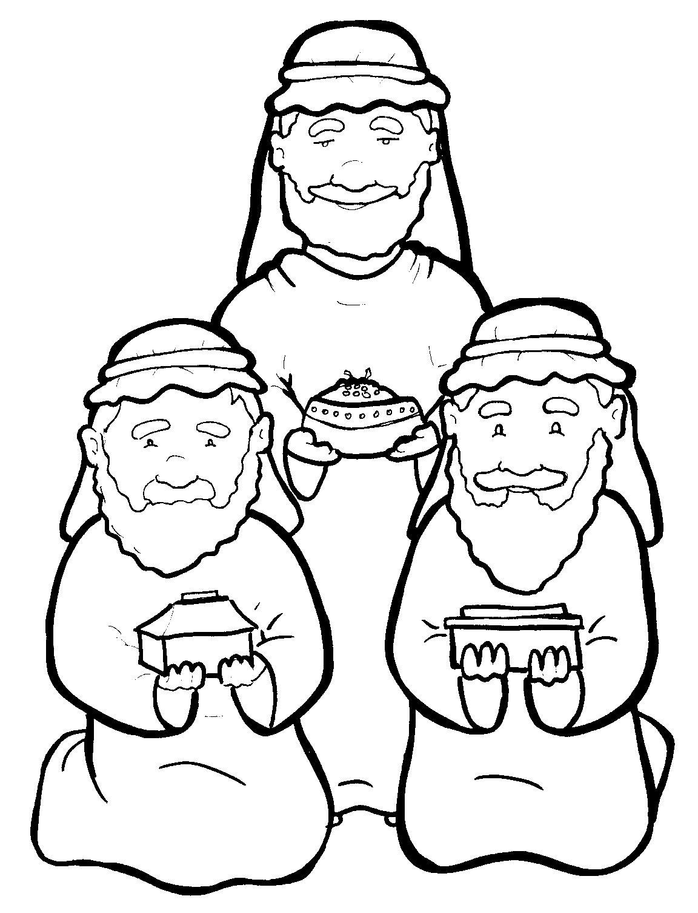
4. Wise Men Give Gifts to Jesus
Part 2
New Words
Rule Breakers

Slide 2
Other Sounds – Soft C
ce, ci, cy make the soft sound
cent
city
fancy

Slide 3
frankincense

Slide 4
New Words
Jerusalem
worshipped
worship
myrrh

Slide 5
Rule Breakers
These words do not follow phonetic patterns.
give
would

Slide 6
to
saw
of
you
have
said

Slide 7
put
was
is
from
his
they

Slide 8
were
full
their
where

