Slide 1
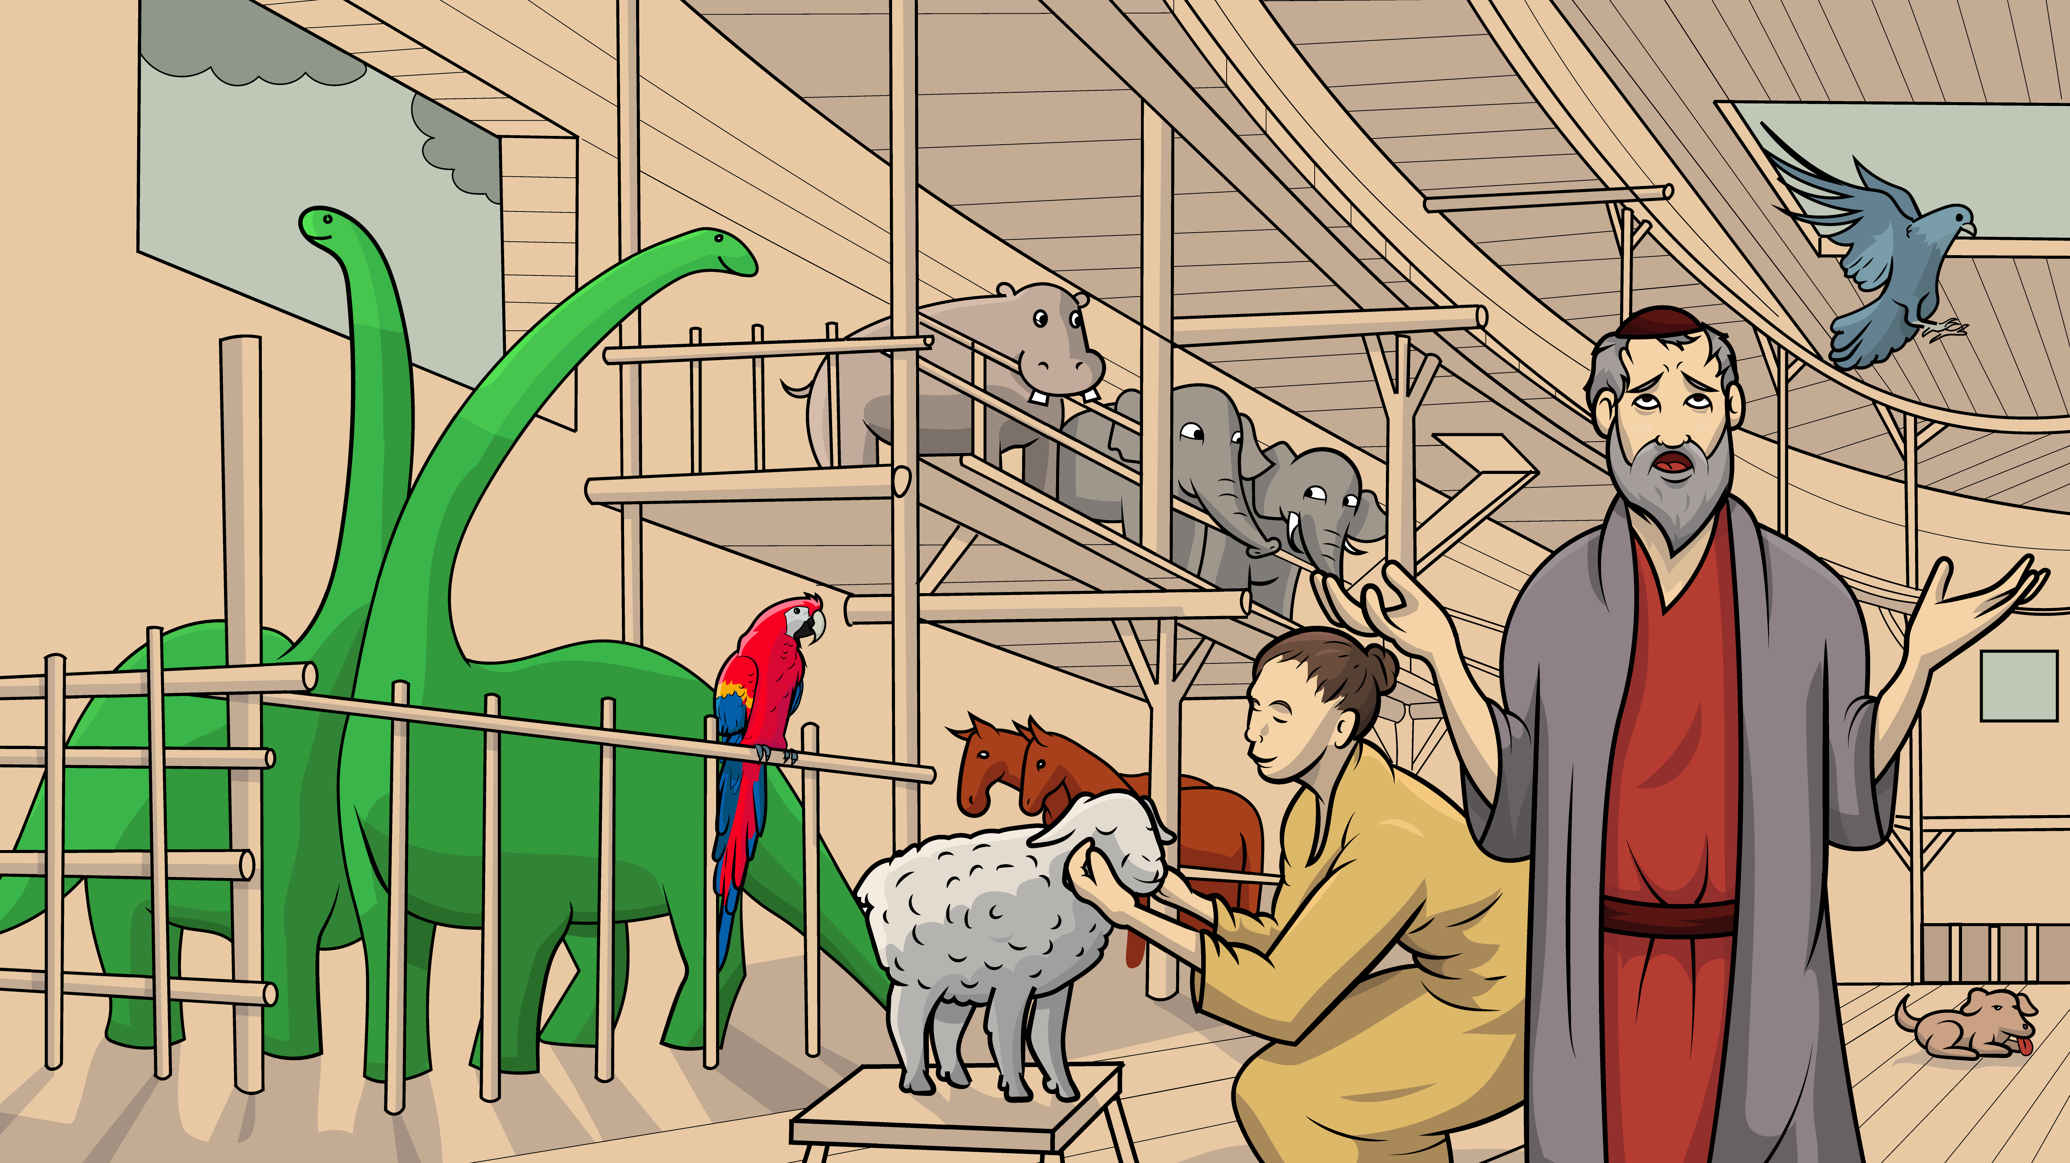
Story 1.10 Oh, No, Off We Go !
Noah’s Ark, Part 2
Genesis 7
( Open Vowels )

Slide 2
New Words to Read
no go so hi
be she me he
we amen open

Slide 3
why my shy fly
cry sky dry try
spy by pry (to pull off)

Slide 4
Sight Words
humans keep birds open happen oh

Slide 5
Rule Breakers (Read and Spell)
to do the
said what was

Slide 6
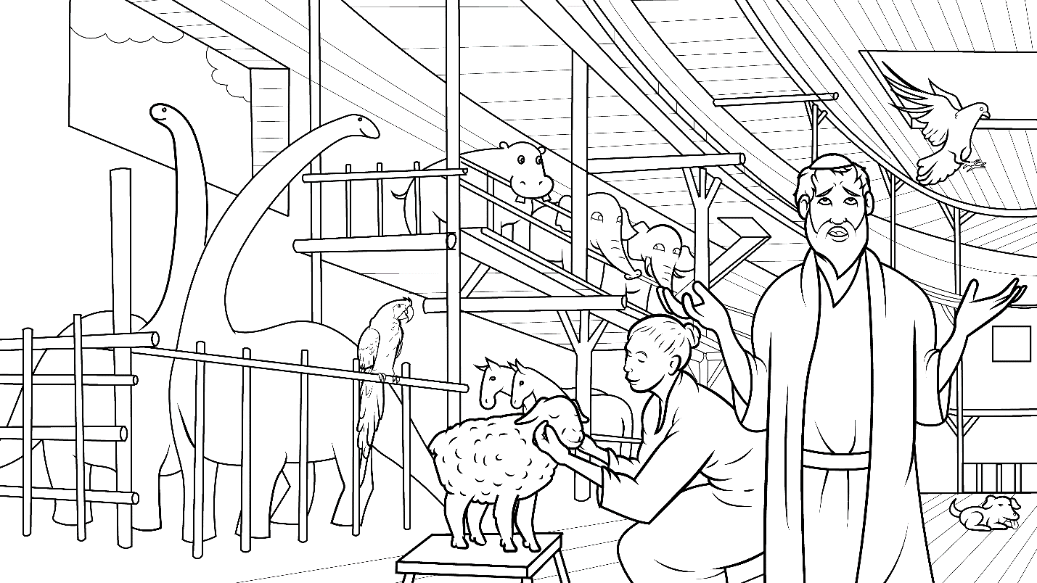
Story 1.10 Oh, No, Off We Go !
I Read,
You Read
Bible Story
Noah’s Ark, Part 2
Genesis 7
( Open Vowels )

Slide 7
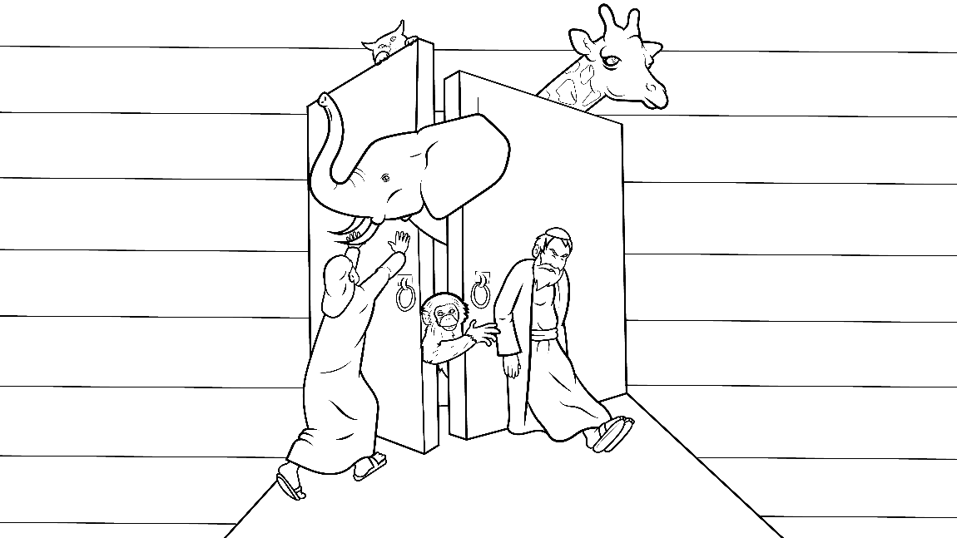
After God shut that big door on the ark
– bam – Noah
had a big job.

Slide 8
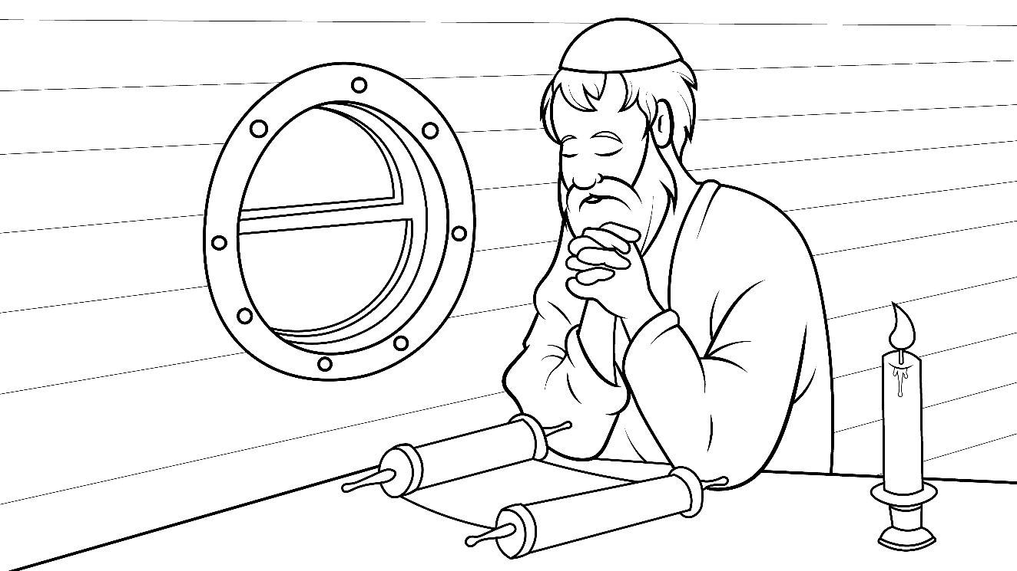
So much to ask God.
“Why?”
he did cry.

Slide 9
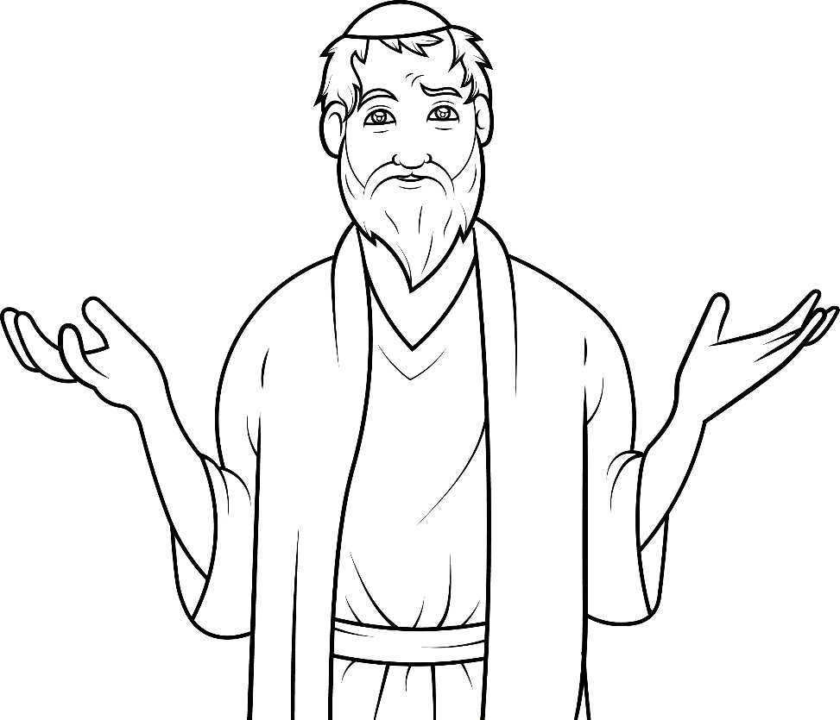
“Oh me. Oh my. Why did so much bad happen?

Slide 10
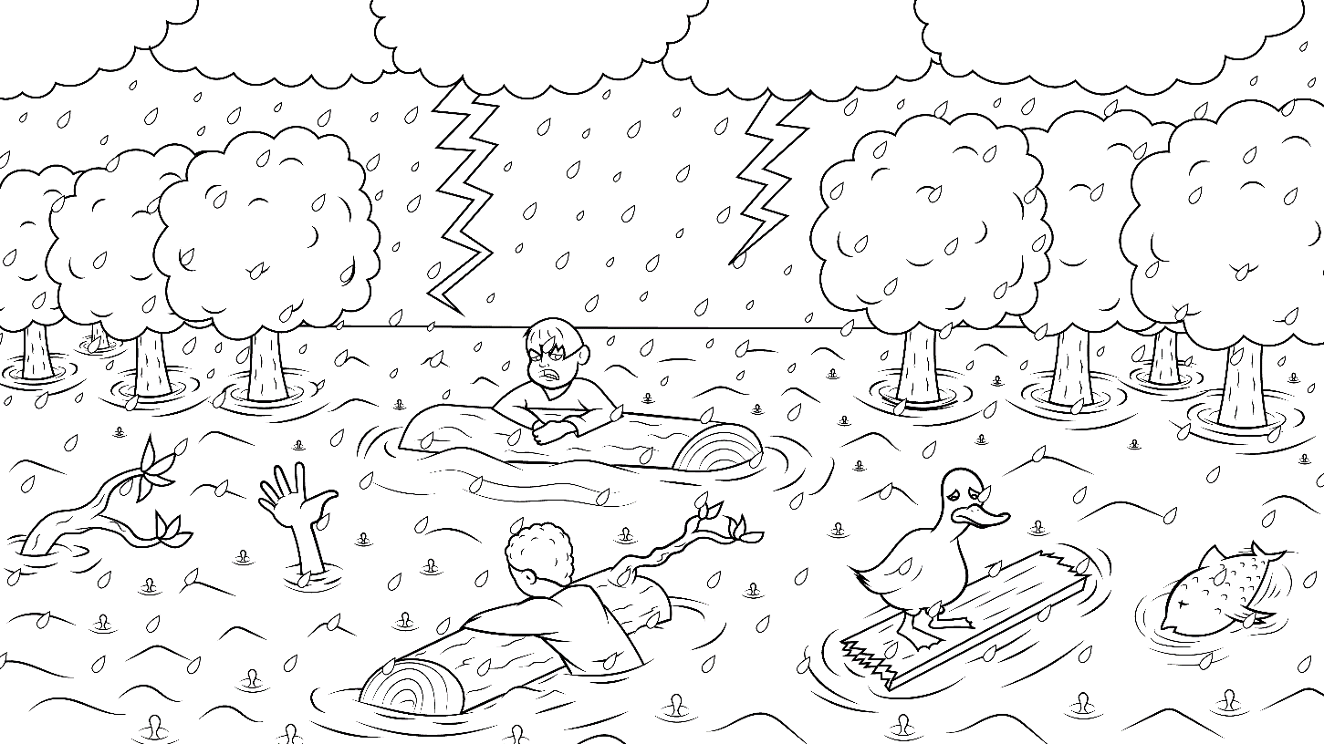
Why did the sky open?
Will we be dry?
Why did humans
and animals all die?”

Slide 11
Noah knew that God was still good
so he said,
“Oh me. Oh my. I will try to do my job.”

Slide 12
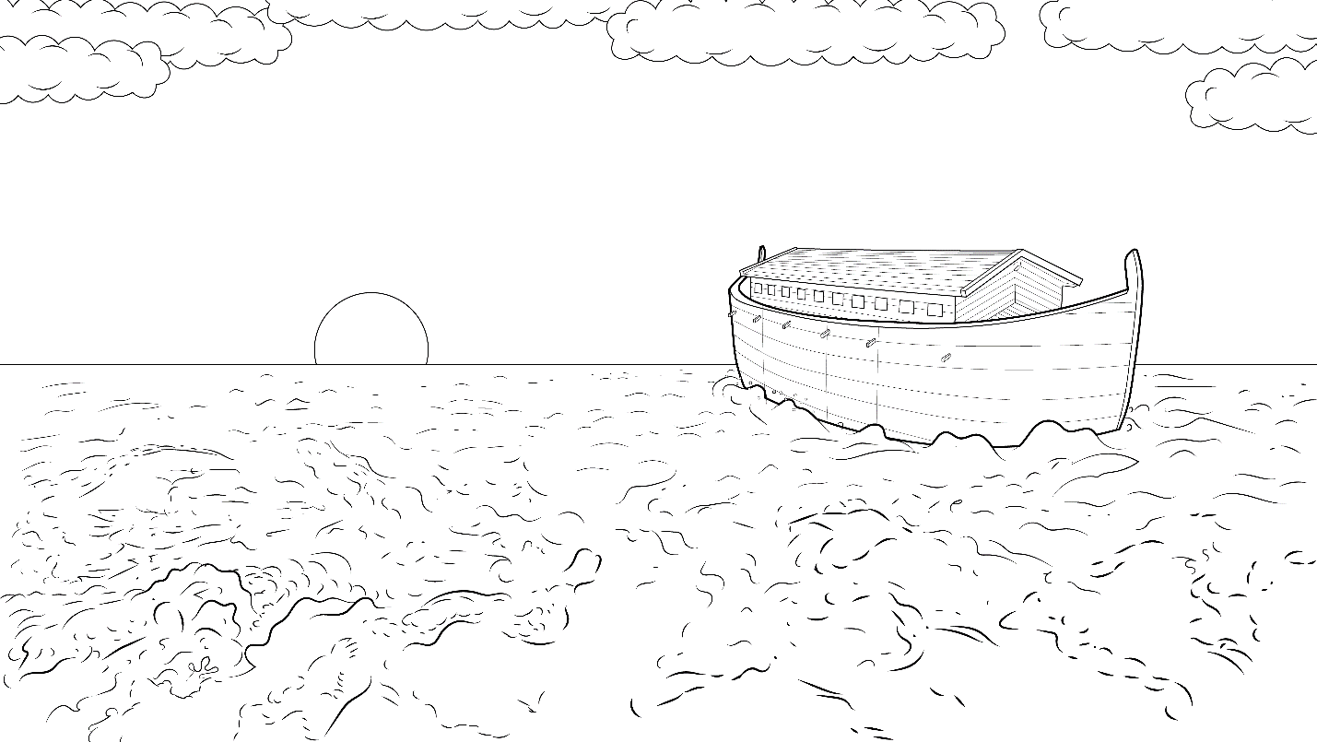
Noah had a window on top of the ark.
“Oh me. Oh my. I will try to pry it open to spy on the sky.

Slide 13
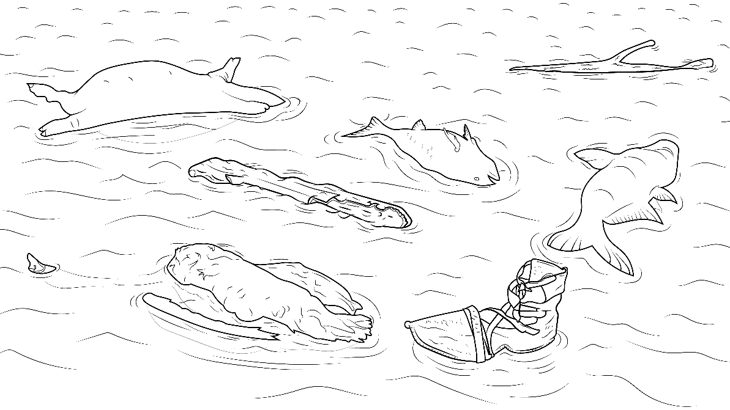
What is wet? When will it be dry?

Slide 14
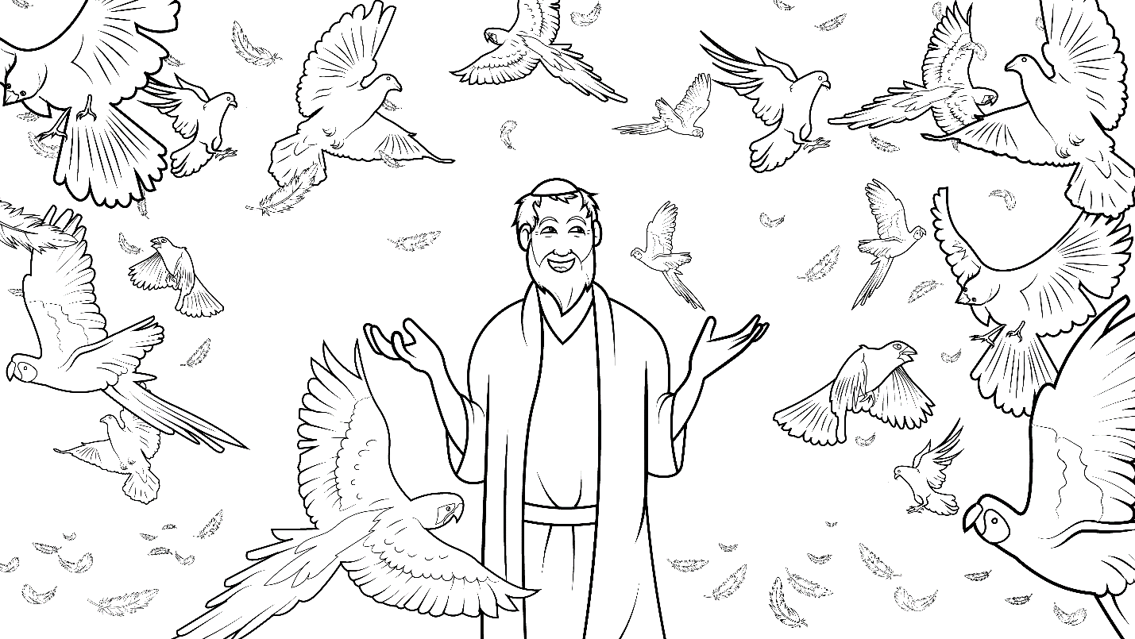
What just went by?
So, on this ship, birds can fly?
No…yes!”

Slide 15
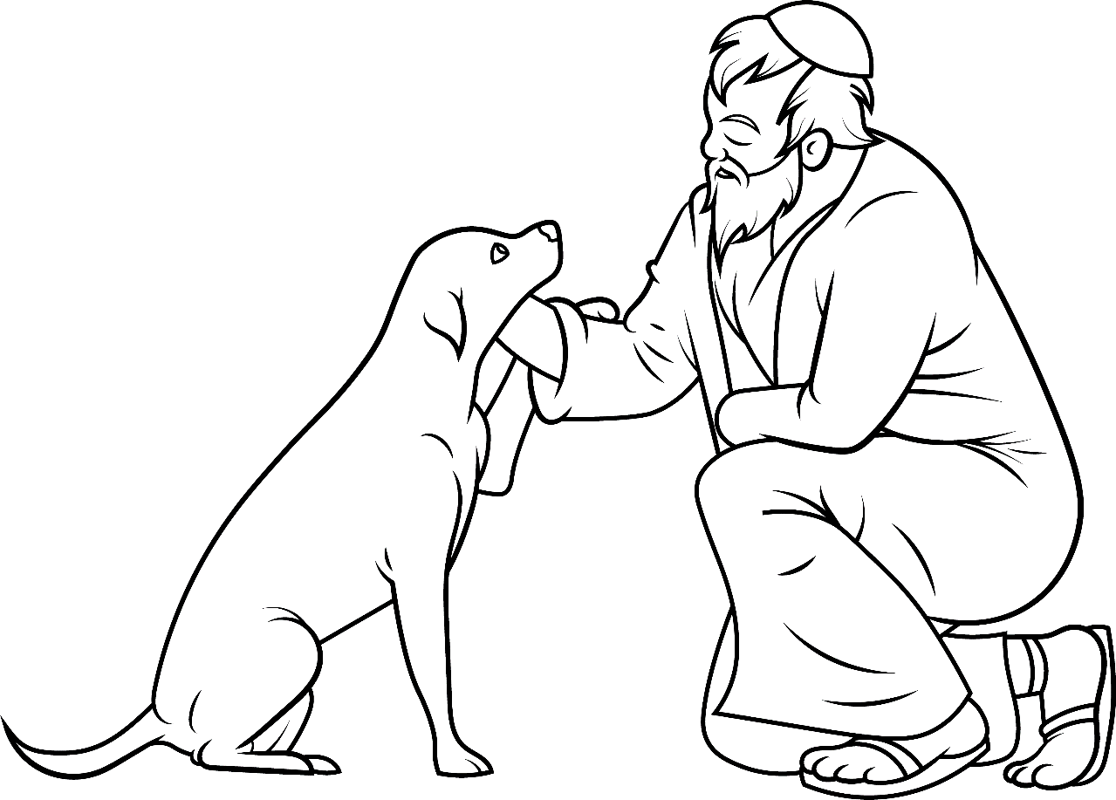
Noah and his wife took care of the animals.

Slide 16
She said, “Oh me. Oh my. I will try to keep my shy pets dry.”

Slide 17
The only humans and
animals still
alive were all alone
on the big sea.
They were
sad, so sad.

Slide 18
Noah said to his wife,
“Hi. I will not be sad, no.
I will be glad and try to trust God.”

Slide 19
She said to him, “Oh me. Oh my. I will try to be glad.
I will try to trust God as we go. Yes, we will try. Amen.”

Slide 20
The End

Slide 21
1.10 Story Without Illustrations
Oh, No,
Off We Go!
Genesis 7

Slide 22
After God shut that big door on the ark – bam – Noah had a big job.
So much to ask God. “Why?” he did cry.
“Oh me. Oh my. Why did so much bad happen?

Slide 23
Why did the sky open? Will we be dry? Why did humans and animals all die?” Noah knew that God was still good so he said,
“Oh me. Oh my. I will try to do my job.”

Slide 24
Noah had a window on top of the ark.
“Oh me. Oh my. I will try to pry it open to spy on the sky. What is wet?
When will it be dry? What just went by?
So, on this ship, birds can fly? No…yes!”

Slide 25
Noah and his wife took care of the animals. She said, “Oh me. Oh my.
I will try to keep my shy pets dry.”
The only humans and animals still alive
were all alone on the big sea.

Slide 26
They were sad, so sad.
Noah said to his wife,
“Hi. I will not be sad, no.
I will be glad and try to trust God.”

Slide 27
She said to him, “Oh me. Oh my.
I will try to be glad.
I will try to trust God as we go.
Yes, we will try.
Amen.”

Slide 28
The End

Slide 29
Story: Carol Hale
Illustrations: Ivan Mader
Power Point arrangements: Steve March
www.EasyReadEnglish.com
www.EZReadEnglish.org/lower-levels

Slide 30
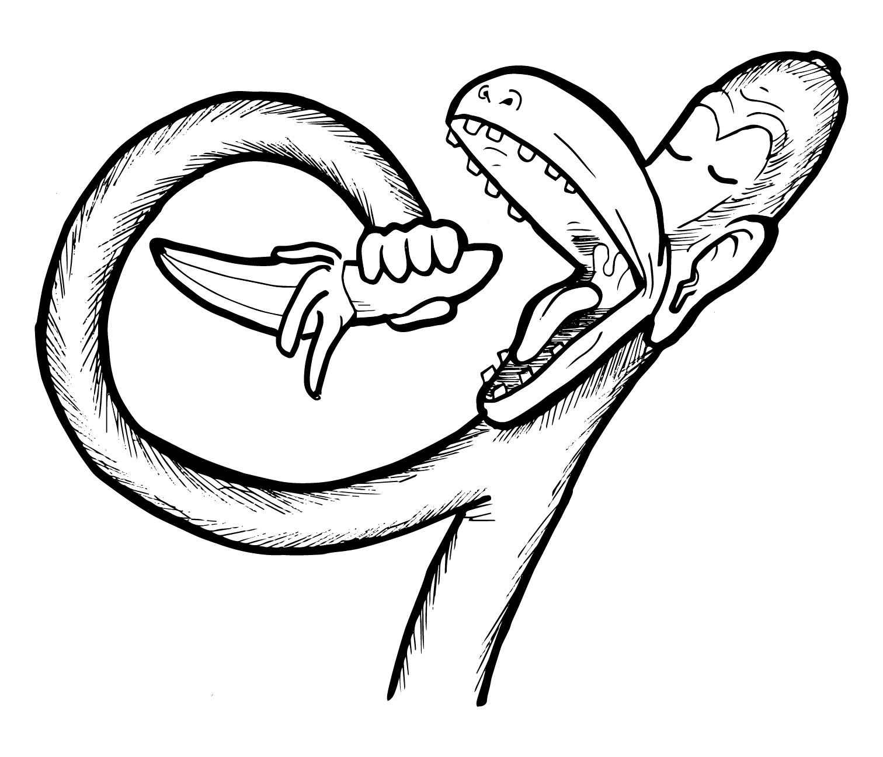
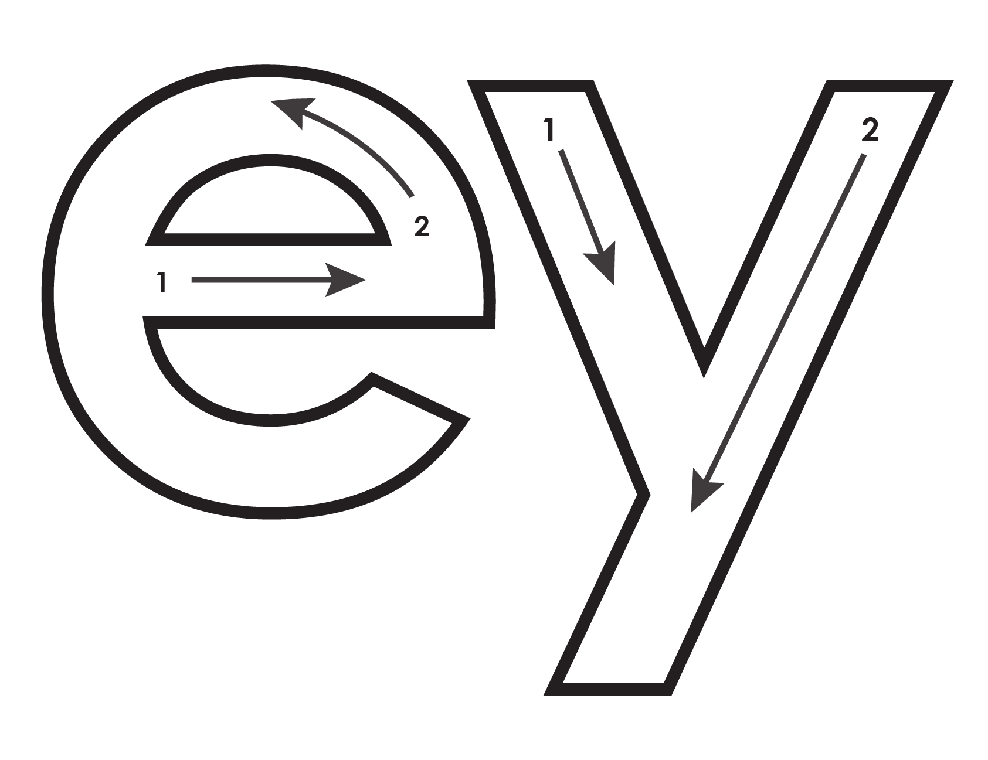
Another important teaching tool…
Easy Breezy Reading (https://www.easybreezyreading.com)
Designed to help new, struggling, and especially dyslexic learners, Easy Breezy Reading is broken up into Laughing Letters and Funny Phonograms. Both tools use illustrated patterns that mimic the shapes of the letters to give your students one more sense to link the phonetic sound of the letters.
ey
monk
Our scope and sequence matches Easy Read English Lower Levels. Progressing through the Easy Breezy Reading curriculum is sure to accelerate your students’ comprehension of the written English language.
You can procure Laughing Letters or Funny Phonograms through our website.
https://www.easybreezyreading.com/curriculum

