Slide 1

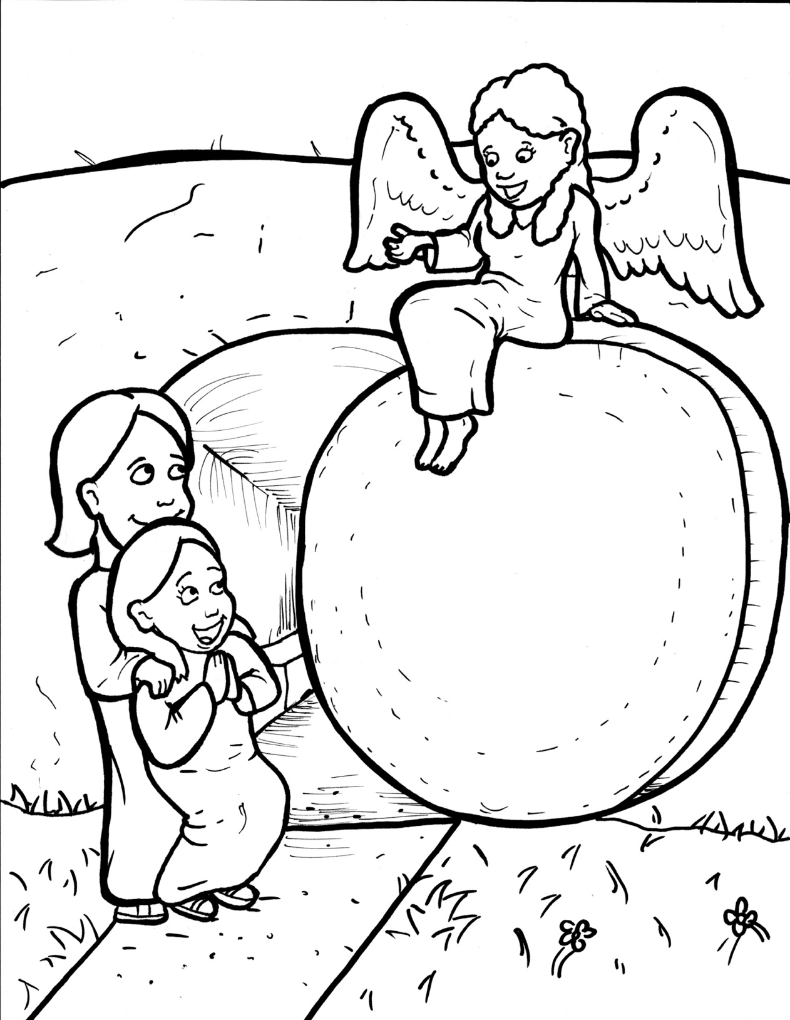
Part 3
41. Jesus is Alive!
Syllable Divisions

Slide 2

Dividing Words
Into Syllables

Slide 3
Rabbit Words
When you see two consonants
between two vowels,
divide between the consonants.
ra it
bb
rab bit

Slide 4
al so
also

Slide 5
af ter
after

Slide 6
fol low
follow

Slide 7
hap py
happy

Slide 8
re mem ber
remember

Slide 9
sud den
sudden

Slide 10
dis ci ples
disciples

Slide 11
Tiger Words
When you see one consonant
between two vowels,
divide after the first vowel.
Try this pattern first.
ti er
g
ti ger

Slide 12
Je sus
Jesus

Slide 13
Pe ter
Peter

Slide 14
be lieve
believe

Slide 15
be came
became

Slide 16
re mem ber
remember

Slide 17
tru ly
truly

Slide 18
Camel Words
When you see one consonant
between two vowels,
divide after the first consonant.
Try this pattern second.
ca el
m
cam el

Slide 19
bod y
body

Slide 20
ris en
risen

Slide 21
lin en
linen

Slide 22
liv ing
living

Slide 23
Turtle Words
When you see consonant-l-e,
count back three and divide.
tur
t
l
e
tur tle

Slide 24
dis ci ple
disciple

Slide 25
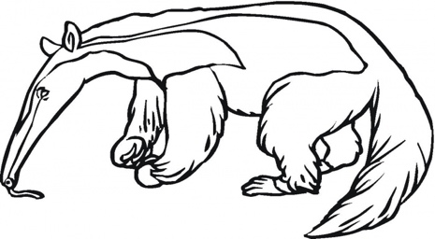
Anteater Words
These compound words are made up of two smaller words.
ant
eater
1
2
ant eater

Slide 26
in side
inside

Slide 27
be came
became

Slide 28
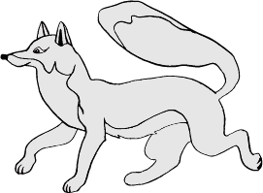
Foxes Suffixes
Focus on your base word.
fox es
fox es

Slide 29
spices
spices

Slide 30
liv ing
living

Slide 31
glow ing
glowing

Slide 32
real ly
really

Slide 33
tru ly
truly

Slide 34
looked
looked

Slide 35
picked
picked

Slide 36
worshipped
worshipped

Slide 37
rolled
rolled

Slide 38
died
died

Slide 39
followed
followed

Slide 40
appeared
appeared

Slide 41
remembered
remembered

Slide 42
Hamster Words
When you see three consonants between two vowels,
divide after the first consonant.
ha
mst
er
ham ster

Slide 43
wor shipped
worshipped

Slide 44
Other Syllable Divisions
Some words don’t fit so neatly
into standard syllable division patterns.

Slide 45
a live
alive

Slide 46
a way
away

Slide 47
a fraid
afraid

Slide 48
a mong
among

Slide 49
ap pear
appear

Slide 50
emp ty
empty

Slide 51
ang el
angel

