Slide 1

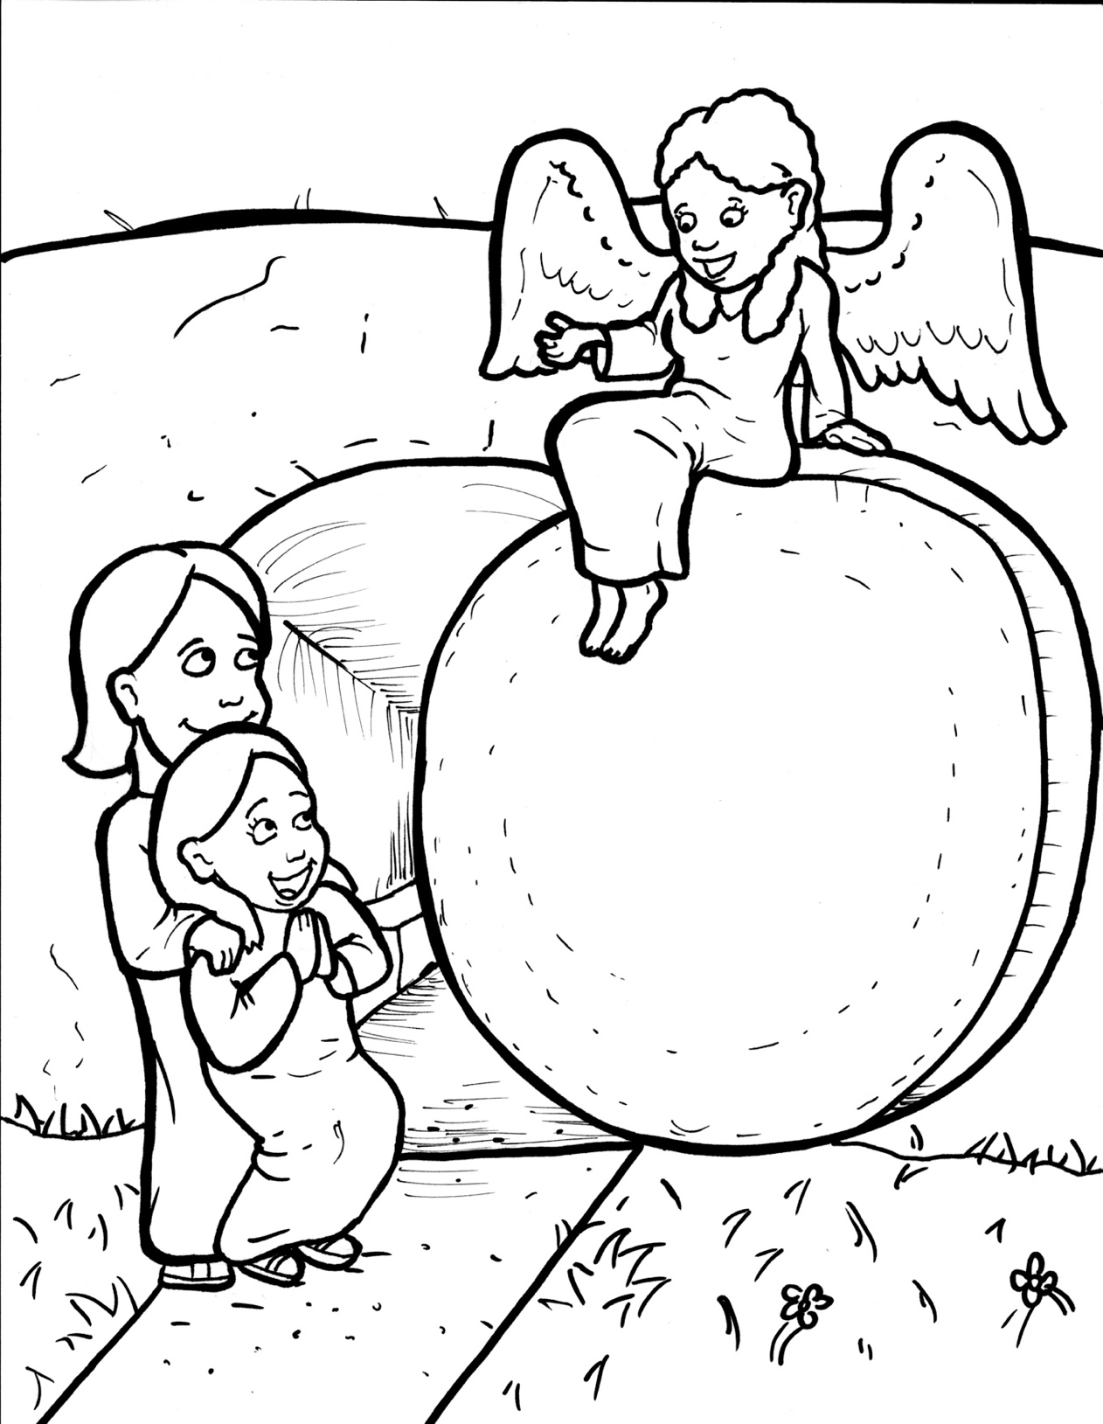
Part 5
41. Jesus is Alive!
Vocabulary
Original Bible Story

Slide 2

Vocabulary

Slide 3
perplexed
(per -PLEX -ed)
confused

Slide 4
dazzling
(DAZ - zling)
bright and shiny

Slide 5
delivered
(de - LIV - ered)
given

Slide 6
apostles
(a - POS - tles)
Jesus’ 12
first followers

Slide 7
nonsense
(NON - sense)
not making sense,
foolish

Slide 8
departed
(de - PART - ed)
went away

Slide 9
Jesus is
Alive!
Luke 24:1-12
World English Bible (WEB)

Slide 10
But on the first day of the week,
at early dawn,

Slide 11
they and some others came
bringing the spices
to the tomb,
which they had prepared.

Slide 12
They found the stone
rolled away from the tomb.

Slide 13
They entered in, and didn’t find
the Lord Jesus’ body.

Slide 14
While they were greatly
perplexed about this,

Slide 15
behold, two men stood by them
in dazzling clothing.

Slide 16
Becoming terrified,
they bowed their faces
down to the earth.

Slide 17
They said to them,
“Why do you seek the living
among the dead?

Slide 18
He isn’t here, but is risen.

Slide 19
Remember what he told you
when he was still in Galilee,

Slide 20
saying that the Son of Man
must be delivered up
into the hands of sinful men

Slide 21
and be crucified, and
the third day rise again?”

Slide 22
They remembered his words,
and returned from the tomb,

Slide 23
and told all these things
to the eleven and to all the rest.

Slide 24
Now they were Mary
Magdalene,
Joanna, and
Mary the mother of James.

Slide 25
The other women with them
told these things to the apostles.

Slide 26
These words seemed to them
to be nonsense,
and they didn’t believe them.

Slide 27
But Peter got up
and ran to the tomb.

Slide 28
Stooping and looking in,
he saw the strips of linen
lying by themselves,

Slide 29
and he departed to his home,
wondering what had happened.

