Slide 1
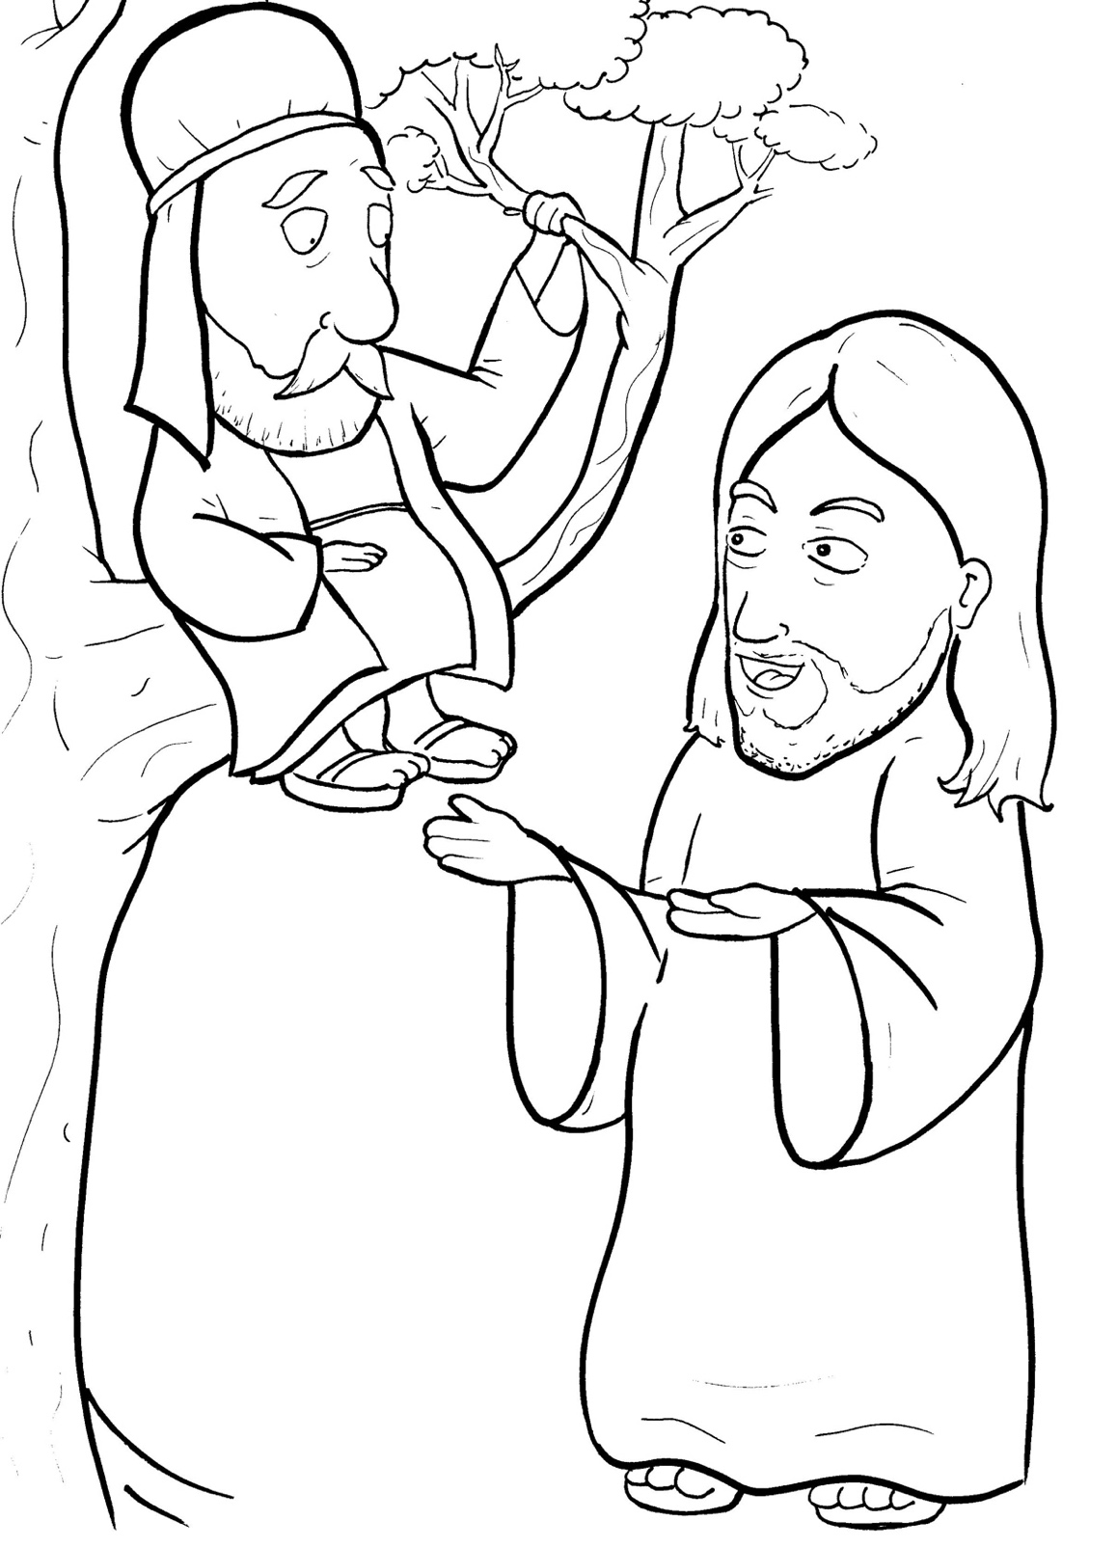
11. Jesus Loves a Short, Bad Man
Part 5
Vocabulary
Original Bible Story

Slide 2
Vocabulary

Slide 3
chief
(chief):
the leader

Slide 4
murmur
mur):
(MUR -
to complain quietly

Slide 5
salvation
tion):
(sal -
VA -
being saved (from hell)

Slide 6
tax
(tax):
money paid to the government

Slide 7
restore
STORE):
(re -
to put back the way it was

Slide 8
Son of Man
(SON):
a name Jesus often called himself to show he was human as well as God

Slide 9
Jesus Loves a Short, Bad Man
Luke 19:1-10
World English Bible (WEB)

Slide 10
He entered and was passing through Jericho.
There was a man named Zacchaeus.
He was a chief tax collector, and he was rich.

Slide 11
He was trying to see who Jesus was, and couldn’t because of the crowd, because he was short.

Slide 12
He ran on ahead, and climbed up into a sycamore tree to see him, for he was going to pass that way.

Slide 13
When Jesus came to the place, he looked up and saw him, and said to him,

Slide 14
“Zacchaeus, hurry and come down, for today I must stay at your house.”

Slide 15
He hurried, came down, and received
him joyfully.

Slide 16
When they saw it, they all murmured, saying, “He has gone in to lodge with a man who is a sinner.”

Slide 17
Zacchaeus stood and said to the Lord, “Behold, Lord, half of my goods I give to the poor.

Slide 18
If I have wrongfully exacted anything of anyone, I restore four times as much.”

Slide 19
Jesus said to him, “Today, salvation has come to this house, because he also is a son of Abraham.

Slide 20
For the Son of Man came to seek and to save that which was lost.”

