Slide 1
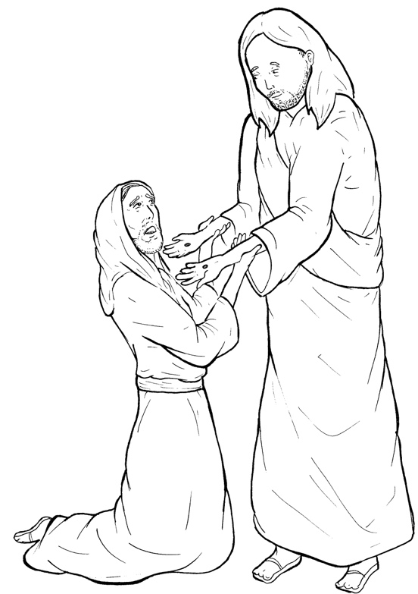
Part 4
43. Jesus Appears to Thomas
Story in Easy Read English
Questions
Story in Phrases

Slide 2
Thomas was one of the 12
disciples.

Slide 3
He had not been with the others
when Jesus appeared to them.

Slide 4
“We have seen the Lord!”
the men told Thomas.

Slide 5
“I will not believe it,”
Thomas said.

Slide 6
“I must see the nail marks in
his hands.

Slide 7
I must put my own fingers
into those marks.

Slide 8
Unless I put my own hand
into his side,
I will not believe.”

Slide 9
A week later, the disciples
were in a locked room again.

Slide 10
Thomas was with them this time.

Slide 11
Jesus came and stood
among them.

Slide 12
“Peace be with you,” Jesus said.

Slide 13
Jesus said to Thomas,
“Go ahead.

Slide 14
Put your fingers into my hands.

Slide 15
Put your hand into my side.

Slide 16
Stop doubting and believe.”

Slide 17
Thomas fell to his knees and said,
“My Lord and my God!”

Slide 18
Jesus said, “You believe
because you have seen.

Slide 19
But blessed are those who have
not seen and yet believe.

Slide 20
Question 1
Why did Thomas finally believe that Jesus had come back to life?

Slide 21
Question 2
What were his words to Jesus when he believed?

Slide 22
Question 3
What did Jesus say to Thomas about believers?

Slide 23
Question 4
What does this mean? “Blessed are those who have not seen and yet believe.” Are you a believer?

Slide 24
Prayer
Dear Jesus,
I have never put my fingers into the holes on your crucified hands. But I believe. I believe that you are the Messiah, the Son of God, the Savior of the World. You are my Lord and my God. Thank you for blessing me with this truth.
Amen

Slide 25
Jesus Appears to
Thomas
Phrased for Fluency

Slide 26
Thomas was one
of the 12
disciples.

Slide 27
He had not been
with the others
when Jesus
appeared to them.

Slide 28
“We have seen
the Lord!”
the men
told Thomas.

Slide 29
“I will not
believe it,”
Thomas said.

Slide 30
“I must
see the nail marks
in his hands.

Slide 31
I must
put my own fingers
into those marks.

Slide 32
Unless I put
my own hand
into his side,
I will not
believe.”

Slide 33
A week later,
the disciples
were in
a locked room again.

Slide 34
Thomas
was with them
this time.

Slide 35
Jesus came
and stood among them.

Slide 36
“Peace be with you,”
Jesus said.

Slide 37
Jesus said
to Thomas,
“Go ahead.

Slide 38
Put your fingers
into my hands.

Slide 39
Put your hand
into my side.

Slide 40
Stop doubting
and believe.”

Slide 41
Thomas fell
to his knees
and said,
“My Lord
and my God!”

Slide 42
Jesus said,
“You believe
because you have seen.

Slide 43
But blessed
are those
who have not seen
and yet believe.”

