Slide 1
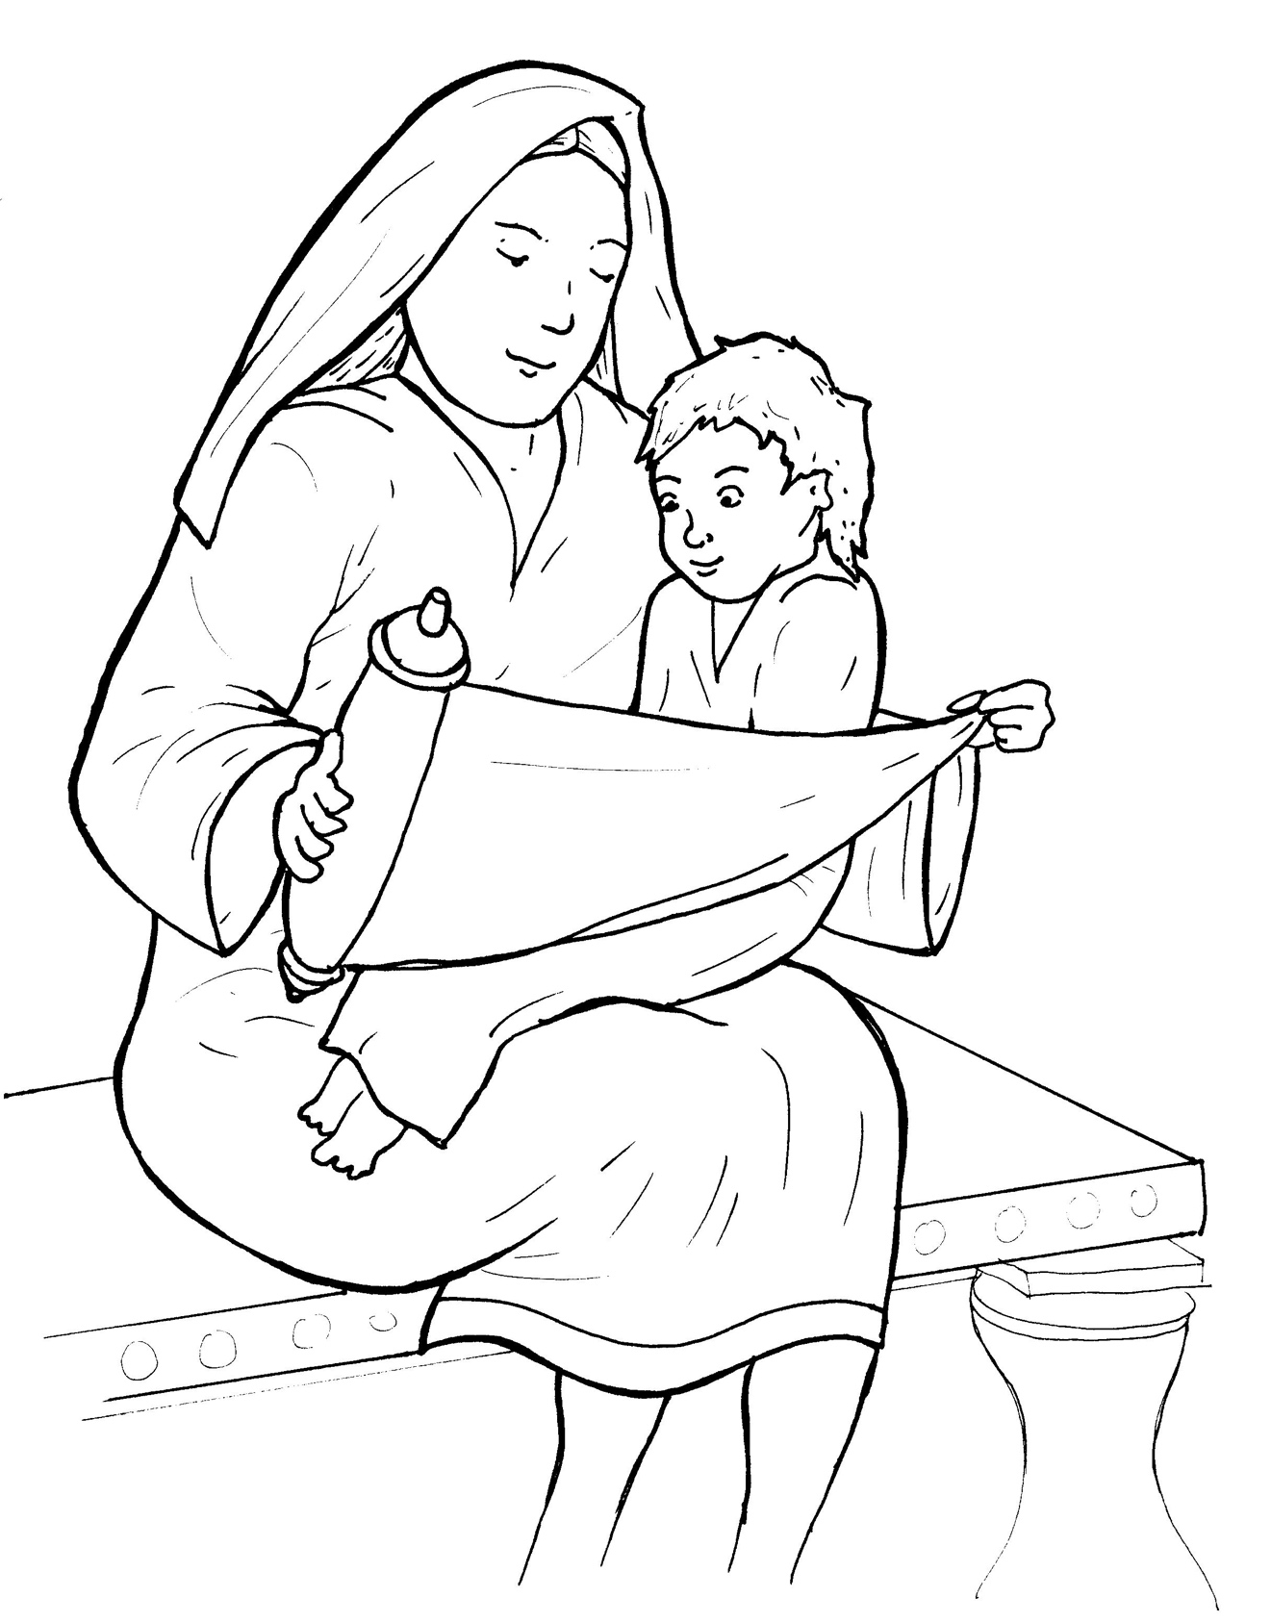
6. Jesus Grows Up
Part 1
Syllable Charts

Slide 2
Words in Syllable Types

Slide 3
Closed – Short Vowel
A closed syllable has one vowel
followed by one or more consonants,
and the vowel is short.
st
o
p
˘

Slide 4
man
Naz-

Slide 5
kept
-seph
-den
-reth
-pen-
-cret

Slide 6
hid-
with
sin-
sis-
Scrip-
fill

Slide 7
not
God

Slide 8
-sus
much
cut
but

Slide 9
Open – Long Vowel
An open syllable has one vowel
with no consonant after it,
and the vowel is long.
−
go

Slide 10
fa vor

Slide 11
we
she
Je sus
se cret

Slide 12
qui et
Mes si ah

Slide 13
Jo seph
ho ly
o bey

Slide 14
ev er y
Mar y
ho ly

Slide 15
Silent e – Long Vowel
A silent e syllable has one vowel,
followed by one consonant
and a silent e at the end.
The vowel is long.
−
ca
e
v

Slide 16
gave
a maze

Slide 17
these

Slide 18
Vowel Teams – Long Vowel
Many vowel teams follow this rule:
When two vowels get together,
the first one names its letter.
So the first vowel will make its long sound,
and the second vowel is silent.
−
e
a
t

Slide 19
-ways

Slide 20
nails

Slide 21
greet
sweet

Slide 22
lie

Slide 23
bright

Slide 24
know
low

Slide 25
news
knew
grew

Slide 26
Vowel Teams – Other Sounds
Sometimes vowel teams make other sounds.
oil

Slide 27
all

Slide 28
a bout
pound

Slide 29
bow
town

Slide 30
good
wood

Slide 31
R - Controlled
R-controlled syllables have one or more vowels
followed by an “r.”
The “r” changes the sound of the vowel.
o
r
ange

Slide 32
star
car pen ter

Slide 33
her
ev er y
sis ter
car pen ter

Slide 34
birth

Slide 35
hurt

Slide 36
Scrip tures

Slide 37
word

Slide 38
fa vor

Slide 39
Consonant – l-e
When you see consonant l-e at the end of a word,
count back three.
The “l-e” makes the /–le/ sound.
pur
p
l
e

Slide 40
peo ple

Slide 41
Other Sounds – Long Vowel
These syllables or words are closed,
so the vowel should be short,
but the vowel is long.
−
cold

Slide 42
old
gold
told

Slide 43
child

Slide 44
kind

Slide 45
Other Sounds – -nk/-ng
The “-nk” and “-ng”
change the sound of the vowel.
bank
thing

Slide 46
sang

Slide 47
strong

Slide 48
kings
things

Slide 49
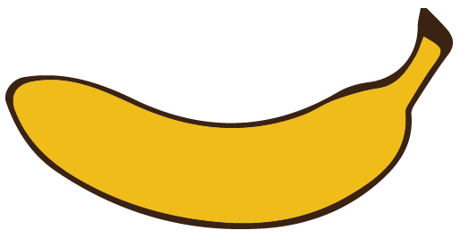
Other Sounds – schwa
The schwa syllable has an “a” that sounds
like the /u/ in banana.
The banana is even shaped like a short u.
ba nan a

Slide 50
a bout
Mes si ah
Naz a reth

