Slide 1
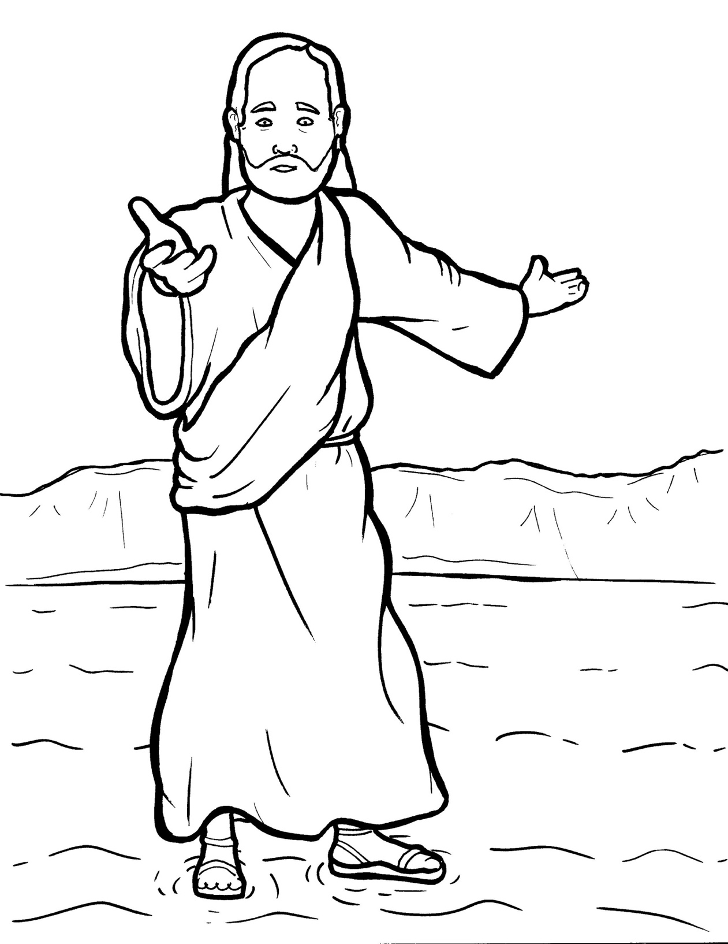
19. Jesus Walks on the Water
Part 1
Syllable Charts

Slide 2
Words in Syllable Types

Slide 3
Closed – Short Vowel
A closed syllable has one vowel
followed by one or more consonants,
and the vowel is short.
st
o
p
˘

Slide 4
and
hand
had
that

Slide 5
help
felt
tell
went

Slide 6
dis-
him
hills
wind

Slide 7
on
-cross
top
God

Slide 8
up
-sus
but
just

Slide 9
Open – Long Vowel
An open syllable has one vowel
with no consonant after it,
and the vowel is long.
−
go

Slide 10
be
Je sus
he
Pe ter

Slide 11
I
dis ci ples

Slide 12
no

Slide 13
tru ly

Slide 14
cry

Slide 15
tru ly
real ly

Slide 16
Silent e – Long Vowel
A silent e syllable has one vowel,
followed by one consonant
and a silent e at the end.
The vowel is long.
−
ca
e
v

Slide 17
lake
save
brave
waves
a mazed

Slide 18
like
a rrived

Slide 19
a lone
shore

Slide 20
Vowel Teams – Long Vowel
Many vowel teams follow this rule:
When two vowels get together,
the first one names its letter.
So the first vowel will make its long sound,
and the second vowel is silent.
−
e
a
t

Slide 21
a fraid

Slide 22
pray

Slide 23
fear
reach
real ly

Slide 24
died
cried

Slide 25
night
right

Slide 26
boat

Slide 27
Vowel Teams – Other Sounds
Sometimes vowel teams make other sounds.
oil

Slide 28
out

Slide 29
down

Slide 30
join

Slide 31
walk
wa ter

Slide 32
R - Controlled
R-controlled syllables have one or more vowels
followed by an “r.”
The “r” changes the sound of the vowel.
o
r
ange

Slide 33
hard
start

Slide 34
Pe ter

Slide 35
Lord

Slide 36
shore

Slide 37
oars

Slide 38
Consonant – l-e
When you see consonant l-e at the end of a word,
count back three.
The “l-e” makes the /–le/ sound.
pur
p
l
e

Slide 39
dis ci ples

Slide 40
Other Sounds – Long Vowel
These syllables or words are closed,
so the vowel should be short,
but the vowel is long.
−
cold

Slide 41
ghost

Slide 42
Other Sounds – -nk/-ng
The “-nk” and “-ng”
change the sound of the vowel.
bank
thing

Slide 43
strong

Slide 44
sink

Slide 45
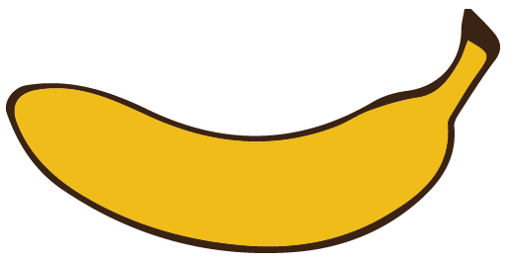
Other Sounds – schwa
The schwa syllable has an “a” that sounds
like the /u/ in banana.
The banana is even shaped like a short u.
ba nan a

Slide 46
a cross
a lone
a fraid
a rrived
a mazed

