Slide 1

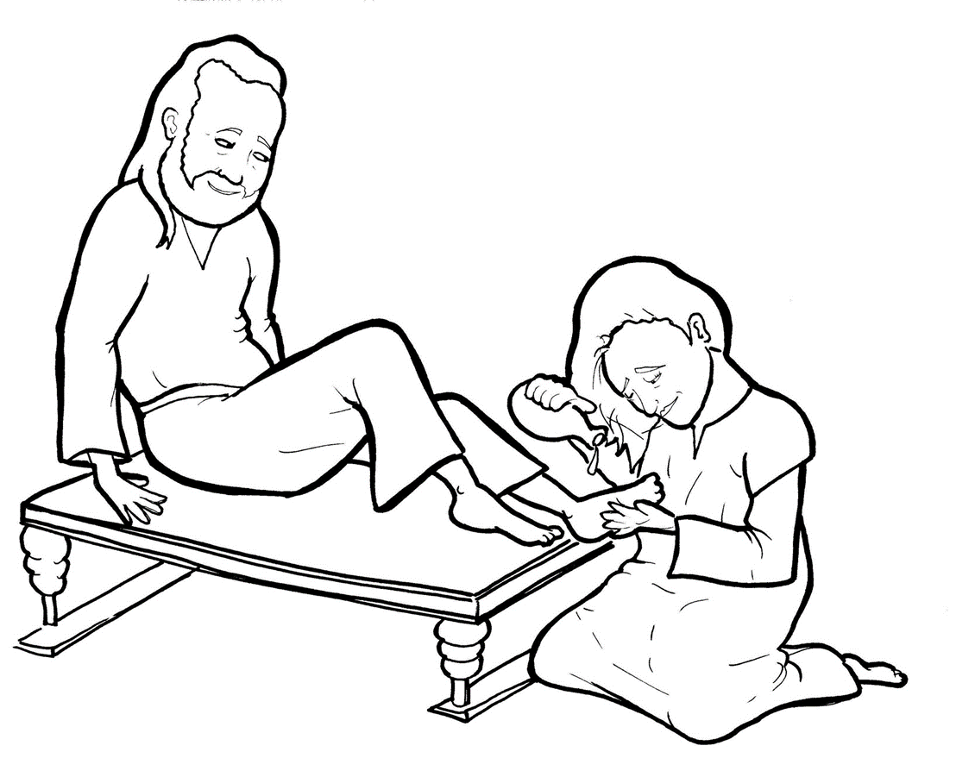
14. A Woman Washes Jesus’ Feet
Part 3
Syllable Divisions

Slide 2
Dividing Words
Into Syllables

Slide 3
Rabbit Words
When you see two consonants
between two vowels,
divide between the consonants.
ra it
bb
rab bit

Slide 4
dis ci ple
disciple

Slide 5
din ner
dinner

Slide 6
per fume
perfume

Slide 7
im por tant
important

Slide 8
get ting
getting

Slide 9

Tiger Words
When you see one consonant
between two vowels,
divide after the first vowel.
Try this pattern first.
ti er
g
ti ger

Slide 10
Je sus
Jesus

Slide 11
Ju das
Judas

Slide 12
tru ly
truly

Slide 13
rea son
reason

Slide 14
Camel Words
When you see one consonant
between two vowels,
divide after the first consonant.
Try this pattern second.
ca el
m
cam el

Slide 15
giv en
given

Slide 16
read y
ready

Slide 17
Turtle Words
When you see consonant-l-e,
count back three and divide.
tur
t
l
e
tur tle

Slide 18
dis ci ple
disciple

Slide 19
peo ple
people

Slide 20

Anteater Words
These compound words are made up of two smaller words.
ant
eater
1
2
ant eater

Slide 21
in to
into

Slide 22
Other Syllable Divisions
Some words don’t fit so neatly
into standard syllable division patterns.

Slide 23
a bout
about

Slide 24
a round
around

Slide 25
a lone
alone

Slide 26

Foxes Suffixes
Focus on your base word.
fox es
fox es

Slide 27
poured
poured

Slide 28
smelled
smelled

Slide 29
yelled
yelled

Slide 30
cried
cried

Slide 31
kissed
kissed

Slide 32
wiped
wiped

Slide 33
giv en
given

Slide 34
beauti ful
beautiful

Slide 35
gett ing
getting

