Slide 1

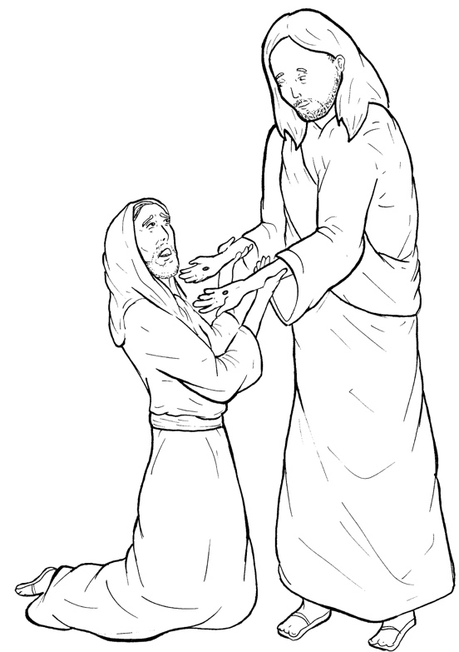
Part 5
43. Jesus Appears to Thomas
Vocabulary
Original Bible Story

Slide 2

Vocabulary

Slide 3
disciple
(dis - CI - ple)
a person who follows Jesus

Slide 4
believing
(be - LIEV - ing)
feeling that something is true

Slide 5
unbelieving
(un - be - LIEV - ing)
feeling that something is not true

Slide 6
blessed
(blessed)
given joy and what we need from God

Slide 7
signs
(signs)
amazing things that happen
which point to God

Slide 8
presence
(PRES - ence)
in front of

Slide 9
Jesus Appears to
Thomas
John 20:24-31
World English Bible (WEB)

Slide 10
But Thomas, one of the twelve,
called Didymus, wasn’t with
them when Jesus came.

Slide 11
The other disciples
therefore said to him,
“We have seen the Lord!”

Slide 12
But he said to them,
“Unless I see in his hands
the print of the nails,

Slide 13
put my finger into
the print of the nails,
and put my hand into his side,
I will not believe.”

Slide 14
After eight days,
again his disciples were inside
and Thomas was with them.

Slide 15
Jesus came,
the doors being locked,
and stood in the middle,
and said, “Peace be to you.”

Slide 16
Then he said to Thomas,
“Reach here your finger,
and see my hands.

Slide 17
Reach here your hand,
and put it into my side.

Slide 18
Don’t be unbelieving,
but believing.”

Slide 19
Thomas answered him,
“My Lord and my God!”

Slide 20
Jesus said to him,
“Because you have seen me,
you have believed.

Slide 21
Blessed are those
who have not seen
and have believed.”

Slide 22
Therefore, Jesus did many other signs
in the presence of his disciples,
which are not written in this book;

Slide 23
but these are written
that you may believe that Jesus
is the Christ, the Son of God,

Slide 24
and that believing
you may have life in his name.

