Slide 1
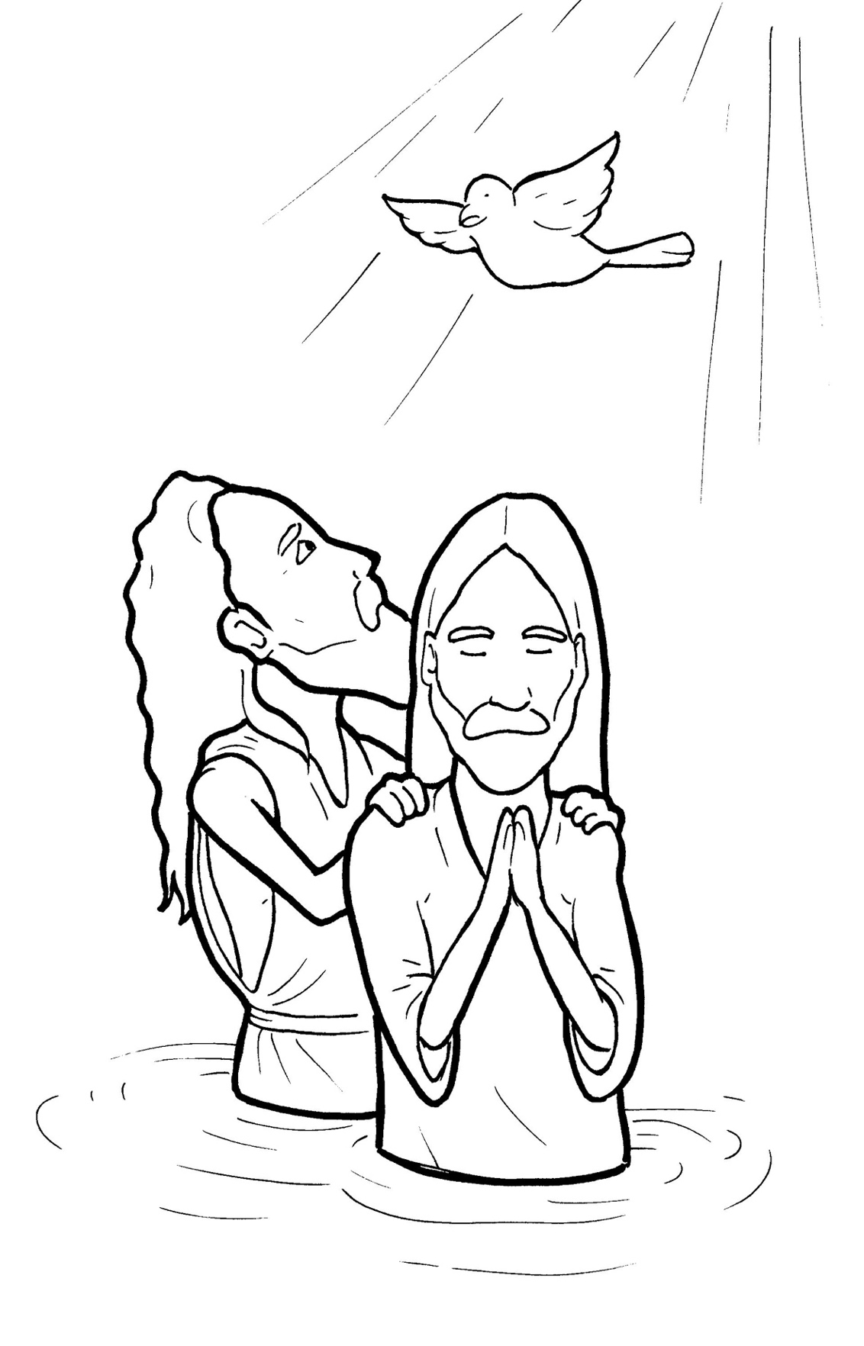
9. Jesus Gets Baptized
Part 1
Syllable Charts

Slide 2
Words in Syllable Types

Slide 3
Closed – Short Vowel
A closed syllable has one vowel
followed by one or more consonants,
and the vowel is short.
st
o
p
˘

Slide 4
ask
that
bap-
-gan

Slide 5
fresh
-pen
well
when
pres-
-ent

Slide 6
with
sins
drip
-fill
riv-
-gin

Slide 7
God
John
stop

Slide 8
up
but
-sus
ful-

Slide 9
Open – Long Vowel
An open syllable has one vowel
with no consonant after it,
and the vowel is long.
−
go

Slide 10
he
be
Je sus
be gin
be gan

Slide 11
so
o pen
Cho sen

Slide 12
by
my
sky

Slide 13
read y

Slide 14
Silent e – Long Vowel
A silent e syllable has one vowel,
followed by one consonant
and a silent e at the end.
The vowel is long.
−
ca
e
v

Slide 15
takes

Slide 16
like
time
bap tize

Slide 17
rose

Slide 18
Vowel Teams – Long Vowel
Many vowel teams follow this rule:
When two vowels get together,
the first one names its letter.
So the first vowel will make its long sound,
and the second vowel is silent.
−
e
a
t

Slide 19
a way
stay

Slide 20
need
a greed

Slide 21
please
years

Slide 22
low er

Slide 23
proof

Slide 24
grew

Slide 25
Vowel Teams – Other Sounds
Sometimes vowel teams make other sounds.
oil

Slide 26
out
a bout

Slide 27
down

Slide 28
look

Slide 29
voice

Slide 30
saw

Slide 31
read y
heav en

Slide 32
R - Controlled
R-controlled syllables have one or more vowels
followed by an “r.”
The “r” changes the sound of the vowel.
o
r
ange

Slide 33
parted

Slide 34
torn
Jor dan

Slide 35
riv er
low er

Slide 36
bird

Slide 37
years

Slide 38
world
work

Slide 39
Consonant – l-e
When you see consonant l-e at the end of a word,
count back three.
The “l-e” makes the /–le/ sound.
pur
p
l
e

Slide 40
peo ple

Slide 41
Other Sounds – Long Vowel
These syllables or words are closed,
so the vowel should be short,
but the vowel is long.
−
cold

Slide 42
old

Slide 43
Other Sounds – -nk/-ng
The “-nk” and “-ng”
change the sound of the vowel.
bank
thing

Slide 44
rang

Slide 45
drip ping

Slide 46
mis sion

Slide 47
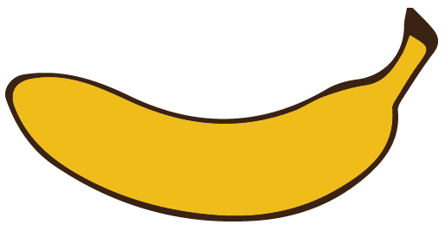
Other Sounds – schwa
The schwa syllable has an “a” that sounds
like the /u/ in banana.
The banana is even shaped like a short u.
ba nan a

Slide 48
a greed
a bout
a way

Slide 49
love
dove
covered

