Slide 1
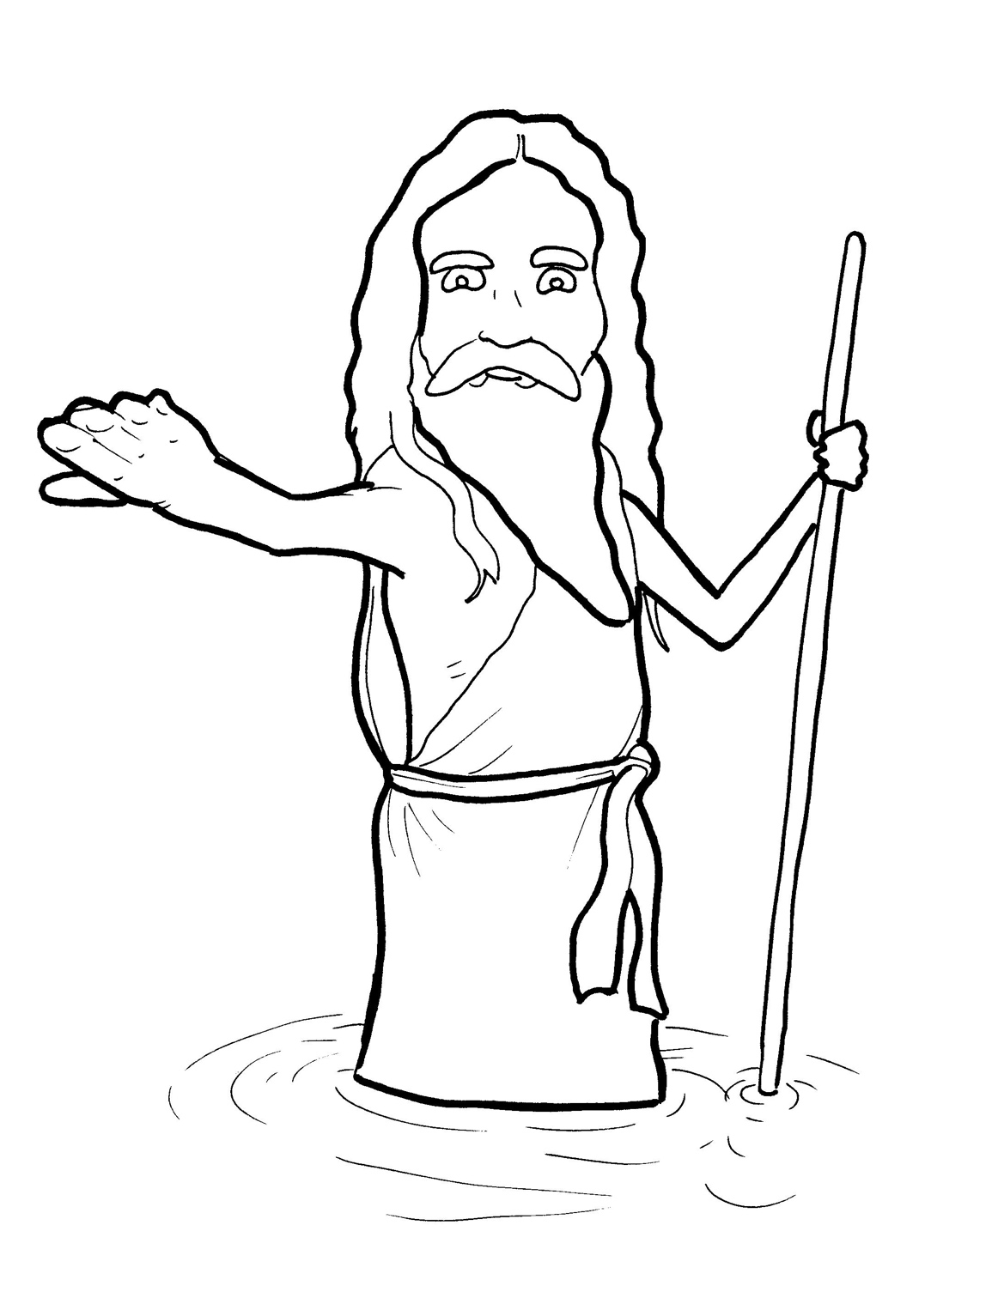
8. John the Baptist Points to Jesus
Part 2
New Words
Rule Breakers

Slide 2
Other Sounds – Soft C
ce, ci, cy make the soft sound
cent
city
fancy

Slide 3
voice

Slide 4
Silent Letters
John

Slide 5
Possessives
camel’s skin
God’s kingdom

Slide 6
New Words
repent
priests
repented
Jewish
baptized
wilderness

Slide 7
Rule Breakers
These words do not follow phonetic patterns.
the
of

Slide 8
do
from
to
was
they
his

Slide 9
you
could
your
one
are
lived

Slide 10
what
money
who
coming
said
sorry

