Slide 1
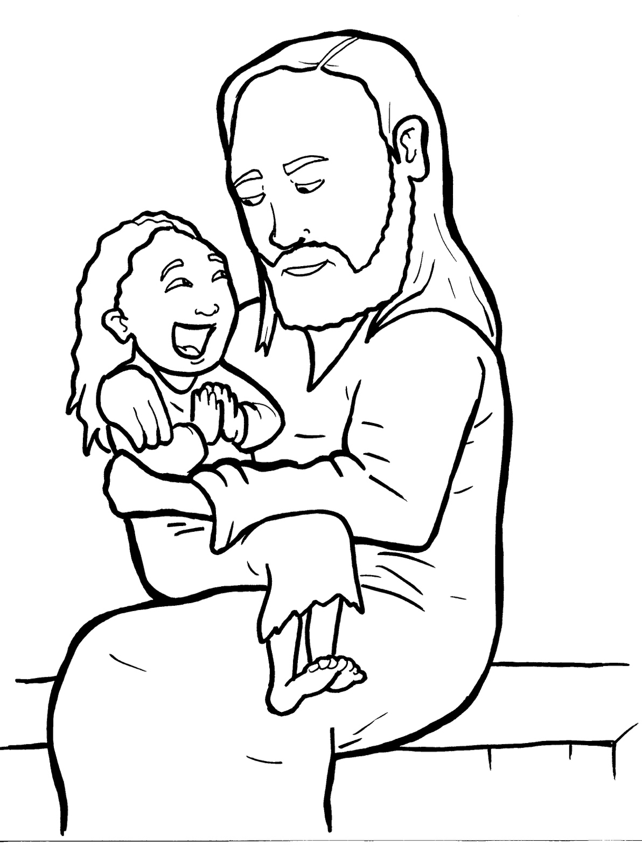
20. A Mother Begs and Believes
Part 5
Vocabulary
Original Bible Story

Slide 2
Vocabulary

Slide 3
mercy
(MER - cy):
kindness

Slide 4
demon
(DE - mon):
an evil spirit

Slide 5
severely
(sev - ERE - ly):
very much (in a bad way)

Slide 6
appropriate
(ap - PRO - pri - ate):
correct

Slide 7
possessed
(po - SSESSed):
controlled by

Slide 8
desire
(de - SIRE):
to want

Slide 9
A Mother Begs And Believes
Matthew 15: 22-28
World English Bible (WEB)

Slide 10
Behold, a Canaanite woman came out from those borders, and cried, saying, “Have mercy on me, Lord, you son of David!

Slide 11
My daughter is severely possessed by a demon!”

Slide 12
But he answered her not a word.

Slide 13
His disciples came and begged him, saying, “Send her away; for she cries after us.”

Slide 14
But he answered, “I wasn’t sent to anyone but the lost sheep of the house of Israel.”

Slide 15
But she came and worshipped him, saying, “Lord, help me.”

Slide 16
But he answered, “It is not appropriate to take the children’s bread and throw it to the dogs.”

Slide 17
But she said, “Yes, Lord, but even the dogs eat the crumbs which fall from their masters’ table.”

Slide 18
Then Jesus answered her, “Woman, great is your faith!

Slide 19
Be it done to you even as you desire.”

Slide 20
And her daughter was healed from that hour.

