Slide 1
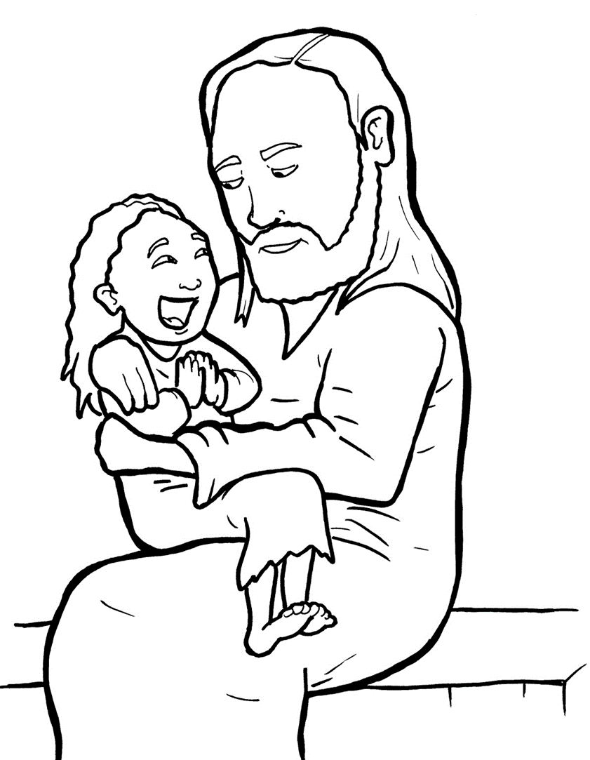
20. A Mother Begs and Believes
Part 2
New Words
Rule Breakers

Slide 2
Other Sounds – Soft C
ce, ci, cy make the soft sound
cent
city
fancy

Slide 3
disciples

Slide 4
Other Sounds – Soft G
ge, gi, gy often make the soft sound
gentle
giant
gym

Slide 5
Gentiles

Slide 6
New Words
daughter
spirit
Jew

Slide 7
Gentiles
evil

Slide 8
Rule Breakers
These words do not follow phonetic patterns.
have
was

Slide 9
has
you
the
mother
of
been

Slide 10
come
to
daughter
great
your

Slide 11
what
said
is
done
spirit
saw

