Slide 1
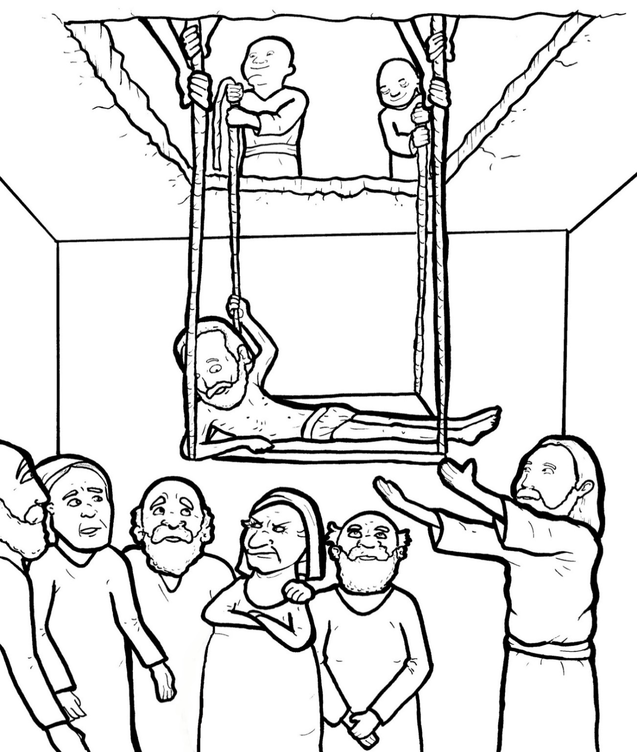
Part 1
29. Friends Bring a Crippled Man to Jesus
Syllable Charts

Slide 2
Words in Syllable Types

Slide 3
Closed – Short Vowel
A closed syllable has one vowel
followed by one or more consonants,
and the vowel is short.
st
o
p
˘

Slide 4
Timing
Box
mat
grab
jam
mad
ran
that

Slide 5
Timing
Box
get
men
nev-
-en

Slide 6
Timing
Box
in
sins
giv-
with
crip-
this

Slide 7
Timing
Box
God
got
top

Slide 8
Timing
Box
up
jump
dug
-sus

Slide 9
Open – Long Vowel
An open syllable has one vowel
with no consonant after it,
and the vowel is long.
−
go

Slide 10
Timing
Box
he
we
Je sus

Slide 11
Timing
Box
I

Slide 12
Timing
Box
go
no

Slide 13
Timing
Box
why

Slide 14
Silent e – Long Vowel
A silent e syllable has one vowel,
followed by one consonant
and a silent e at the end.
The vowel is long.
−
ca
e
v

Slide 15
Timing
Box
came
care
made
take
a maze

Slide 16
Timing
Box
these

Slide 17
Timing
Box
in side
like

Slide 18
Timing
Box
hole
home

Slide 19
Vowel Teams – Long Vowel
Many vowel teams follow this rule:
When two vowels get together,
the first one names its letter.
So the first vowel will make its long sound,
and the second vowel is silent.
−
e
a
t

Slide 20
Timing
Box
praise
faith

Slide 21
Timing
Box
great

Slide 22
Timing
Box
they

Slide 23
Timing
Box
see
seen

Slide 24
Timing
Box
teach

Slide 25
Timing
Box
peo ple

Slide 26
Timing
Box
right

Slide 27
Timing
Box
low er
know

Slide 28
Timing
Box
room
roof

Slide 29
Timing
Box
knew

Slide 30
Vowel Teams – Other Sounds
Sometimes vowel teams make other sounds.
oil

Slide 31
Timing
Box
all

Slide 32
Timing
Box
law
saw

Slide 33
Timing
Box
shout

Slide 34
Timing
Box
down

Slide 35
R - Controlled
R-controlled syllables have one or more vowels
followed by an “r.”
The “r” changes the sound of the vowel.
o
r
ange

Slide 36
Timing
Box
for given

Slide 37
Timing
Box
low er
nev er
teach ers

Slide 38
Timing
Box
carr ied

Slide 39
Consonant – l-e
When you see consonant l-e at the end of a word,
count back three.
The “l-e” makes the /–le/ sound.
pur
p
l
e

Slide 40
Timing
Box
peo ple
crip pled

Slide 41
Other Sounds – Long Vowel
These syllables or words are closed,
so the vowel should be short,
but the vowel is long.
−
cold

Slide 42
Timing
Box
minds

Slide 43
Other Sounds – -nk/-ng
The “-nk” and “-ng”
change the sound of the vowel.
bank
thing

Slide 44
Timing
Box
think

Slide 45
Timing
Box
thing
think ing

Slide 46
Other Sounds – schwa
The schwa syllable has an “a” that sounds
like the /u/ in banana.
The banana is even shaped like a short u.
ba nan a

Slide 47
Timing
Box
a mazed

Slide 48
Timing
Box
son

