Slide 1

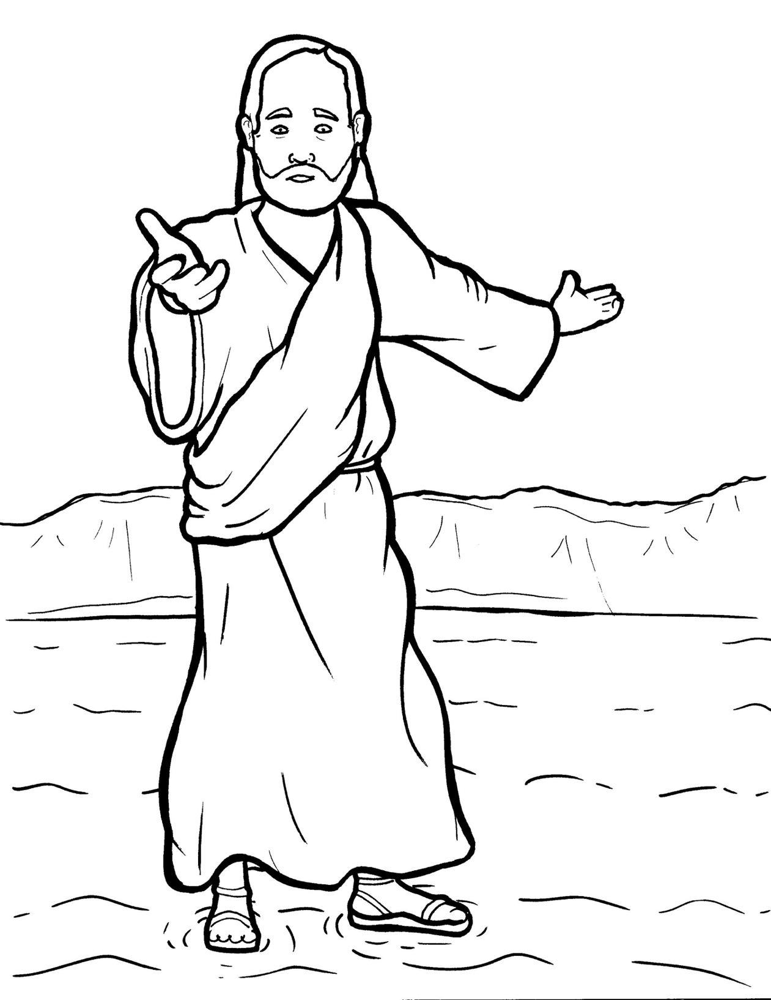
19. Jesus Walks on the Water
Part 3
Syllable Divisions

Slide 2
Dividing Words
Into Syllables

Slide 3
Rabbit Words
When you see two consonants
between two vowels,
divide between the consonants.
ra it
bb
rab bit

Slide 4
dis ci ple
disciple

Slide 5

Tiger Words
When you see one consonant
between two vowels,
divide after the first vowel.
Try this pattern first.
ti er
g
ti ger

Slide 6
Je sus
Jesus

Slide 7
Pe ter
Peter

Slide 8
tru ly
truly

Slide 9
Turtle Words
When you see consonant-l-e,
count back three and divide.
tur
t
l
e
tur tle

Slide 10
dis ci ple
disciple

Slide 11

Anteater Words
These compound words are made up of two smaller words.
ant
eater
1
2
ant eater

Slide 12
in to
into

Slide 13
Other Syllable Divisions
Some words don’t fit so neatly
into standard syllable division patterns.

Slide 14
a lone
alone

Slide 15
a cross
across

Slide 16
a fraid
afraid

Slide 17
a mazed
amazed

Slide 18
a rrived
arrived

Slide 19

Foxes Suffixes
Focus on your base word.
fox es
fox es

Slide 20
pushed
pushed

Slide 21
reached
reached

Slide 22
helped
helped

Slide 23
walked
walked

Slide 24
arrived
arrived

Slide 25
amazed
amazed

Slide 26
real ly
really

Slide 27
start ed
started

