Slide 1

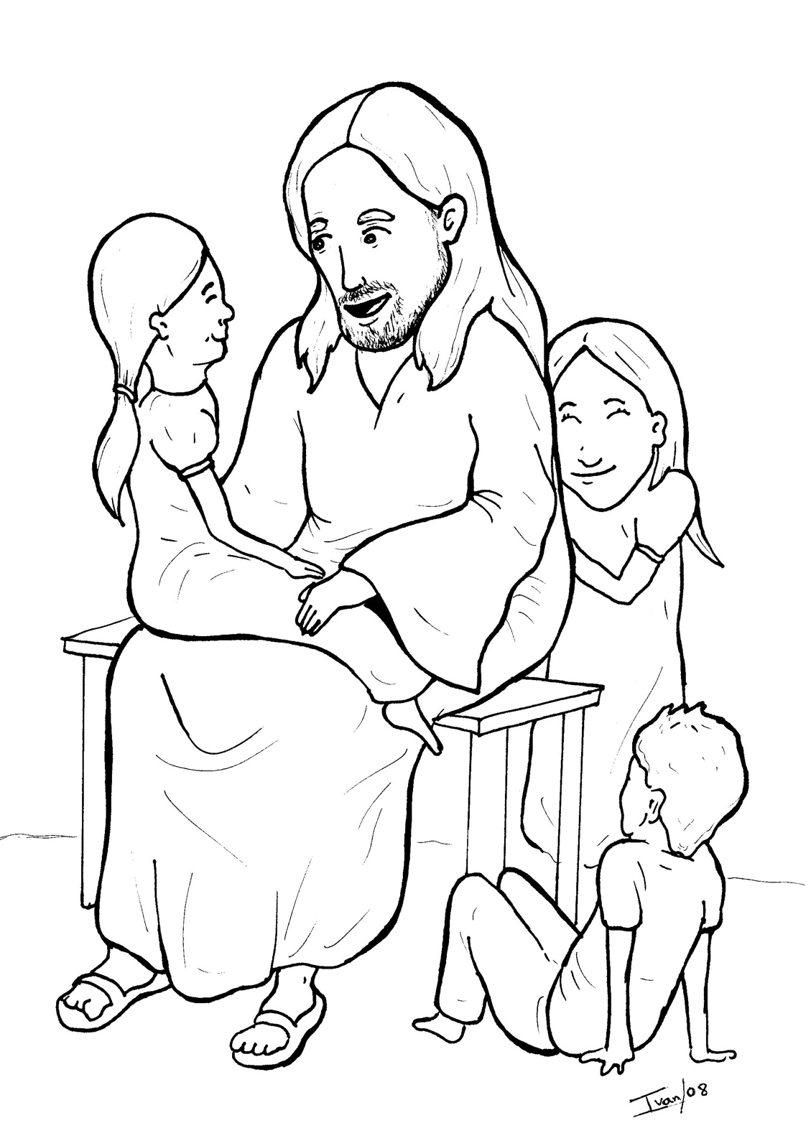
12. Jesus Loves the Little Children
Part 1
Syllable Charts

Slide 2
Words in
Syllable Types

Slide 3
Closed – Short Vowel
A closed syllable has one vowel
followed by one or more consonants,
and the vowel is short.
st
o
p
˘

Slide 4
ran
dads
and
hands
ac-
hap-

Slide 5
bless
-set
nev-
en-
-dren
-cept

Slide 6
lit-
big
with
this
chil-
will

Slide 7
on
got
not
stop
mom
God

Slide 8
up
hug
-sus
must

Slide 9
Open – Long Vowel
An open syllable has one vowel
with no consonant after it,
and the vowel is long.
−
go

Slide 10
ba bies

Slide 11
be
be longs
me
Je sus

Slide 12
dis ci ples

Slide 13
go

Slide 14
my

Slide 15
hap py

Slide 16
Silent e – Long Vowel
A silent e syllable has one vowel,
followed by one consonant
and a silent e at the end.
The vowel is long.
−
ca
e
v

Slide 17
gave

Slide 18
like
mine
smile

Slide 19
these

Slide 20
close
home

Slide 21
Vowel Teams – Long Vowel
Many vowel teams follow this rule:
When two vowels get together,
the first one names its letter.
So the first vowel will make its long sound,
and the second vowel is silent.
−
e
a
t

Slide 22
laid

Slide 23
lay
pray
a way

Slide 24
ba bies

Slide 25
Vowel Teams – Other Sounds
Sometimes vowel teams make other sounds.
oil

Slide 26
our

Slide 27
took

Slide 28
boy

Slide 29
saw

Slide 30
R - Controlled
R-controlled syllables have one or more vowels
followed by an “r.”
The “r” changes the sound of the vowel.
o
r
ange

Slide 31
arms

Slide 32
or
for

Slide 33
nev er
en ter

Slide 34
girl

Slide 35
par ents

Slide 36
Consonant – l-e
When you see consonant l-e at the end of a word,
count back three.
The “l-e” makes the /–le/ sound.
pur
p
l
e

Slide 37
dis ci ples
peo ple

Slide 38
lit tle

Slide 39
Other Sounds – Long Vowel
These syllables or words are closed,
so the vowel should be short,
but the vowel is long.
−
cold

Slide 40
scold ed

Slide 41

Other Sounds – -nk/-ng
The “-nk” and “-ng”
change the sound of the vowel.
bank
thing

Slide 42
be longs

Slide 43
king dom

Slide 44
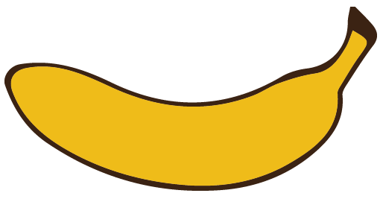
Other Sounds – schwa
The schwa syllable has an “a” that sounds
like the /u/ in banana.
The banana is even shaped like a short u.
ba nan a

Slide 45
a way

Slide 46
king dom

Slide 47
loves

