Slide 1
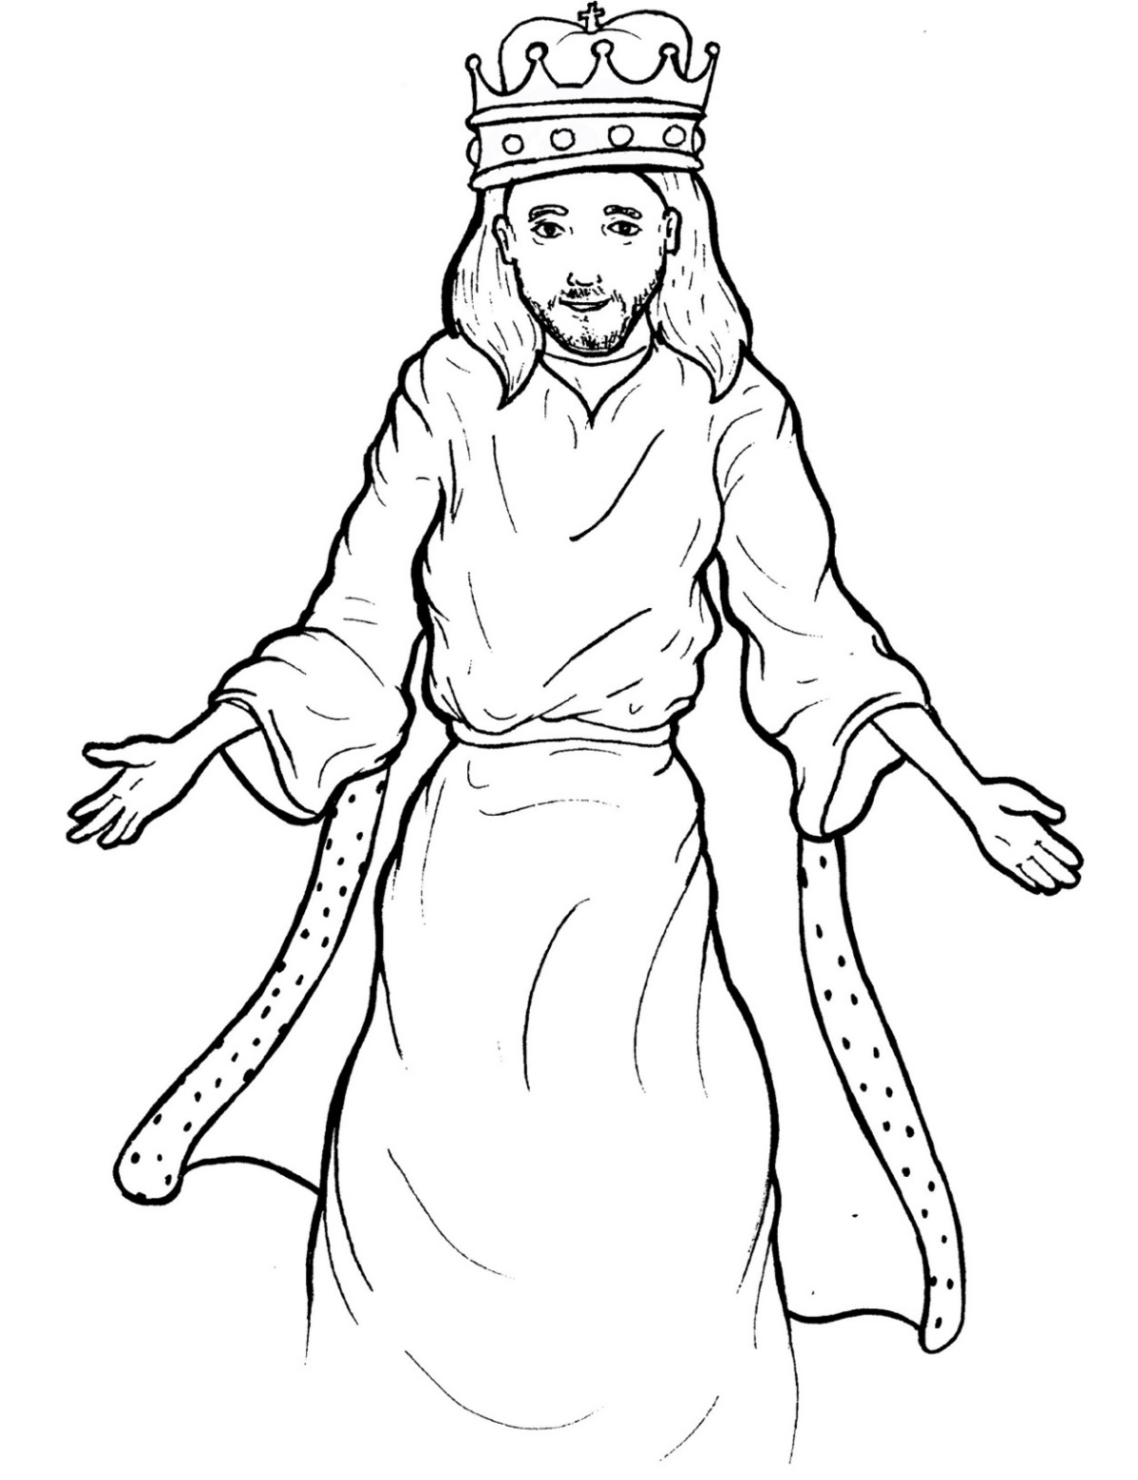
Part 2
45. Jesus Lives as King
New Words
Rule Breakers

Slide 2
Other Sounds – Soft G
ge, gi, gy often make the soft sound
gentle
giant
gym

Slide 3
angels

Slide 4
Silent Letters
knee
Christ

Slide 5
New Words
angels
Christ
Spirit
comfort

Slide 6
Rule Breakers
Words like these do not follow phonetic patterns.
to
you
said
could
two
f
from

Slide 7
is
of
his
to
as
into

Slide 8
one
said
the
says
two
from

Slide 9
some
gives
wants
there
lives
where

Slide 10
Christ
above
Father
coming

Slide 11
they
heart
Son
obey

