Slide 1
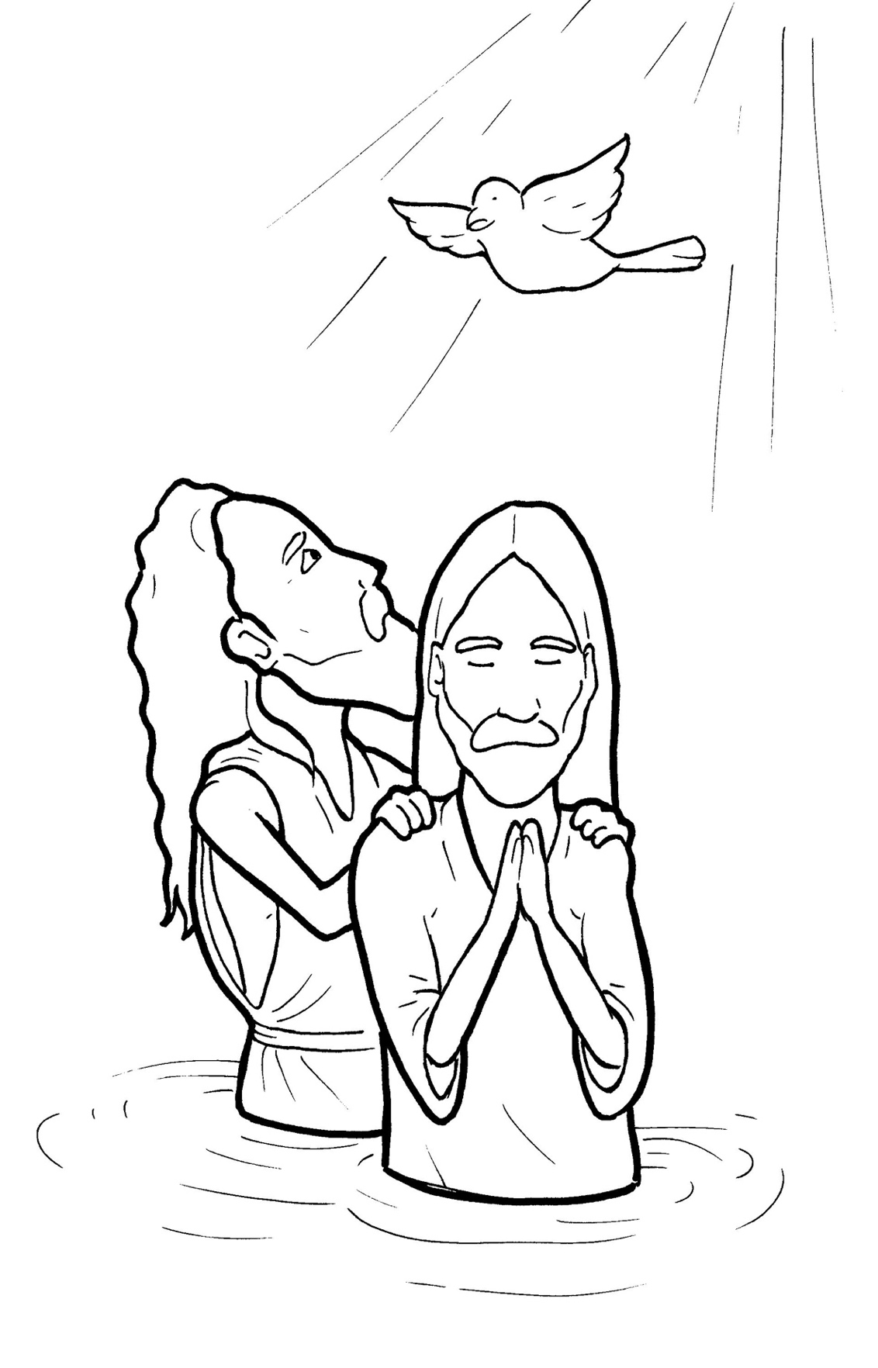
9. Jesus Gets Baptized
Part 5
Vocabulary
Original Bible Story

Slide 2
Vocabulary

Slide 3
baptize
(BAP -
tize):
to show the world you want
to follow Jesus using a water
custom

Slide 4
hinder
(HIN -
der ):
to hold back

Slide 5
righteousness
(RIGHT -
eous -
ness):
doing what is right

Slide 6
behold
HOLD):
(be -
see!

Slide 7
descend
SCEND):
(de -
to go down

Slide 8
beloved
LOVED):
(be -
much loved

Slide 9
Jesus Gets Baptized
Matthew 3:13 -17
World English Bible (WEB)

Slide 10
Then Jesus came from Galilee to the Jordan to John, to be baptized by him.

Slide 11
But John would have hindered him, saying,
“I need to be baptized by you, and you come to me?”

Slide 12
But Jesus, answering, said to him, “Allow it now, for this is the fitting way for us to fulfill all righteousness.”

Slide 13
Then he allowed him. Jesus, when he was baptized, went up directly from the water: and behold, the heavens were opened
to him.

Slide 14
He saw the Spirit of God descending as a dove, and coming on him.

Slide 15
Behold, a voice out of the heavens said, “This is my beloved Son, with whom I am well pleased.”

