Slide 1
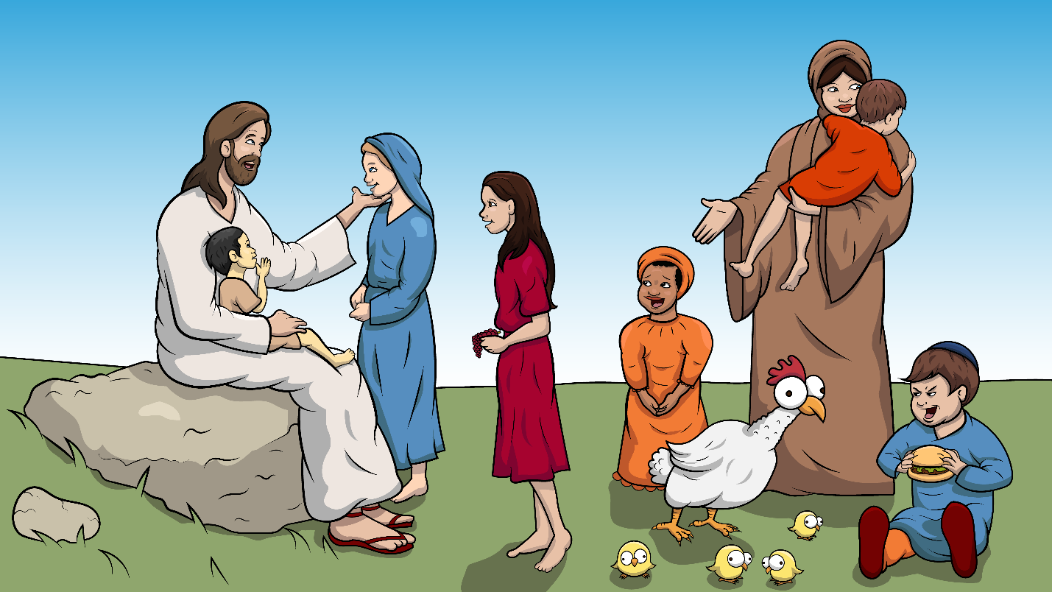
Song 1.8 Jesus Loves Children a Bunch
Jesus and the
Little Children
Mark 10:13-16 (ch)

Slide 2
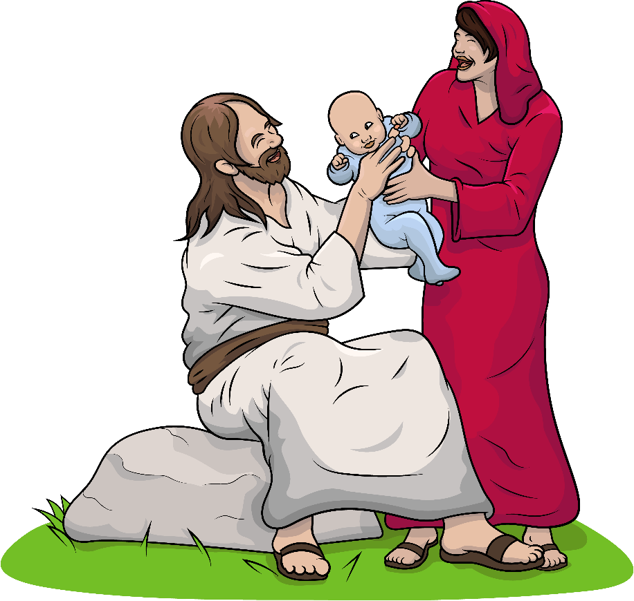
Jesus loves the little children.

Slide 3
He loves them so much,
such a bunch.

Slide 4
Moms and kids
chat at the lunch.

Slide 5
They love Jesus just as much.

Slide 6
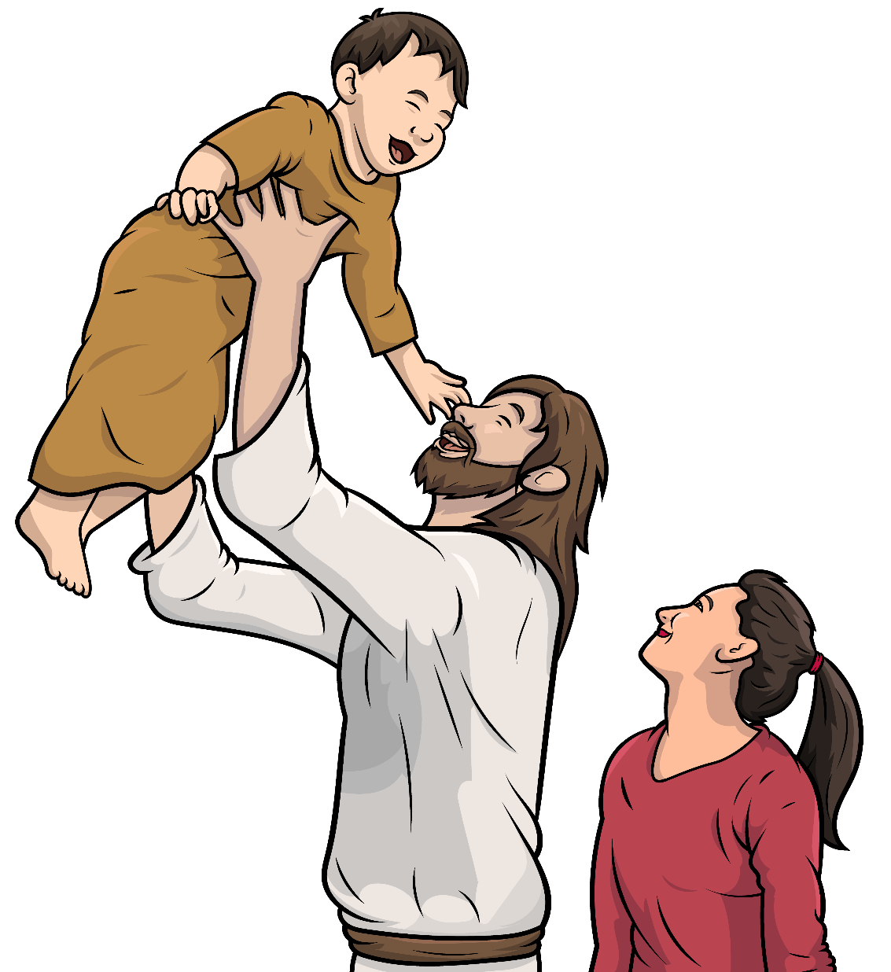
Jesus loves the little children such a bunch.

Slide 7
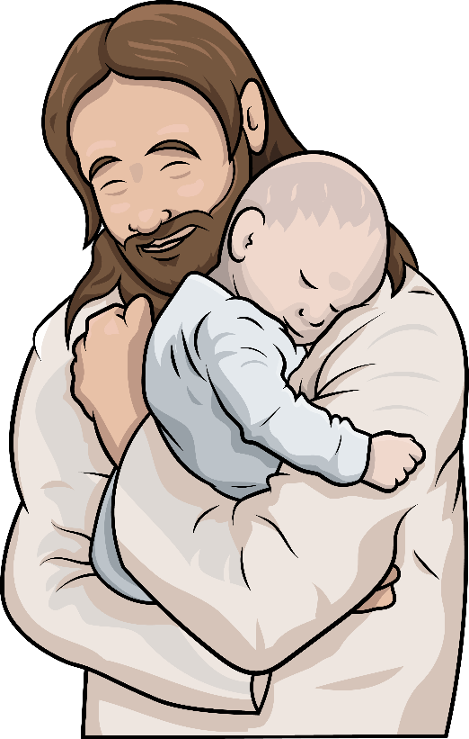
“Jesus, bless my little children.”

Slide 8
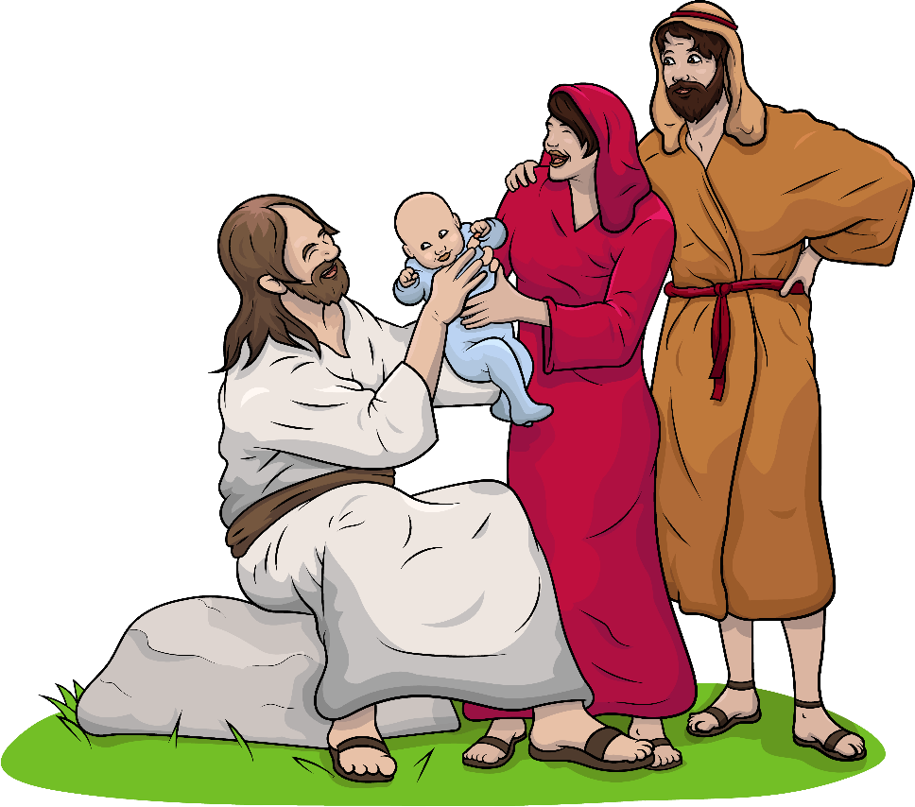
Moms and dads and kids are glad.

Slide 9
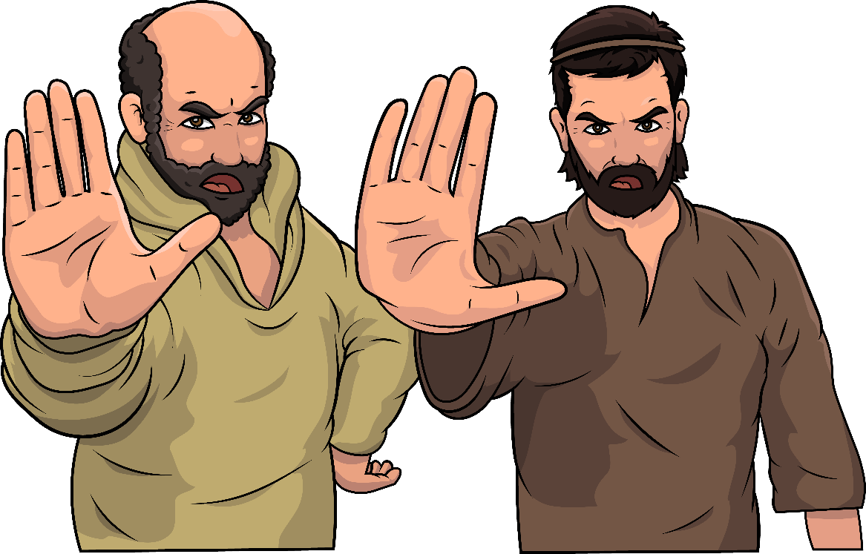
Men said, “Stop and do not stay.”

Slide 10
“You must all go, go away!”

Slide 11
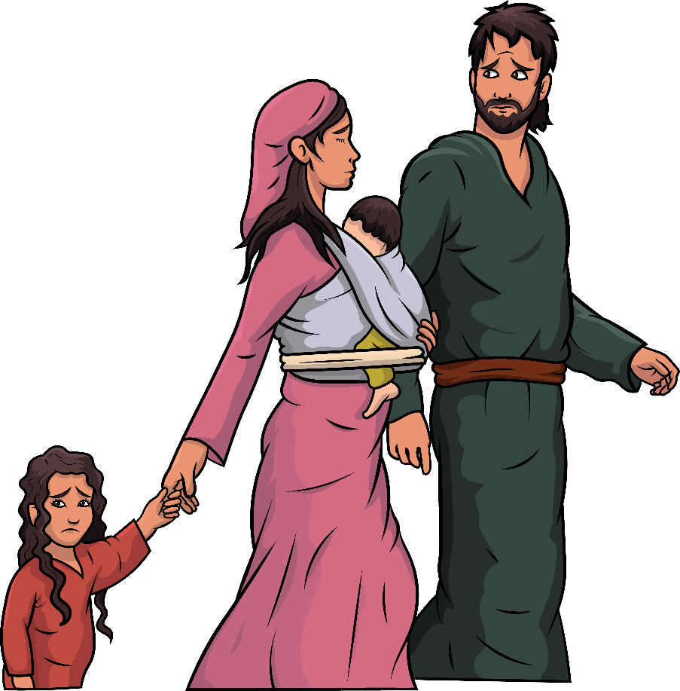
Now, much of the moms and dads
and kids are sad.

Slide 12
Jesus said,
“Come, little children.”

Slide 13
“Come to me
and play and stay.”

Slide 14
“I don’t want you to go away.”

Slide 15
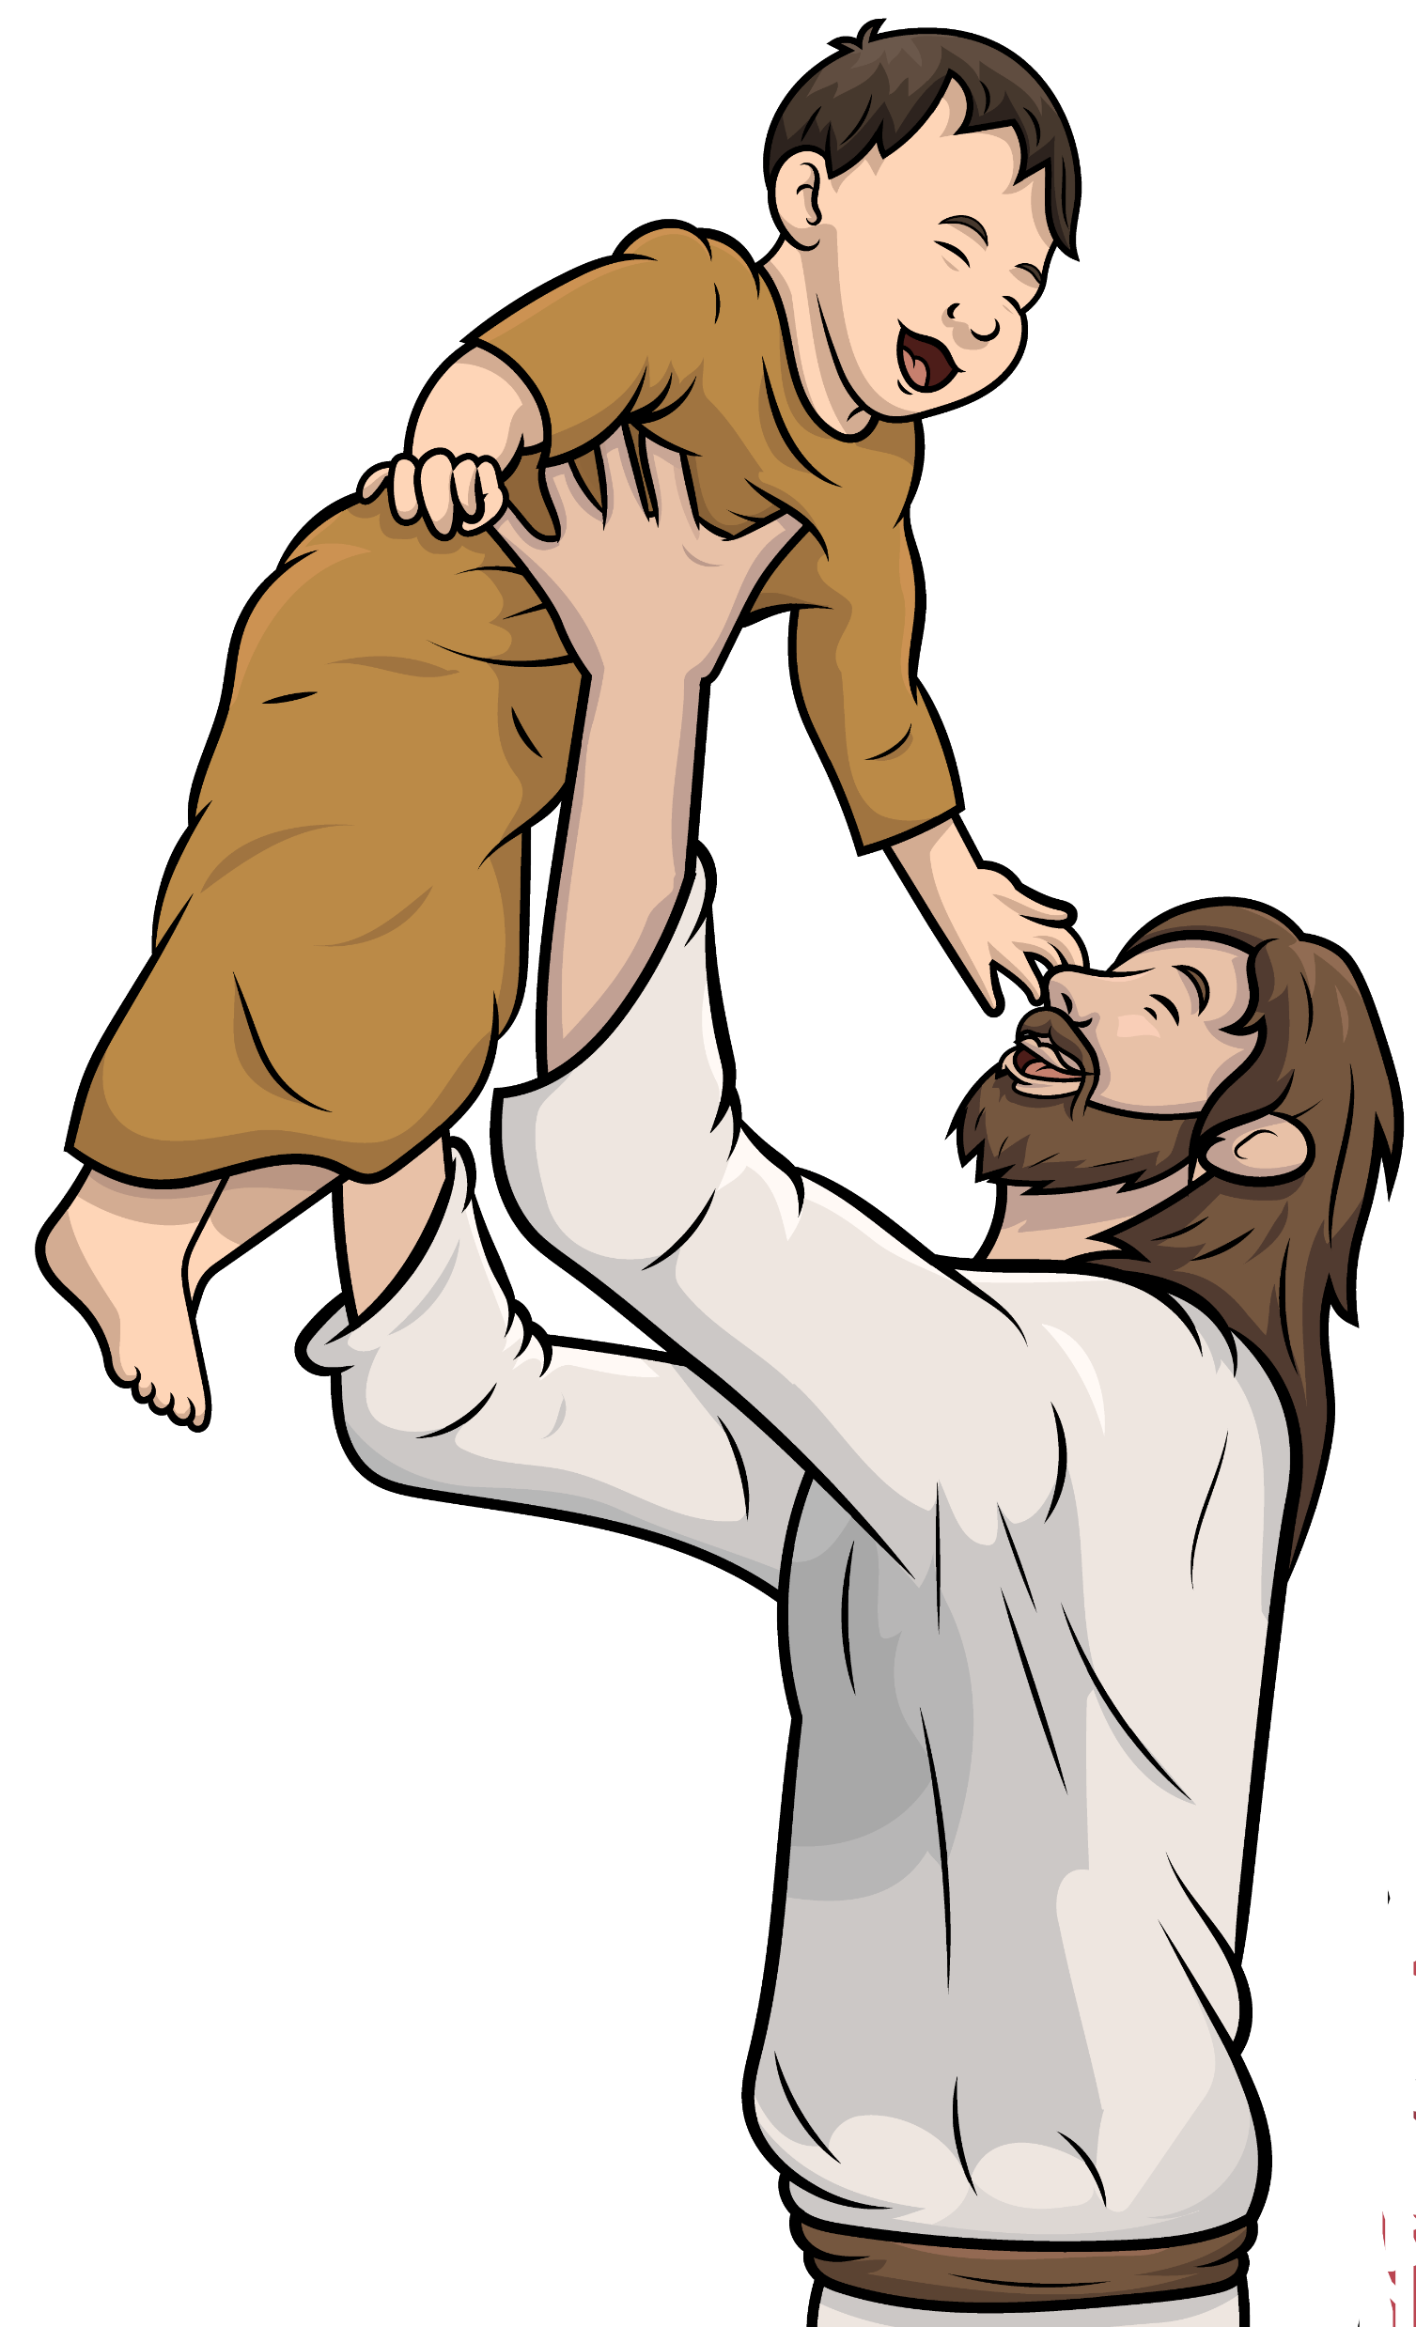
“Come to me;
we’ll play all day!”

Slide 16
Jesus loves the
little children
such a bunch.

Slide 17
The End

Slide 18
Song lyrics and melody: Carol Hale
Song arrangements and singer: Steffi VornBerger
Illustrations: Ivan Mader
Power Point arrangements: Steve March
www.EasyReadEnglish.com
www.EZReadEnglish.org/Lower-Levels

Slide 19
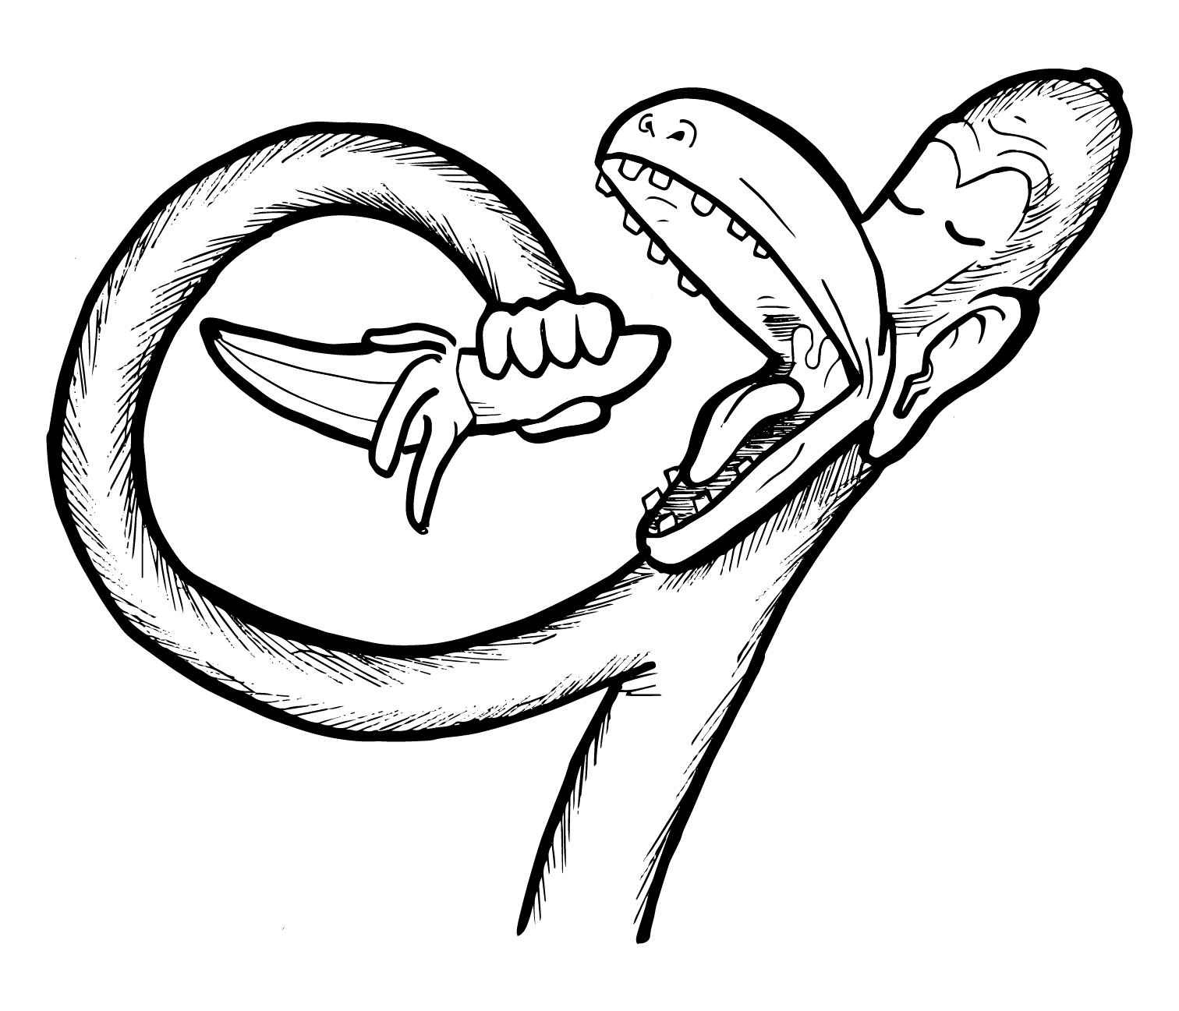
Another important teaching tool…
Easy Breezy Reading (https://www.easybreezyreading.com)
Designed to help new, struggling, and especially dyslexic learners, Easy Breezy Reading is broken up into Laughing Letters and Funny Phonograms. Both tools use illustrated patterns that mimic the shapes of the letters to give your students one more sense to link the phonetic sound of the letters.
ey
monk
Our scope and sequence matches Easy Read English Lower Levels. Progressing through the Easy Breezy Reading curriculum is sure to accelerate your students’ comprehension of the written English language.
You can procure Laughing Letters or Funny Phonograms through our website.
https://www.easybreezyreading.com/curriculum

