Slide 1
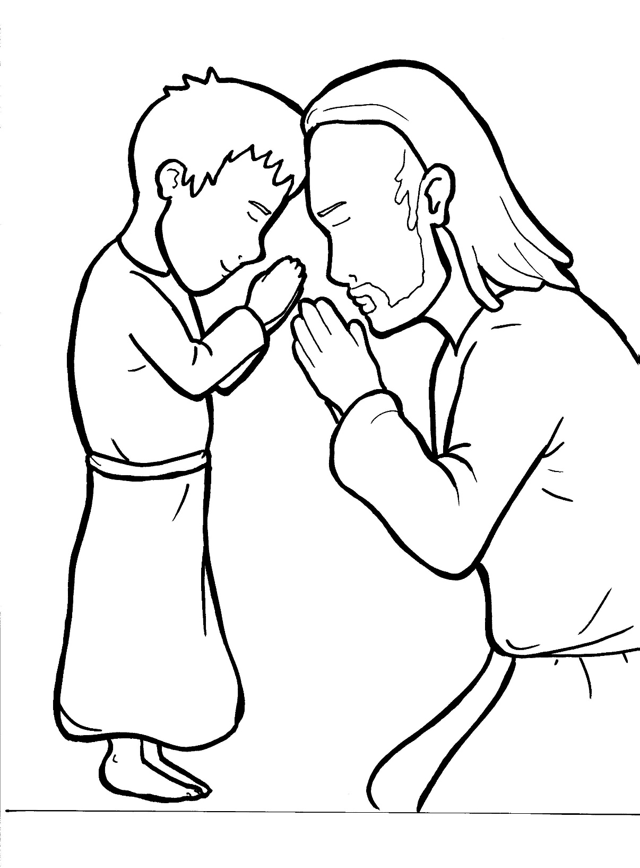
Part 2
26. The Lord’s Prayer
New Words
Rule Breakers

Slide 2
Other Sounds – Soft C
ce, ci, cy make the soft sound
cent
city
fancy

Slide 3
Timing
Box
dis ci ples

Slide 4
Possessives
Lord’s prayer
Jesus’ disciples

Slide 5
New Words
kingdom
tempted
amen

Slide 6
Rule Breakers
Words like these do not follow phonetic patterns.
to
you
said
could
two
f
from

Slide 7
is
of
as
one
to
who

Slide 8
you
from
your
what
give
want

Slide 9
done
against
come
Father

