Slide 1
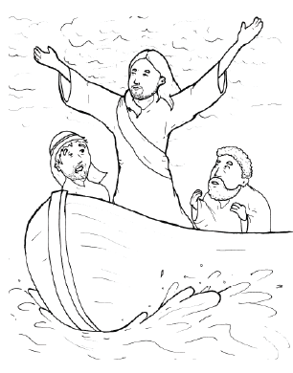
17. Jesus Stops a Storm
Part 2
New Words
Rule Breakers

Slide 2
Other Sounds – Soft C
ce, ci, cy make the soft sound
cent
city
fancy

Slide 3
disciples

Slide 4
Other Sounds – Soft G
ge, gi, gy often make the soft sound
gentle
giant
gym

Slide 5
huge
gentle

Slide 6
New Words
terrified
obey

Slide 7
Rule Breakers
These words do not follow phonetic patterns.
his
almost

Slide 8
water
to
they
you
are
your

Slide 9
was
who
were
is

