Slide 1

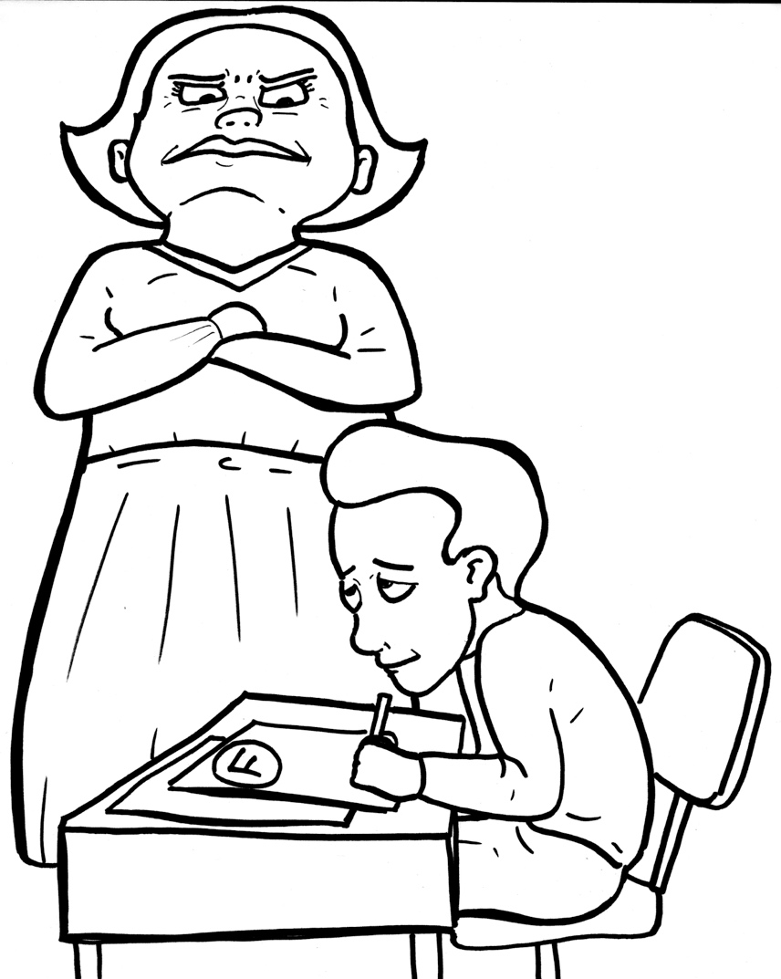
Part 5
46. First, the Bad News
– Sin Separates
Vocabulary
Original Bible Story
You cheated!

Slide 2
Vocabulary

Slide 3
righteous
(RIGHT -
eous):
correct and good

Slide 4
unprofitable
ble):
(un -
PROF -
it -
a -
not gaining anything

Slide 5
deceit
(de -
CEIT):
cheating or lies

Slide 6
viper
(VI -
per):
snake

Slide 7
destruction
(de -
STRUC-
tion):
ruin

Slide 8
judgment
ment):
(JUDG -
a final decision

Slide 9
First, the Bad News -
Sin Separates
Romans 3:9b – 18, 23
World English Bible (WEB)

Slide 10
They are all under sin. As it is written,
“There is no one righteous; no, not one.

Slide 11
There is no one who understands.
There is no one who seeks after God.

Slide 12
They have all turned away.
They have together become unprofitable.

Slide 13
There is no one who does good, no,
not so much as one.”

Slide 14
“Their throat is an open tomb.
With their tongues they have used deceit.”

Slide 15
"The poison of vipers is under their lips.”

Slide 16
“Their mouth is full of cursing and bitterness.”

Slide 17
“Their feet are swift to shed blood.
Destruction and misery are in their ways.

Slide 18
The way of peace, they haven’t known.”

Slide 19
“There is no fear of God before their eyes.”...

Slide 20
… all the world may be brought under the judgment of God...

Slide 21
For all have sinned, and fall short
of the glory of God.

