Slide 1

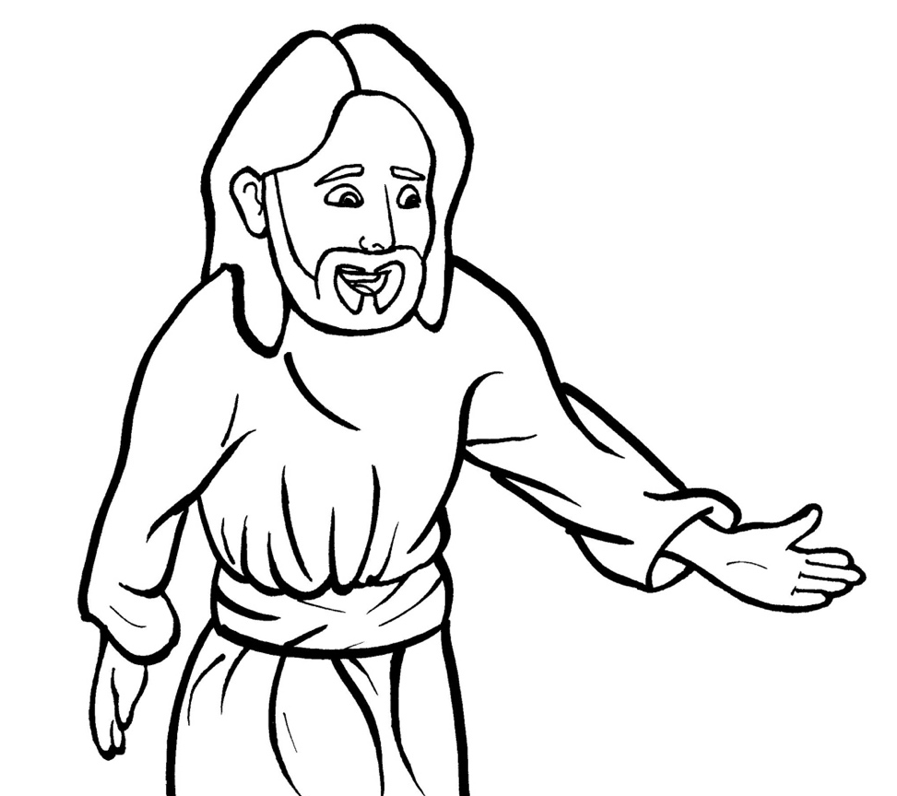
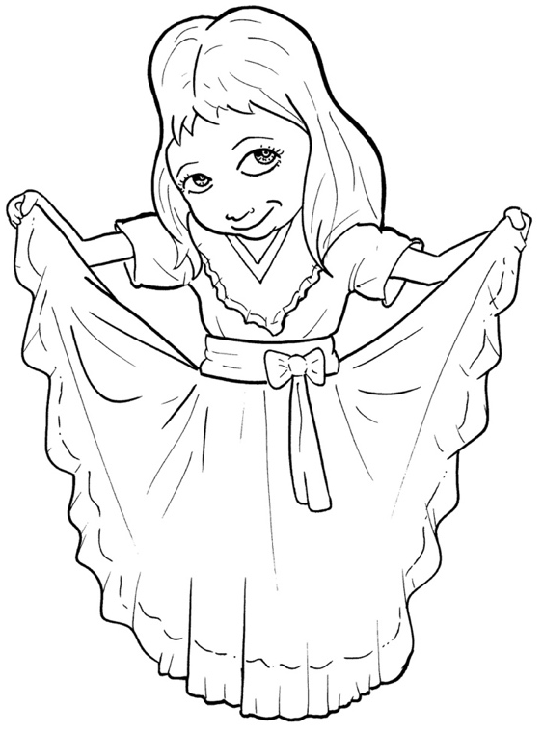
Part 3
47. Now, the Good News – Jesus Saves
Syllable Divisions

Slide 2
Dividing Words
Into Syllables

Slide 3
Rabbit Words
When you see two consonants
between two vowels,
divide between the consonants.
ra it
bb
rab bit

Slide 4
fol low
follow

Slide 5
en joy
enjoy

Slide 6
par ty
party

Slide 7
for giving
forgiving

Slide 8
won der ful
wonderful

Slide 9

Tiger Words
When you see one consonant
between two vowels,
divide after the first vowel.
Try this pattern first.
ti er
g
ti ger

Slide 10
a men
amen

Slide 11
be cause
because

Slide 12
be lieve
believe

Slide 13
Bi ble
Bible

Slide 14
o bey
obey

Slide 15
bro ken
broken

Slide 16
su per
super

Slide 17
Camel Words
When you see one consonant
between two vowels,
divide after the first consonant.
Try this pattern second.
ca el
m
cam el

Slide 18
pun ish
punish

Slide 19
heav en
heaven

Slide 20
ev er y
every

Slide 21
for ev er
forever

Slide 22
Turtle Words
When you see consonant-l-e,
count back three and divide.
tur
t
l
e
tur tle

Slide 23
Bi ble
Bible

Slide 24

Foxes Suffixes
Focus on your base word.
fox es
fox es

Slide 25
real ly
really

Slide 26
pray er
prayer

Slide 27
dy ing
dying

Slide 28
smi ling
smiling

Slide 29
friend ship
friendship

Slide 30
throw ing
throwing

Slide 31
forgiv ing
forgiving

Slide 32
wonder ful
wonderful

Slide 33
punish ment
punishment

Slide 34
sinned
sinned

Slide 35
fixed
fixed

Slide 36
raised
raised

Slide 37
saved
saved

Slide 38

Anteater Words
These compound words are made up of two smaller words.
ant
eater
1
2
ant eater

Slide 39
for ever
forever

Slide 40
for giving
forgiving

Slide 41
who ever
whoever

Slide 42
with out
without

Slide 43
some one
someone

Slide 44
some where
somewhere

