Slide 1
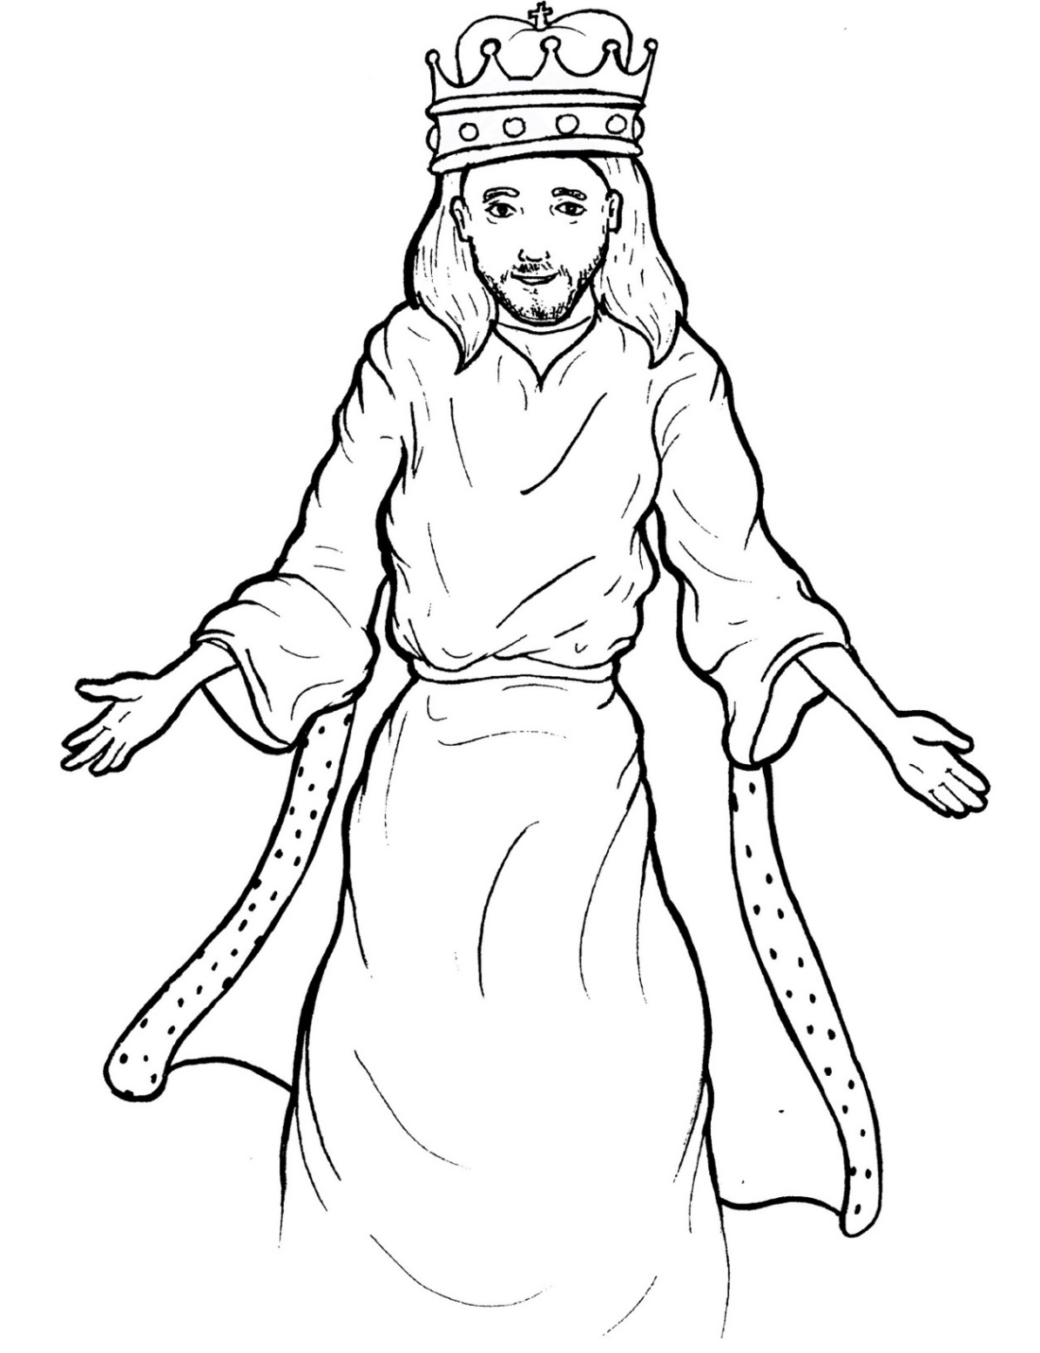
Part 4
45. Jesus Lives as King
Story in Easy Read English
Questions
Story in Phrases

Slide 2
Jesus rose up into the clouds.

Slide 3
His followers stood there, amazed.

Slide 4
They stared at the sky.

Slide 5
Two angels came.

Slide 6
They said, “In the same way he left,
Jesus will return.”

Slide 7
So where is Jesus now?

Slide 8
The Bible says he is in heaven.

Slide 9
He sits at the right hand of God.

Slide 10
A bright rainbow shines over
his throne.

Slide 11
God is a three-person being:

Slide 12
God the Father,
God the Son (Jesus),
and God the Holy Spirit.

Slide 13
The Spirit lives inside every
believer.

Slide 14
He gives comfort and wisdom.

Slide 15
Jesus obeyed God.

Slide 16
He died on the cross.

Slide 17
So, God lifted him to the
highest place.

Slide 18
His name is above every name.

Slide 19
One day, every knee will bow
before him.

Slide 20
Every mouth will say,
“Jesus Christ is Lord.”

Slide 21
Even now, people from every
nation bow before his throne.

Slide 22
They worship him.

Slide 23
Jesus is the king over every ruler
or king.

Slide 24
He wants to be the king of
every heart.

Slide 25
Jesus said, “I am the beginning
and the end.

Slide 26
Yes, I am coming soon.”

Slide 27
Look to the skies.

Slide 28
Jesus will return some day.

Slide 29
Even so, come, Lord Jesus.
Amen.

Slide 30
Question 1
Where is Jesus now?

Slide 31
Question 2
What three forms does God come in?

Slide 32
Question 3
Who does the Holy Spirit live inside?

Slide 33
Question 4
Is Jesus the king of your heart? Have you asked Jesus to be your Lord?

Slide 34
Prayer
Dear King Jesus,
I worship you. Your name is above every name. You are the king over every king. You are my Lord. Come, Lord Jesus, into our lives.
Amen

Slide 35
Jesus Lives
as King
Phrased for Fluency

Slide 36
Jesus
rose up
into the clouds.

Slide 37
His followers
stood there,
amazed.

Slide 38
They stared
at the sky.

Slide 39
Two angels came.
They said,
“In the same way
he left,
Jesus will return.”

Slide 40
So where is
Jesus now?
The Bible says
he is in heaven.

Slide 41
He sits
at the right hand of God.

Slide 42
A bright rainbow
shines
over his throne.

Slide 43
God is
a three-person being:
God the Father,
God the Son
(Jesus),
and God the Holy Spirit.

Slide 44
The Spirit lives
inside every believer.

Slide 45
He gives comfort and wisdom.

Slide 46
Jesus obeyed God.
He died on the cross.

Slide 47
So,
God lifted him
to the highest place.

Slide 48
His name
is above
every name.

Slide 49
One day,
every knee
will bow
before him.

Slide 50
Every mouth
will say,
“Jesus Christ is Lord.”

Slide 51
Even now,
people
from every nation
bow before his throne.

Slide 52
They worship him.

Slide 53
Jesus is
the king
over every ruler
or king.

Slide 54
He wants to be
the king
of every heart.

Slide 55
Jesus said,
“I am the beginning
and the end.

Slide 56
Yes,
I am coming
soon.”

Slide 57
Look to the skies.
Jesus will return
some day.

Slide 58
Even so,
come,
Lord Jesus.
Amen.

