Slide 1

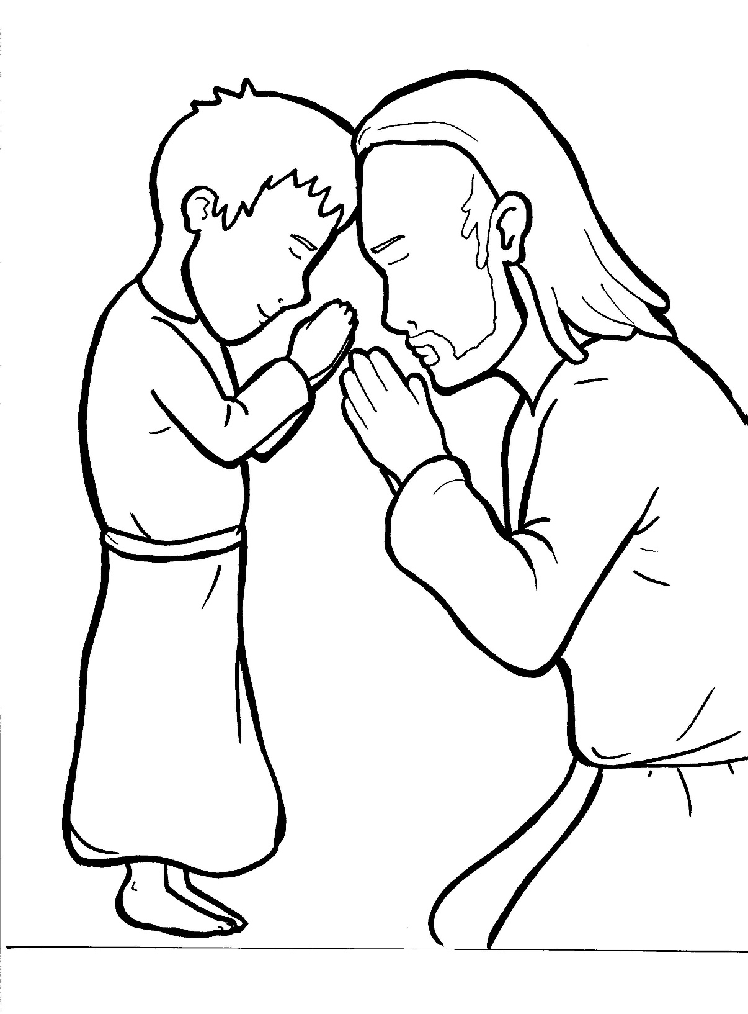
Part 4
26. The Lord’s Prayer
Story in Easy Read English
Questions
Story in Phrases

Slide 2
One of Jesus’ disciples asked,
“Lord, teach us to pray.”

Slide 3
Jesus said: “When you pray, say:

Slide 4
Our Father in heaven, may your
name be set apart as holy.

Slide 5
May your kingdom come.

Slide 6
May what you want to happen
really happen.

Slide 7
May this will of yours be done on earth,
just like your will is done in heaven.

Slide 8
Give us our bread to eat every day.

Slide 9
Forgive us our sins.

Slide 10
Forgive us in the same way that we
forgive those who sin against us.

Slide 11
Help us so that we are not tempted
to sin.

Slide 12
Save us from the evil one.

Slide 13
For yours is the kingdom, and the
power, and the glory forever.
Amen.”

Slide 14
Question 1
What did Jesus ask for in this famous prayer?

Slide 15
Question 2
How can you set God’s name apart as holy?

Slide 16
The Lord’s Prayer
Part 1
Our Father which art in heaven, hallowed be thy Name. Thy kingdom come. Thy will be done, on earth as it is in heaven.

Slide 17
The Lord’s Prayer
Part 2
Give us this day, our daily bread. And forgive us our trespasses, as we forgive those who trespass against us. And lead us not into temptation, but deliver us from evil.

Slide 18
The Lord’s Prayer
Part 3
For thine is the kingdom, and the power, and the glory for ever and ever.
Amen.
Traditional and most widely accepted version. Anglican Book of Common Prayer, 1662

Slide 19
The Lord’s Prayer
Phrased for Fluency

Slide 20
One of Jesus’
disciples
asked,
“Lord, teach us
to pray.”

Slide 21
Jesus said:
“When you pray,
say:

Slide 22
Our Father
in heaven,
may your name
be set apart
as holy.

Slide 23
May your kingdom
come.

Slide 24
May what you want
to happen
really happen.

Slide 25
May this will
of yours
be done
on earth,
just like your will
is done
in heaven.

Slide 26
Give us our bread
to eat
every day.

Slide 27
Forgive us
our sins.

Slide 28
Forgive us
in the same way
that we forgive those
who sin against us.

Slide 29
Help us
so that
we are not
tempted
to sin.

Slide 30
Save us
from the evil one.

Slide 31
For yours
is the kingdom,
and the power,
and the glory
forever.
Amen.”

