Slide 1
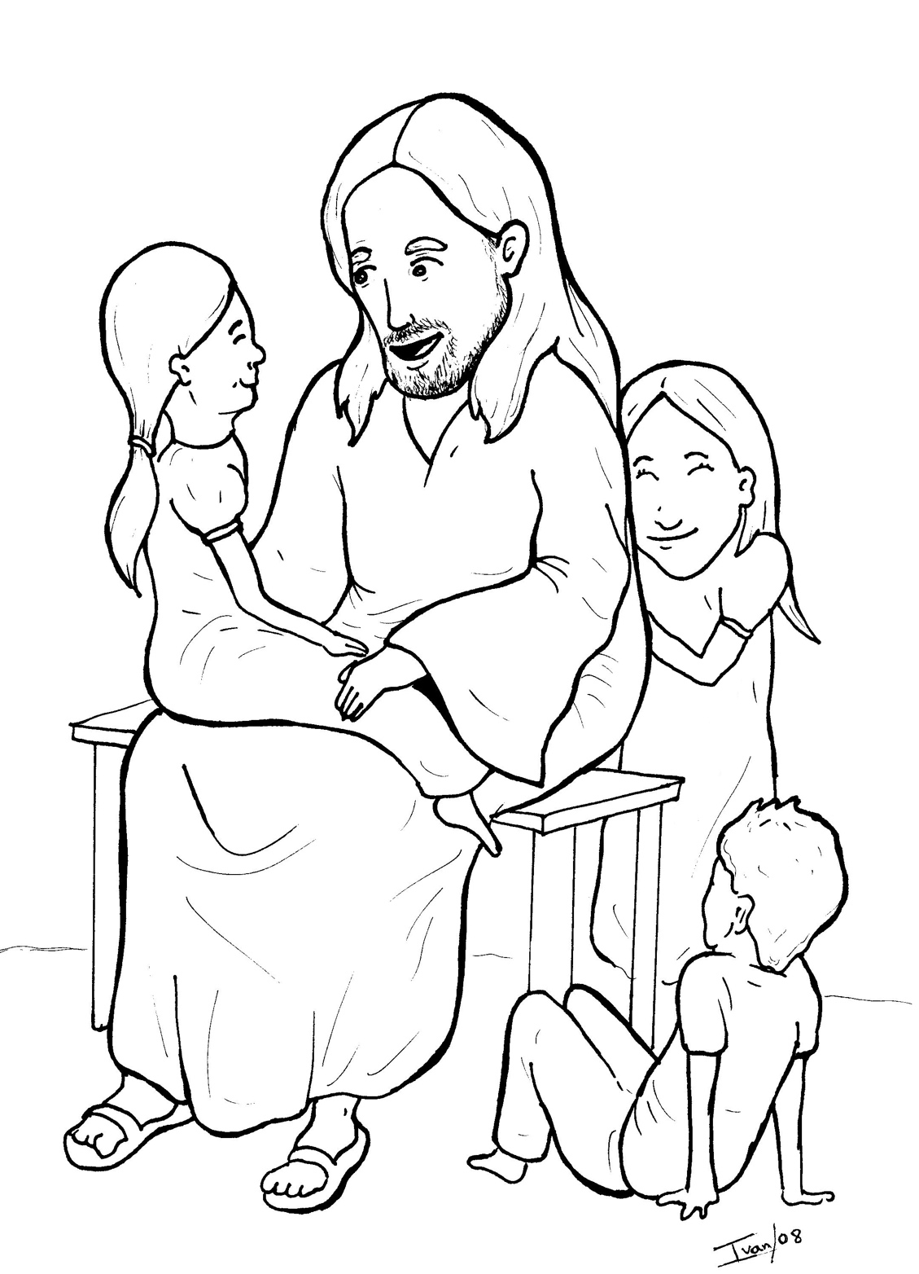
12. Jesus Loves the Little Children
Part 5
Vocabulary
Original Bible Story

Slide 2
Vocabulary

Slide 3
rebuke
(re -
BUKE):
to scold

Slide 4
forbid
BID):
(for -
to stop

Slide 5
move
(move):
to feel strongly

Slide 6
God's Kingdom
(KING - dom):
everywhere that Jesus is King

Slide 7
indignation
tion):
(in -
dig -
NA -
anger at unfairness

Slide 8
certainly
(CER -
tain -
ly):
for sure

Slide 9
Jesus Loves the
Little Children
Mark 10:13 -16
World English Bible (WEB)

Slide 10
They were bringing to him little children, that he should touch them, but the disciples rebuked those who were bringing them.

Slide 11
But when Jesus saw it, he was moved with indignation, and said to them, “Allow the little children to come to me!

Slide 12
Don’t forbid them, for God’s Kingdom belongs to such as these.

Slide 13
Most certainly I tell you, whoever will not receive God’s Kingdom like a little child, he will in no way enter into it.”

Slide 14
He took them in his arms, and blessed them, laying his hands on them.

