Slide 1
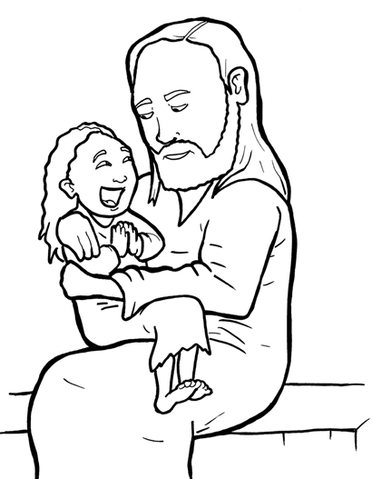
20. A Mother Begs and Believes
Part 4
Story in Easy Read English
Questions
Story in Phrases

Slide 2
Jesus left the land of the Jews.

Slide 3
He visited the land of the Gentiles.

Slide 4
A Gentile mother was sad.

Slide 5
She was sad and scared.

Slide 6
Her little girl had an evil spirit inside her.

Slide 7
But Jesus had come to her town!

Slide 8
The mother ran to him.

Slide 9
She fell at the feet of Jesus.

Slide 10
“Lord, help me,” she begged.

Slide 11
“My daughter has an evil spirit in her.

Slide 12
She is suffering.

Slide 13
Please, please take it out of her.”

Slide 14
At first, Jesus did not say a thing.

Slide 15
“Send her away,” the disciples said.

Slide 16
“She keeps crying out to us.”

Slide 17
Jesus said to her, “I was sent to save the lost Jews first.”

Slide 18
This mother was not a Jew.

Slide 19
But she kept begging Jesus.

Slide 20
“Lord, help me,” she said.

Slide 21
Jesus smiled.

Slide 22
He saw how much she believed in him.

Slide 23
Jesus said, “You have great faith.

Slide 24
Go on your way.

Slide 25
What you asked has been done.”

Slide 26
At that moment, the girl was
healed!

Slide 27
The mother went home.

Slide 28
The child was lying in bed,
happy and healed!

Slide 29
Question 1
What miracle did Jesus perform that
showed his kindness?

Slide 30
Question 2
What did the mother do that
showed her faith in Jesus?

Slide 31
Question 3
Even when people tried to
stop her, how many times did
she ask Jesus for help?

Slide 32
Question 4
Faith brings miracles. What miracle do you need to keep begging Jesus to do for you?

Slide 33
Prayer
Dear Jesus,
You are so kind. You came for everyone. Thank you for this mother’s great faith. Please give me great faith. Please, Lord, I need a miracle. I need you to... Amen

Slide 34
A Mother Begs and Believes
Phrased for Fluency

Slide 35
Jesus
left the land
of the Jews.

Slide 36
He
visited
the land
of the Gentiles.

Slide 37
A Gentile mother
was sad.

Slide 38
She was sad
and scared.

Slide 39
Her little girl
had an evil spirit
inside her.

Slide 40
But Jesus had come
to her town!

Slide 41
The mother ran
to him.

Slide 42
She fell
at the feet
of Jesus.

Slide 43
“Lord,
help me,”
she begged.

Slide 44
“My daughter
has an evil spirit
in her.

Slide 45
She is suffering.

Slide 46
Please,
please
take it out
of her.”

Slide 47
At first,
Jesus did not
say a thing.

Slide 48
“Send her away,”
the disciples said.

Slide 49
“She keeps
crying out
to us.”

Slide 50
Jesus said
to her,
“I was sent
to save the lost Jews
first.”

Slide 51
This mother
was not a Jew.

Slide 52
But
she kept
begging Jesus.

Slide 53
“Lord,
help me,”
she said.

Slide 54
Jesus smiled.

Slide 55
He saw
how much
she believed
in him.

Slide 56
Jesus said,
“You have
great faith.

Slide 57
Go on your way.

Slide 58
What you asked
has been done.”

Slide 59
At that moment,
the girl
was healed!

Slide 60
The mother went home.

Slide 61
The child was
lying in bed,
happy and healed!

