Slide 1
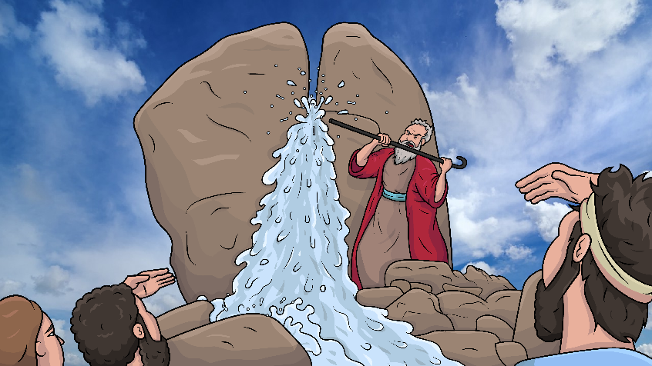
Song 1.12
A Stick Struck the Rock
Story of God’s water miracle in the desert
Numbers 20:1-13 (-ck)
www.EasyReadEnglish.com

Slide 2
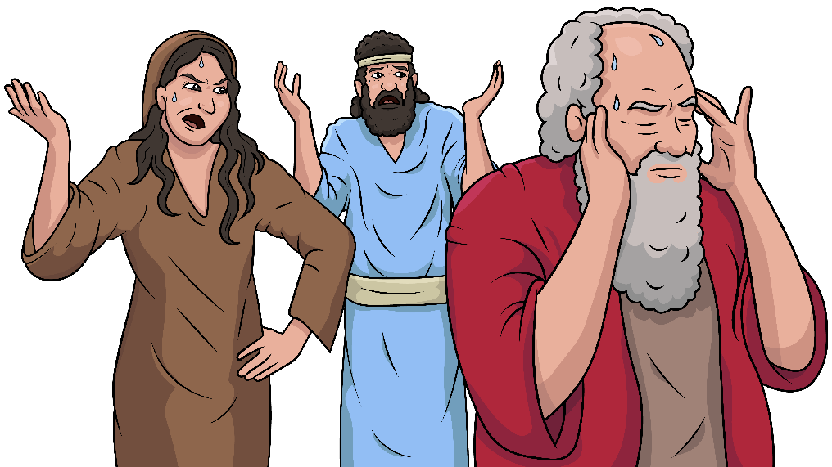
We are stuck,
out of luck

Slide 3
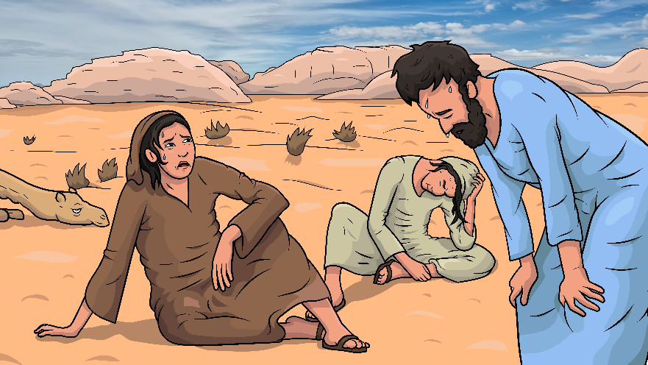
in this desert –
hot and yuck.

Slide 4
With a
black stick
and a whack,
give the rock
a smack.

Slide 5
Water fell from the rock’s crack.

Slide 6
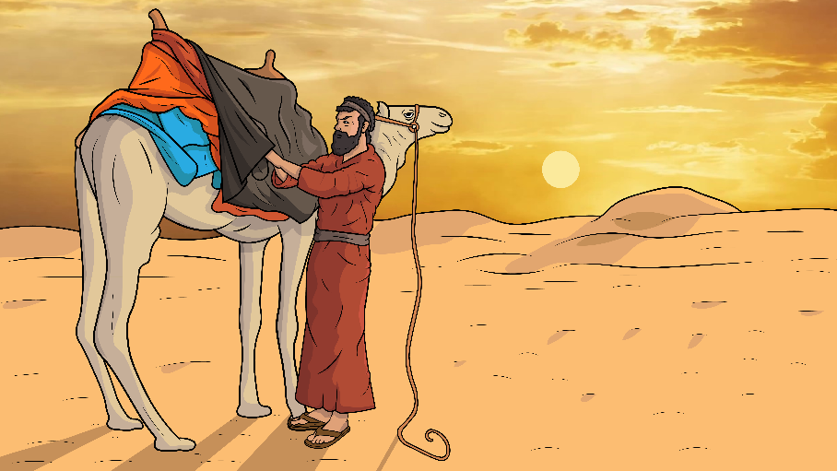
We will pack and go back.

Slide 7
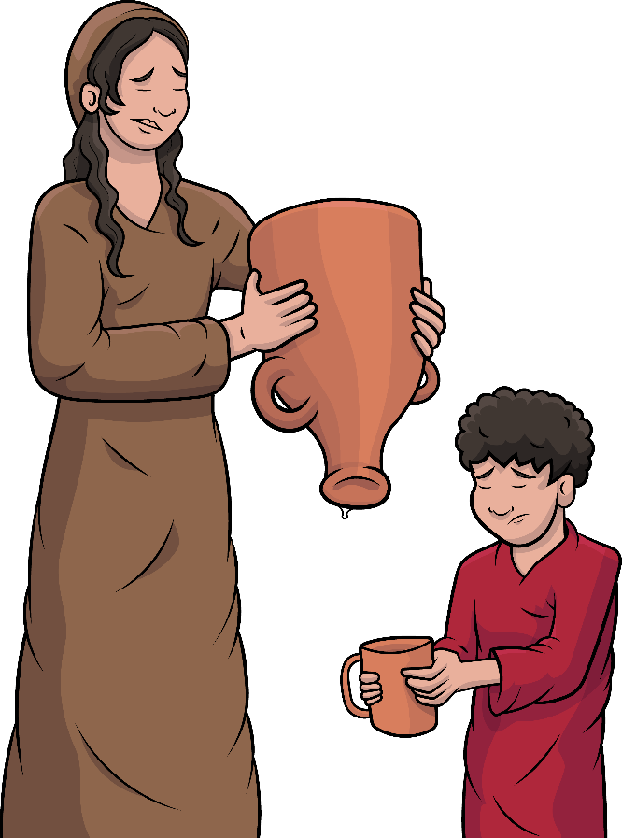
We want water
that we lack.

Slide 8
With a
black stick
and a whack,
give the rock
a smack.

Slide 9
Water fell from the rock’s crack.

Slide 10
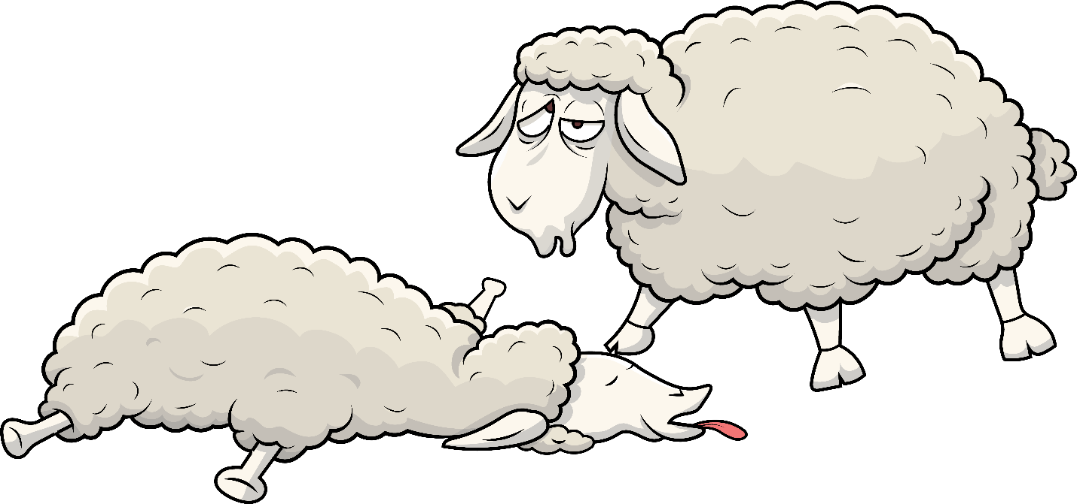
Check, go quick!
Flocks are sick.

Slide 11
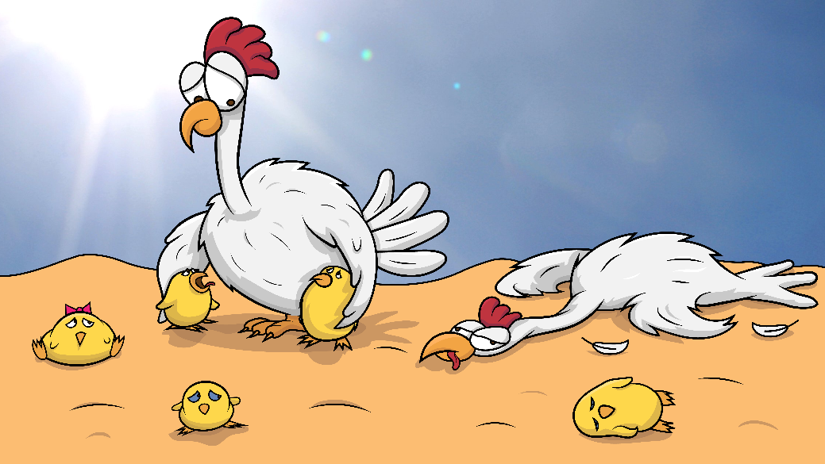
So are the chickens and their chicks.

Slide 12
With a
black stick
and a whack,
give the rock
a smack.

Slide 13
Water fell from the rock’s crack.

Slide 14
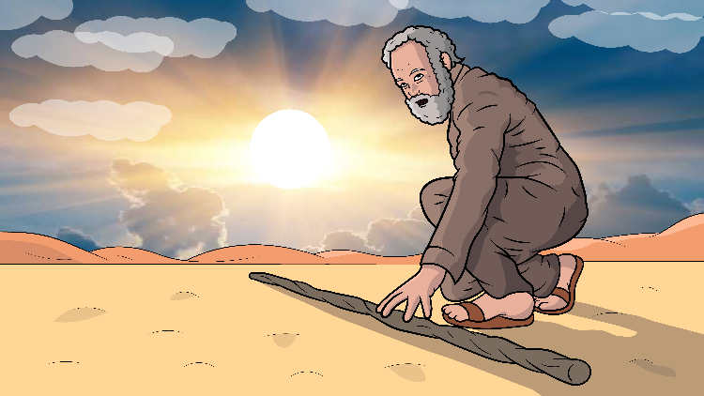
“Moses, pick a big stick.”

Slide 15
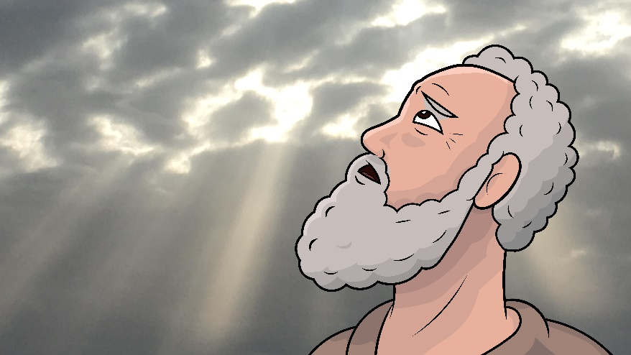
“Talk to the rock.
This is not a trick.”

Slide 16
With a
black stick
and a whack,
give the rock
a smack.

Slide 17
Water fell from the rock’s crack.

Slide 18
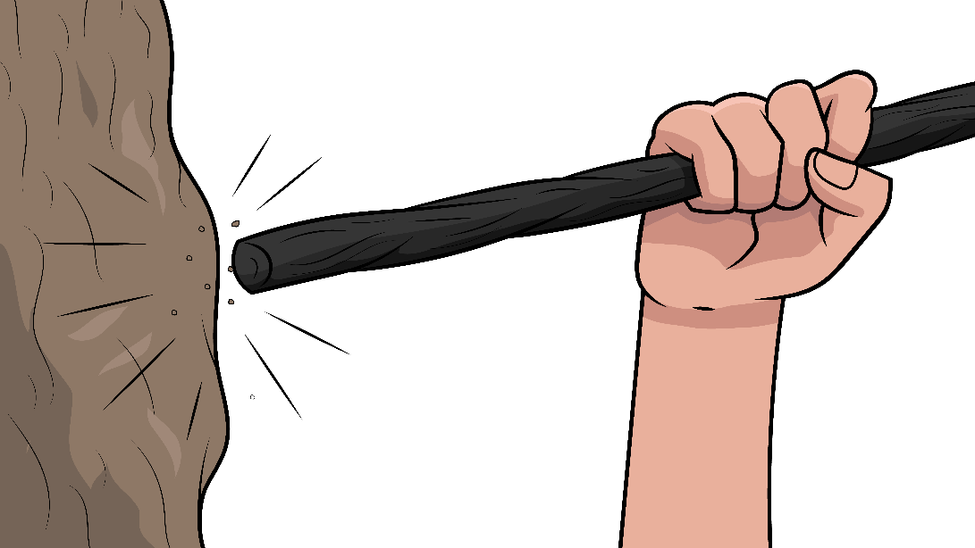
The stick went whack,
then a
crack.

Slide 19
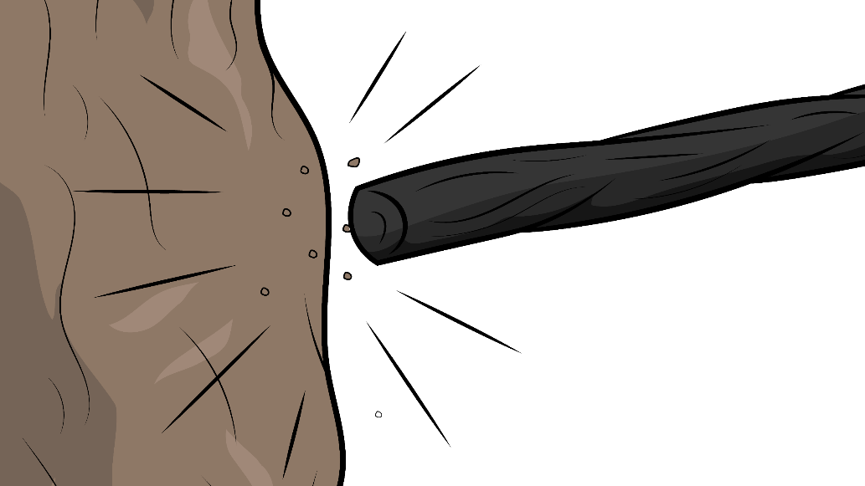
Two hits-
It went smack and smack!

Slide 20
With a black stick and a whack, give the rock a smack.

Slide 21
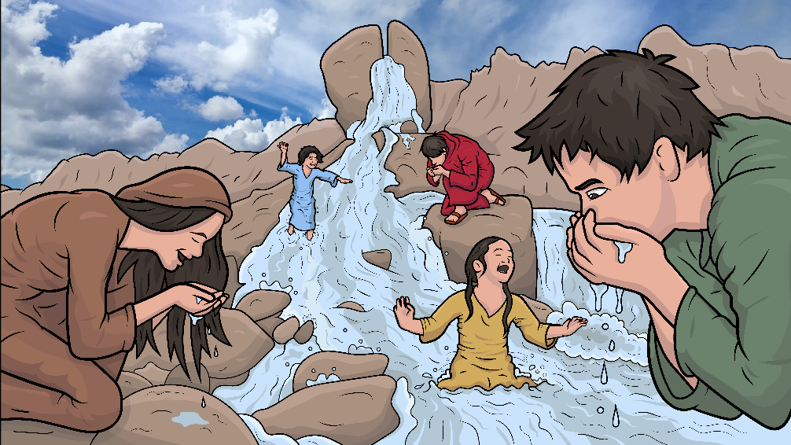
Water fell from the rock’s crack.

Slide 22
With a black stick and a whack, give the rock a smack.

Slide 23
Water fell from the rock’s crack.

Slide 24
The End

Slide 25
Song lyrics: Carol Hale
Song arrangements and singer: Michael Bannon
Illustrations: Ivan Mader
Power Point arrangements: Steve March
www.EasyReadEnglish.com
www.EZReadEnglish.org/Lower-Levels

Slide 26
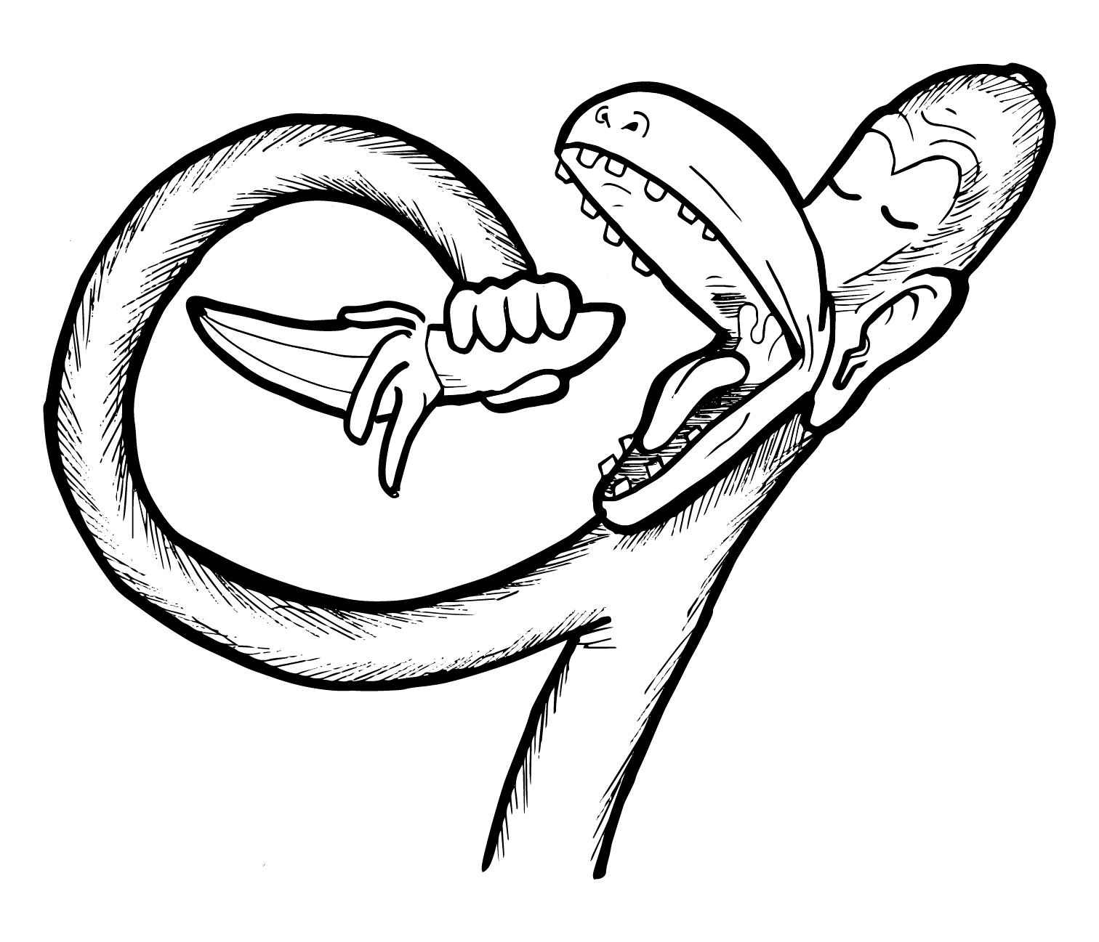
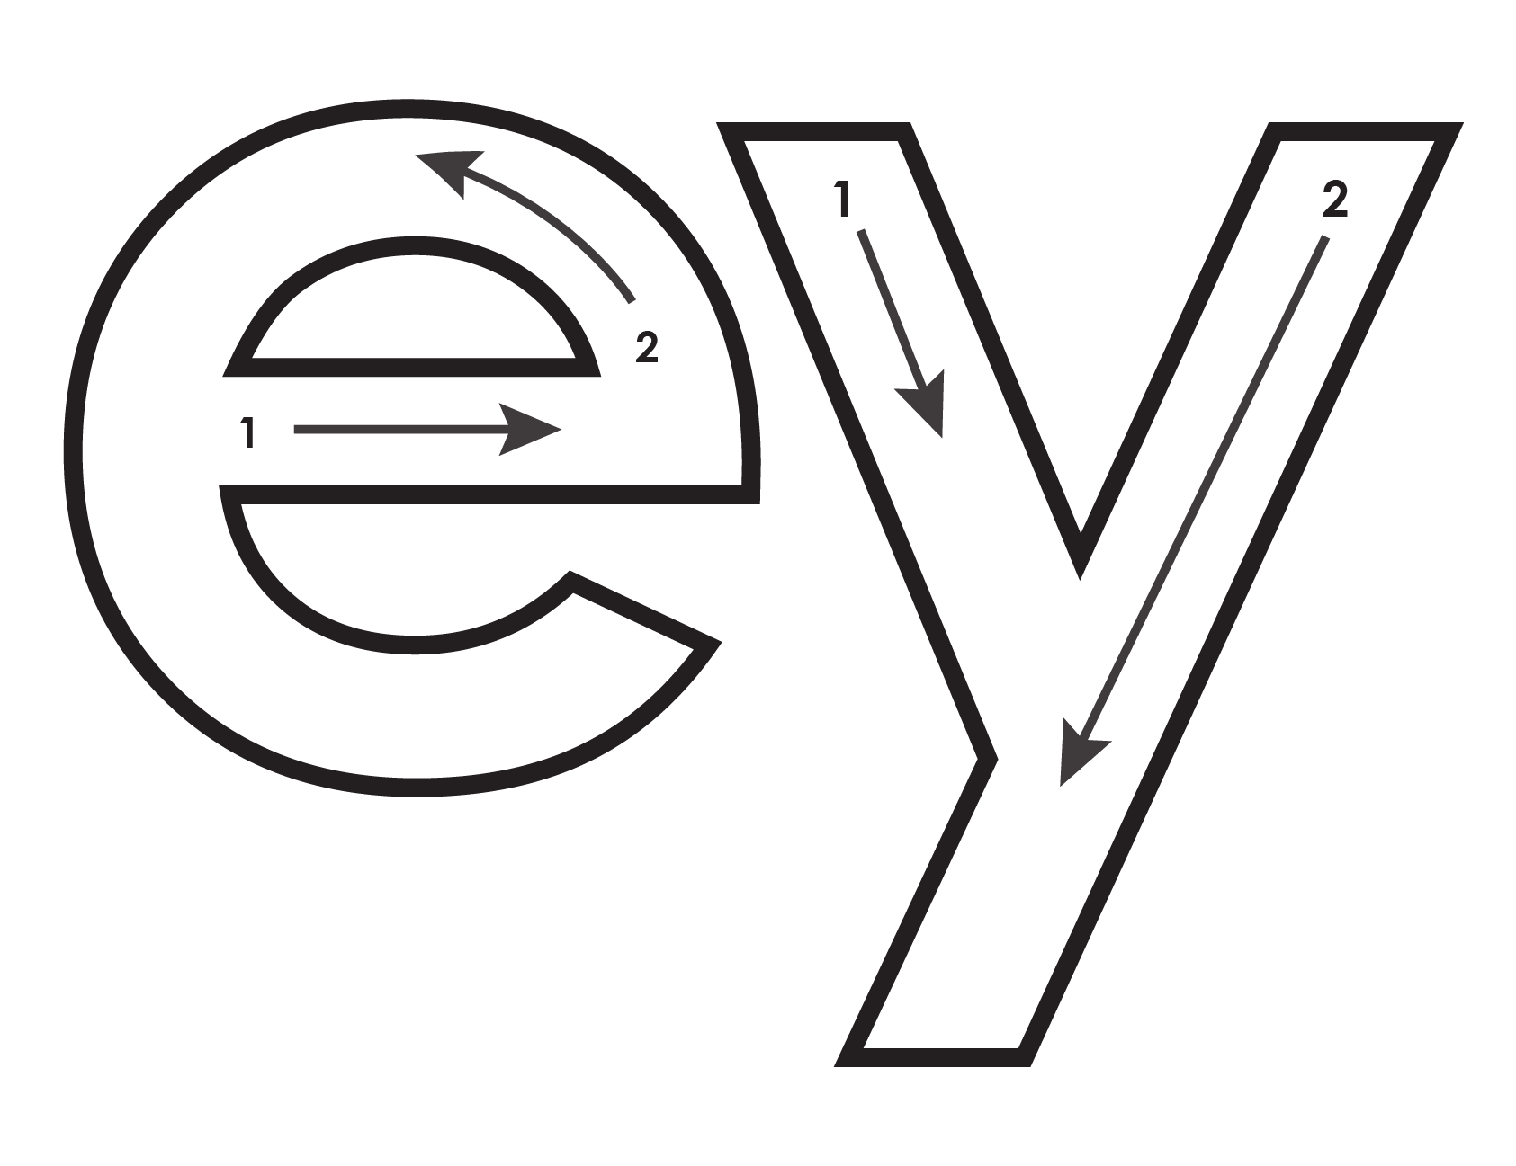
Another important teaching tool…
Easy Breezy Reading (https://www.easybreezyreading.com)
Designed to help new, struggling, and especially dyslexic learners, Easy Breezy Reading is broken up into Laughing Letters and Funny Phonograms. Both tools use illustrated patterns that mimic the shapes of the letters to give your students one more sense to link the phonetic sound of the letters.
ey
monk
Our scope and sequence matches Easy Read English Lower Levels. Progressing through the Easy Breezy Reading curriculum is sure to accelerate your students’ comprehension of the written English language.
You can procure Laughing Letters or Funny Phonograms through our website.
https://www.easybreezyreading.com/curriculum

