Slide 1
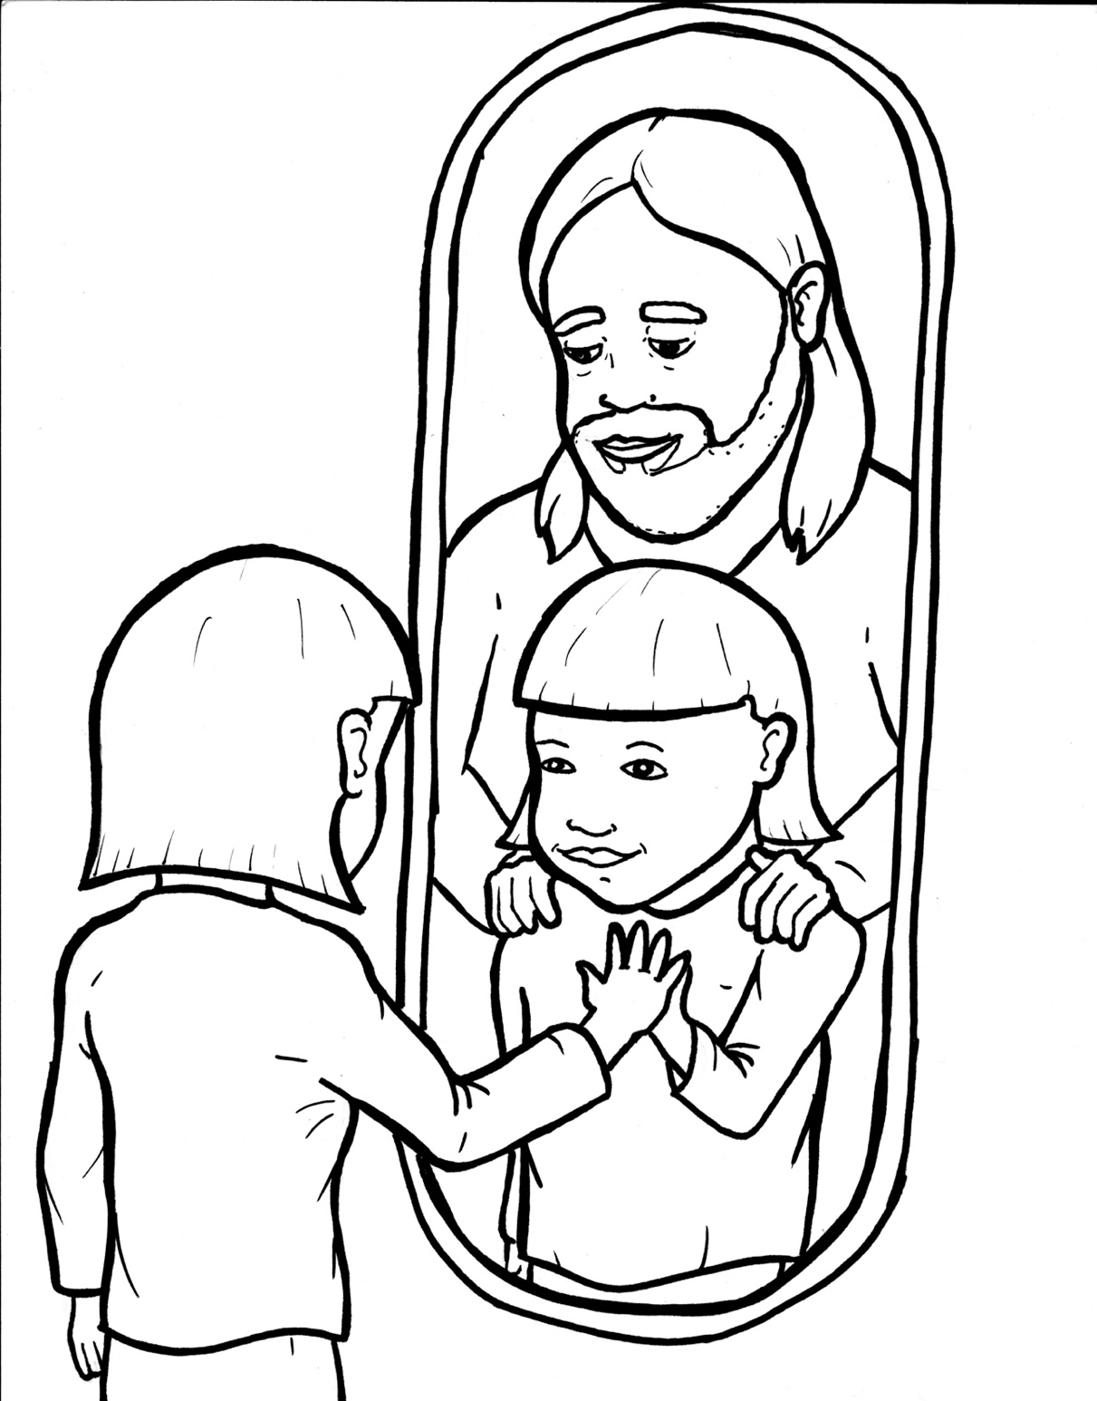
Part 1
48. Wow, I’m a Christian Now!
Syllable Charts

Slide 2
Words in Syllable Types

Slide 3
Closed – Short Vowel
A closed syllable has one vowel
followed by one or more consonants,
and the vowel is short.
st
o
p
˘

Slide 4
hap-
ask
fam-
fact
wrap-
land

Slide 5
en-
sets
ex-
-ent
ev-
-ten

Slide 6
in-
with
lit-
sins
sis-
-giv-

Slide 7
dif-
writ-

Slide 8
God
not
jobs
-dopt

Slide 9
up
run
but
just

Slide 10
Open – Long Vowel
An open syllable has one vowel
with no consonant after it,
and the vowel is long.
−
go

Slide 11
ba by
ma king

Slide 12
we
he
be liever

Slide 13
ex ci ting

Slide 14
o ver
ho ly

Slide 15
ho ly
ba by
glor y
ever y
famil y

Slide 16
Silent e – Long Vowel
A silent e syllable has one vowel,
followed by one consonant
and a silent e at the end.
The vowel is long.
−
ca
e
v

Slide 17
name
make
stare
grace

Slide 18
line
life
like
tribe

Slide 19
a live
in side
wide
ex cite

Slide 20
home
chose

Slide 21
Vowel Teams – Long Vowel
Many vowel teams follow this rule:
When two vowels get together,
the first one names its letter.
So the first vowel will make its long sound,
and the second vowel is silent.
−
e
a
t

Slide 22
wait
praise

Slide 23
a way

Slide 24
see
feel

Slide 25
near
means

Slide 26
be liev er

Slide 27
jour ney

Slide 28
might

Slide 29
own

Slide 30
poof

Slide 31
new

Slide 32
Vowel Teams – Other Sounds
Sometimes vowel teams make other sounds.
oil

Slide 33
dead
heav en

Slide 34
look
book

Slide 35
out
shout

Slide 36
now
power

Slide 37
all

Slide 38
joy ful
en joy

Slide 39
R - Controlled
R-controlled syllables have one or more vowels
followed by an “r.”
The “r” changes the sound of the vowel.
o
r
ange

Slide 40
far
arms
part
starts

Slide 41
ev er y
dif fer ent
ov er

Slide 42
pow er
sis ter
for ev er
believ er

Slide 43
glory
normal

Slide 44
jour ney

Slide 45
world

Slide 46
Consonant – l-e
When you see consonant l-e at the end of a word,
count back three.
The “l-e” makes the /–le/ sound.
pur
p
l
e

Slide 47
lit tle

Slide 48
nor mal

Slide 49
Other Sounds – -nk/-ng
The “-nk” and “-ng”
change the sound of the vowel.
bank
thing

Slide 50
lang uage

Slide 51
king dom
exci ting
shout ing
ma king

Slide 52
strong

Slide 53
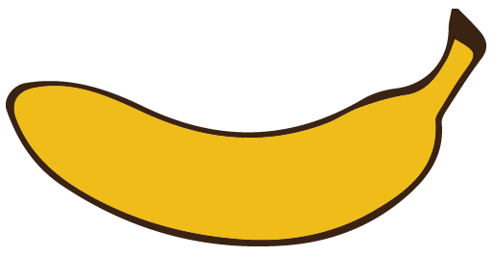
Other Sounds – schwa
The schwa syllable has an “a” that sounds
like the /u/ in banana.
The banana is even shaped like a short u.
ba nan a

Slide 54
a way
a live
a part
a dopt

Slide 55
king dom

