Slide 1

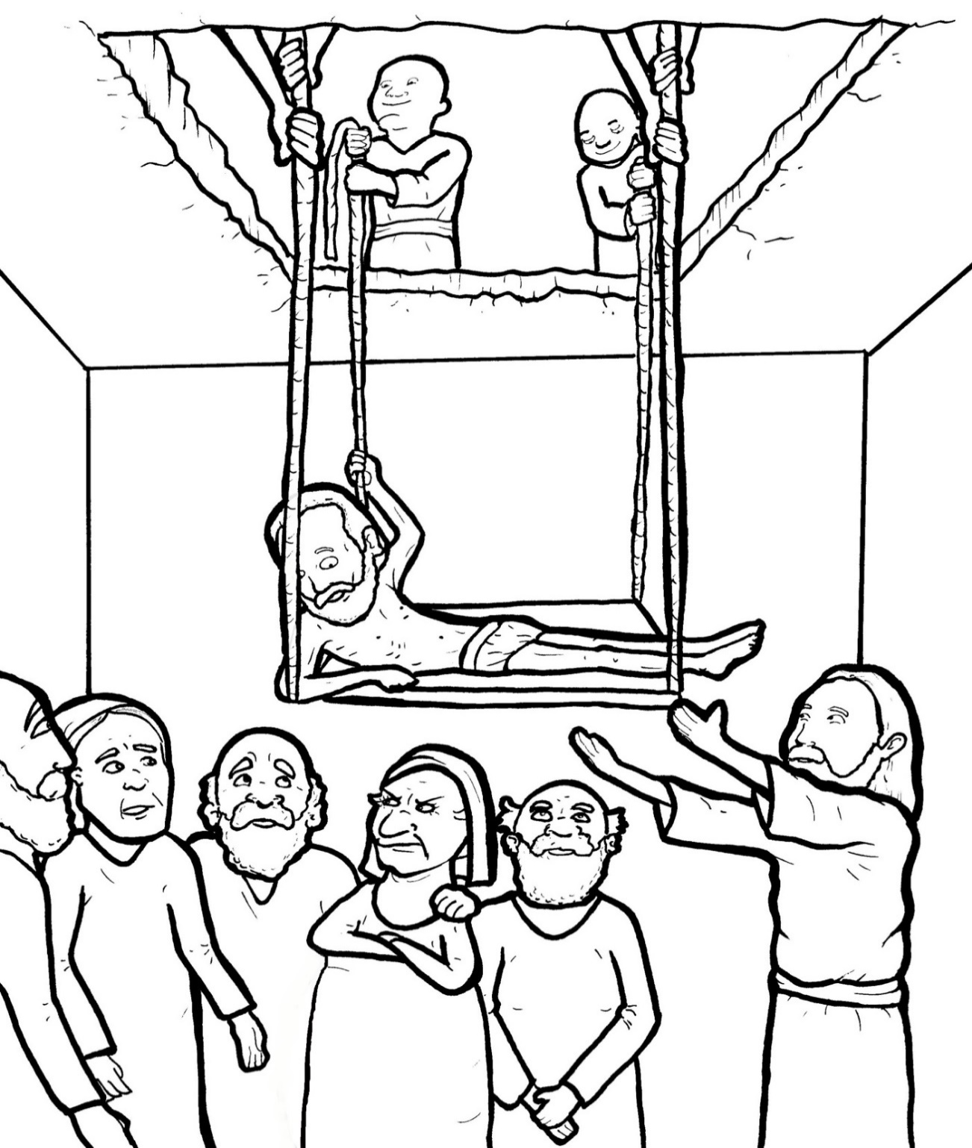
Part 3
29. Friends Bring a Crippled Man to Jesus
Syllable Divisions

Slide 2

Dividing Words
Into Syllables

Slide 3
Tiger Words
When you see one consonant
between two vowels,
divide after the first vowel.
Try this pattern first.
ti er
g
ti ger

Slide 4
Je sus
Jesus

Slide 5
Camel Words
When you see one consonant
between two vowels,
divide after the first consonant.
Try this pattern second.
ca el
m
cam el

Slide 6
nev er
never

Slide 7
Turtle Words
When you see consonant-l-e,
count back three and divide.
tur
t
l
e
tur tle

Slide 8
peo ple
people

Slide 9
crip pled
crippled

Slide 10

Anteater Words
These compound words are made up of two smaller words.
ant
eater
1
2
ant eater

Slide 11
in side
inside

Slide 12
for given
forgiven

Slide 13
every one
everyone

Slide 14
any thing
anything

Slide 15
Other Syllable Divisions
Some words don’t fit so neatly
into standard syllable division patterns.

Slide 16
a mazed
amazed

Slide 17

Foxes Suffixes
Focus on your base word.
fox es
fox es

Slide 18
low er
lower

Slide 19
teach ers
teachers

Slide 20
teach ing
teaching

Slide 21
think ing
thinking

Slide 22
want ed
wanted

Slide 23
shout ed
shouted

Slide 24
jumped
jumped

Slide 25
lowered
lowered

Slide 26
grabbed
grabbed

Slide 27
praised
praised

Slide 28
carried
carried

Slide 29
jammed
jammed

Slide 30
crippled
crippled

