Slide 1
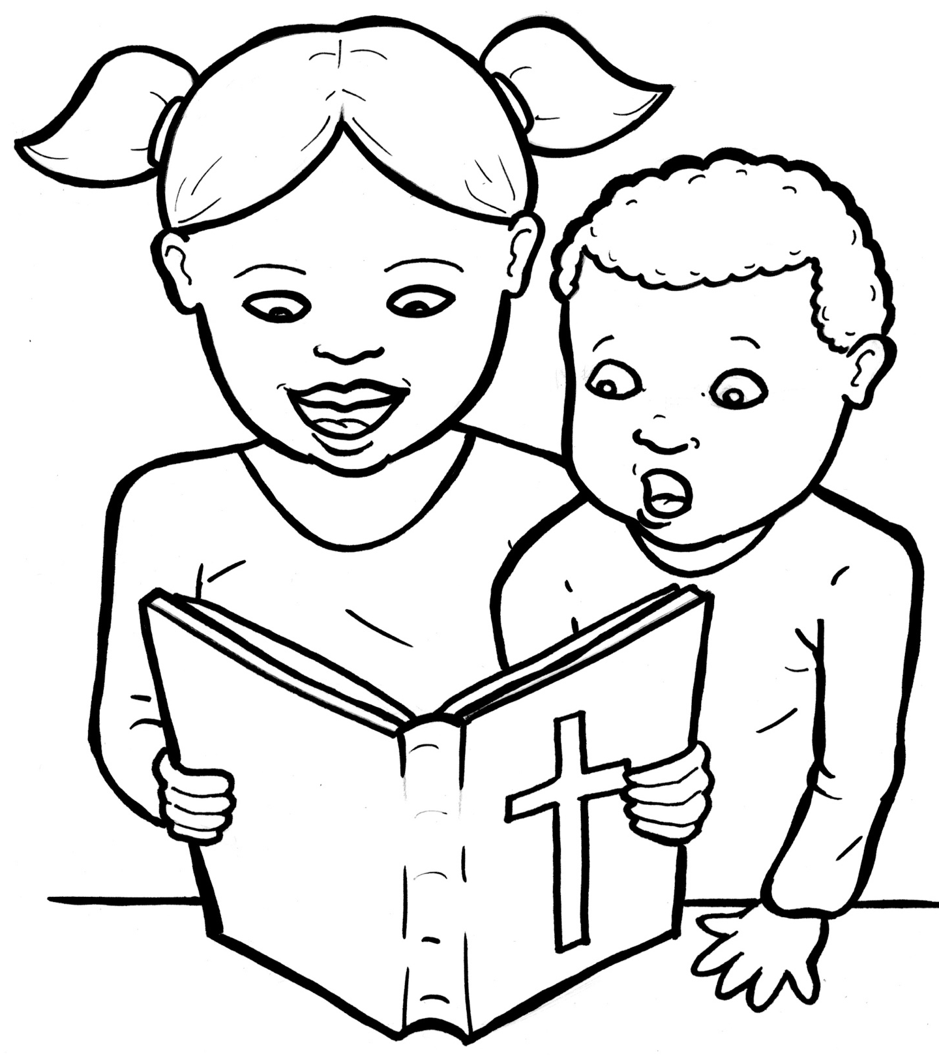
51. I am Alive:
The Bible
Part 1
Syllable Charts

Slide 2
Words in Syllable Types

Slide 3
Closed – Short Vowel
A closed syllable has one vowel
followed by one or more consonants,
and the vowel is short.
st
o
p
˘

Slide 4
fam
-
bad
ask
that
Acts
plan

Slide 5
men
them
ex-
-el
ev-
-ten

Slide 6
tes-
-ems
when
-pels
-self
-ment

Slide 7
big
-til
him
-ish
writ-
-il-

Slide 8
on
God
gos-

Slide 9
un –
us
fun-
-sus

Slide 10
Open – Long Vowel
An open syllable has one vowel
with no consonant after it,
and the vowel is long.
−
go

Slide 11
cre a ting
a ma zing
Is ra el

Slide 12
Je sus
be
he
we
cre a ting

Slide 13
Bi ble

Slide 14
o bey ho ly po ems
al so
go ing

Slide 15
ho ly
stor y
fun ny
ever y
famil y

Slide 16
Silent e – Long Vowel
A silent e syllable has one vowel,
followed by one consonant
and a silent e at the end.
The vowel is long.
−
ca
e
v

Slide 17
page
for gave
tales

Slide 18
these

Slide 19
life
write
in vites

Slide 20
spoke
whole
more

Slide 21
Luke
in cludes

Slide 22
Vowel Teams – Long Vowel
Many vowel teams follow this rule:
When two vowels get together,
the first one names its letter.
So the first vowel will make its long sound,
and the second vowel is silent.
−
e
a
t

Slide 23
pray er
say ings

Slide 24
fail
ex plains

Slide 25
o bey
they

Slide 26
years

Slide 27
stories

Slide 28
peo ple

Slide 29
own

Slide 30
new
Jew ish
Mat thew

Slide 31
true

Slide 32
Vowel Teams – Other Sounds
Sometimes vowel teams make other sounds.
oil

Slide 33
call

Slide 34
look
good
books

Slide 35
a bout

Slide 36
how
down

Slide 37
join

Slide 38
R - Controlled
R-controlled syllables have one or more vowels
followed by an “r.”
The “r” changes the sound of the vowel.
o
r
ange

Slide 39
Mark
starts

Slide 40
for
stor y
stor ies

Slide 41
ev er
ev ery
let ters

Slide 42
first

Slide 43
church

Slide 44
earth

Slide 45
word
world

Slide 46
Consonant – l-e
When you see consonant l-e at the end of a word,
count back three.
The “l-e” makes the /–le/ sound.
pur
p
l
e

Slide 47
Bi ble

Slide 48
peo ple

Slide 49
Other Sounds – Long Vowel
These syllables or words are closed,
so the vowel should be short,
but the vowel is long.
−
cold

Slide 50
told

Slide 51
most

Slide 52
find

Slide 53
Other Sounds – -nk/-ng
The “-nk” and “-ng”
change the sound of the vowel.
bank
thing

Slide 54
songs

Slide 55
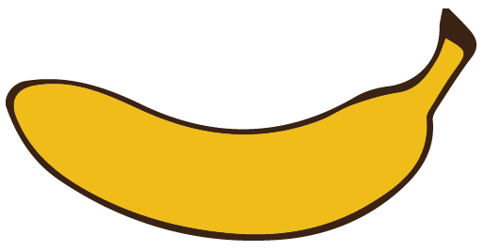
Other Sounds – schwa
The schwa syllable has an “a” that sounds
like the /u/ in banana.
The banana is even shaped like a short u.
ba nan a

Slide 56
a maze
a bout
Tes ta ment

