Slide 1
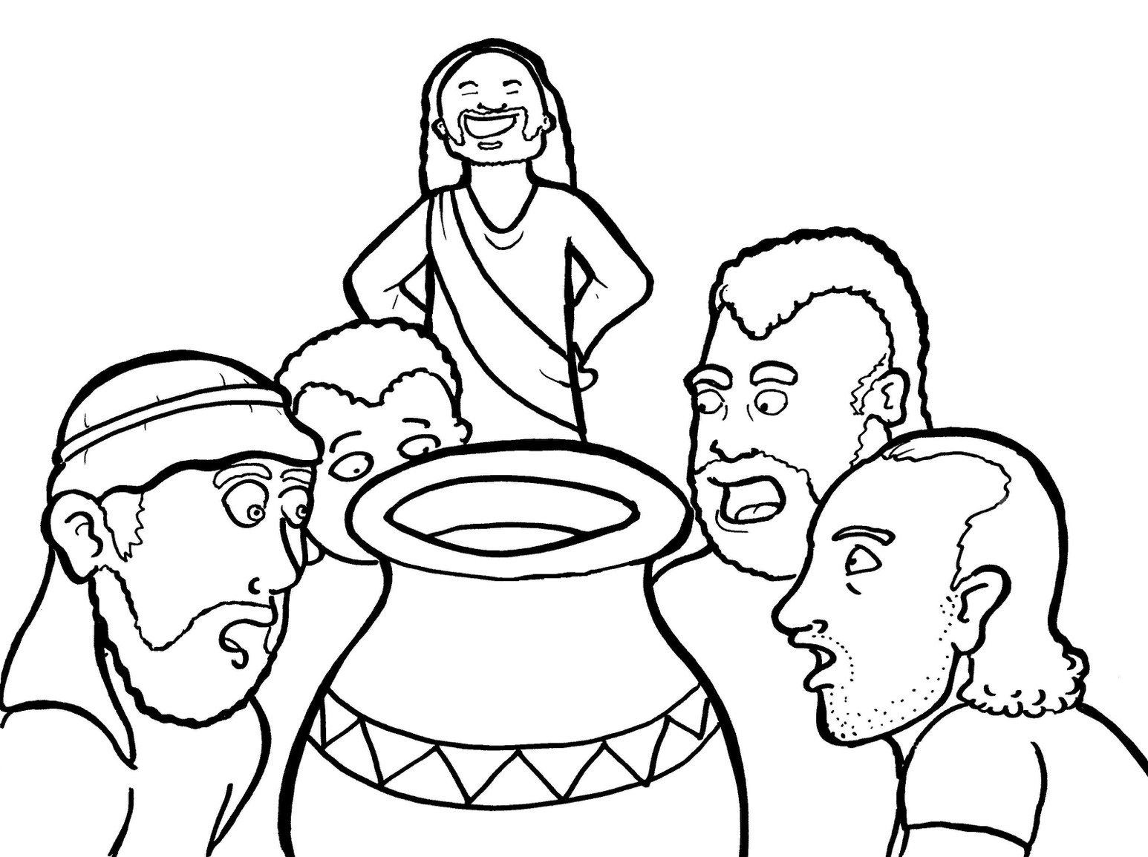
15. Jesus Saves a Wedding
Part 5
Vocabulary
Original Bible Story

Slide 2
Vocabulary

Slide 3
purify
(pur
-if -
Y):
to make clean

Slide 4
feast
(feast):
a party with food

Slide 5
brim
(brim):
top of a jar

Slide 6
sign
(sign):
a miracle

Slide 7
draw
(draw):
to pull out

Slide 8
reveal
(re-
VEAL):
to make known

Slide 9
Jesus Saves a Wedding
John 2:1-11
World English Bible (WEB)

Slide 10
The third day, there was a wedding in Cana of Galilee. Jesus’ mother was there.

Slide 11
Jesus also was invited, with his disciples, to the wedding.

Slide 12
When the wine ran out, Jesus’ mother said to him, “They have no more wine.”

Slide 13
Jesus said to her, “Woman, what does that have to do with you and me? My hour has not yet come.”

Slide 14
His mother said to the servants, “Whatever he says to you, do it.”

Slide 15
Now there were six water pots of stone set there after the Jews’ way of purifying, containing two or three gallons apiece.

Slide 16
Jesus said to them, “Fill the water pots with water.”

Slide 17
So they filled them up to the brim.

Slide 18
He said to them, “Now draw some out, and take it to the ruler of the feast.” So they took it.

Slide 19
When the ruler of the feast tasted the water now become wine, and didn’t know where it came from (but the servants who had drawn the water knew),

Slide 20
the ruler of the feast called the bridegroom and said to him, “Everyone serves the good wine first, and when the guests have drunk freely, then that which is worse.

Slide 21
You have kept the good wine until now!”

Slide 22
The beginning of his signs Jesus did in Cana of Galilee, and revealed his glory; and his disciples believed in him.

