Slide 1
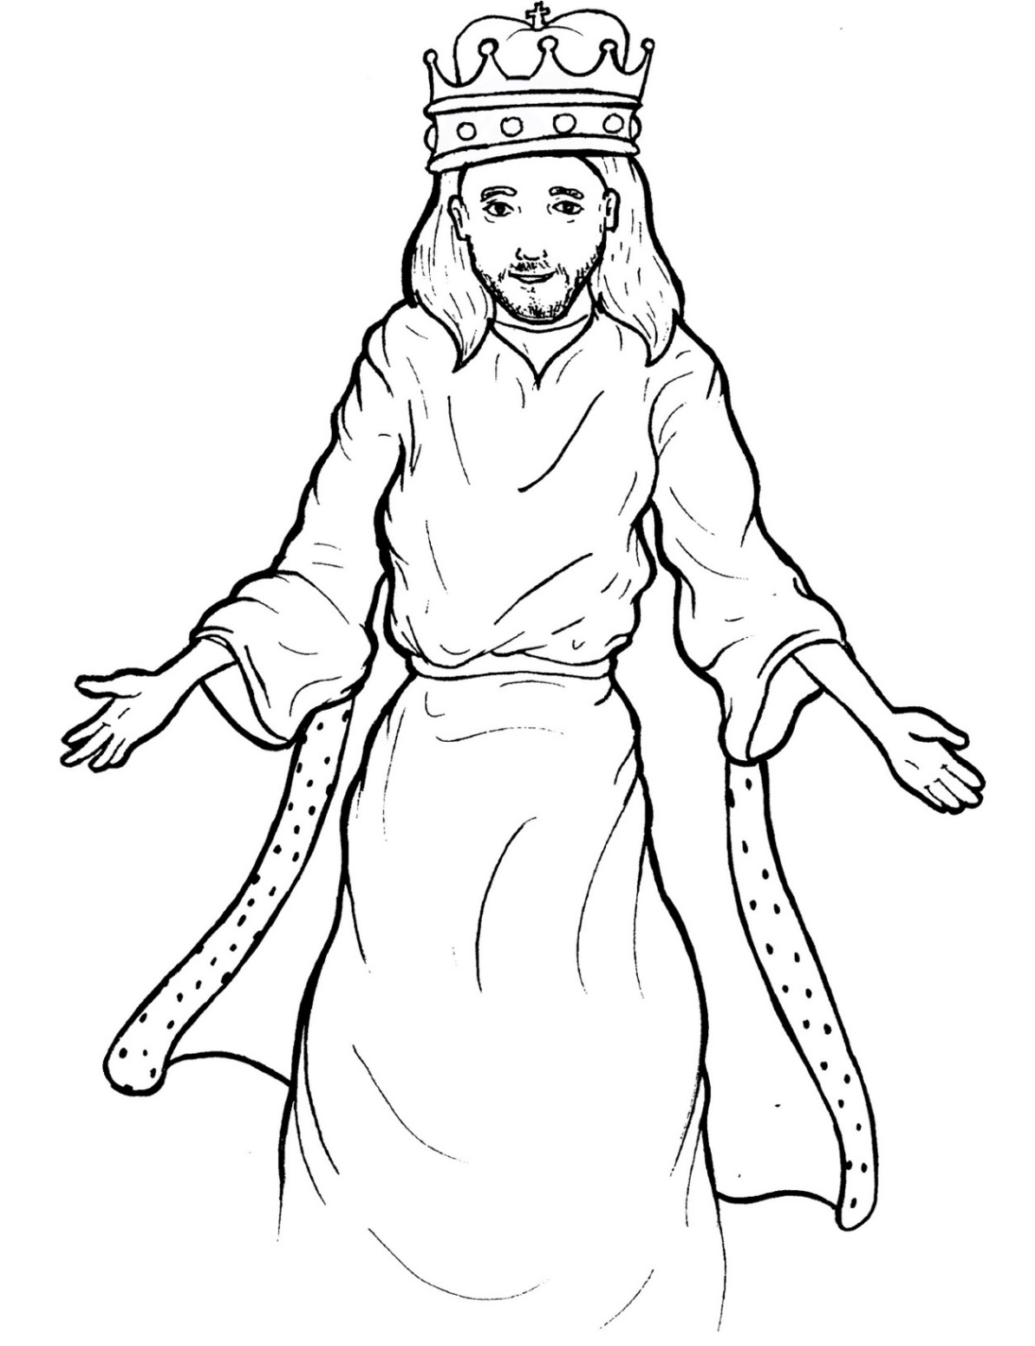
Part 1
45. Jesus Lives as King
Syllable Charts

Slide 2
Words in Syllable Types

Slide 3
Closed – Short Vowel
A closed syllable has one vowel
followed by one or more consonants,
and the vowel is short.
st
o
p
˘

Slide 4
Timing
Box
at
am
and
hand

Slide 5
Timing
Box
left
-en
yes
-men

Slide 6
Timing
Box
end
-ven
ev-
-gels
-est

Slide 7
Timing
Box
lift
-it
wis-
-gin-
sits
-ship

Slide 8
Timing
Box
fol-
on
God
cross

Slide 9
Timing
Box
up
-sus

Slide 10
Open – Long Vowel
An open syllable has one vowel
with no consonant after it,
and the vowel is long.
−
go

Slide 11
Timing
Box
a men
na tion

Slide 12
Timing
Box
he
re turn
Je sus
e ven

Slide 13
Timing
Box
be ing
be fore
be liever
be ginning

Slide 14
Timing
Box
ho ly
ever y

Slide 15
Timing
Box
I
Bi ble

Slide 16
Timing
Box
sky

Slide 17
Timing
Box
so
o bey
o ver
ho ly

Slide 18
Timing
Box
ru ler

Slide 19
Silent e – Long Vowel
A silent e syllable has one vowel,
followed by one consonant
and a silent e at the end.
The vowel is long.
−
ca
e
v

Slide 20
Timing
Box
came
name
same
stare
place
a maze

Slide 21
Timing
Box
shines
in side

Slide 22
Timing
Box
rose
throne

Slide 23
Vowel Teams – Long Vowel
Many vowel teams follow this rule:
When two vowels get together,
the first one names its letter.
So the first vowel will make its long sound,
and the second vowel is silent.
−
e
a
t

Slide 24
Timing
Box
say
day
way

Slide 25
Timing
Box
rain bow

Slide 26
Timing
Box
they
o bey

Slide 27
Timing
Box
knee
three

Slide 28
Timing
Box
be liev er

Slide 29
Timing
Box
peo ple

Slide 30
Timing
Box
right
bright
high est

Slide 31
Timing
Box
died
skies

Slide 32
Timing
Box
rain bow
fol low er

Slide 33
Timing
Box
soon

Slide 34
Vowel Teams – Other Sounds
Sometimes vowel teams make other sounds.
oil

Slide 35
Timing
Box
clouds
mouth

Slide 36
Timing
Box
now
bow

Slide 37
Timing
Box
heav en

Slide 38
Timing
Box
stood
look

Slide 39
R - Controlled
R-controlled syllables have one or more vowels
followed by an “r.”
The “r” changes the sound of the vowel.
o
r
ange

Slide 40
Timing
Box
per son
o ver
ru ler
ev er y

Slide 41
Timing
Box
believ er
follow ers

Slide 42
Timing
Box
re turn

Slide 43
Timing
Box
or
Lord

Slide 44
Timing
Box
be fore

Slide 45
Timing
Box
Spir it

Slide 46
Timing
Box
com fort

Slide 47
Timing
Box
wor ship

Slide 48
Consonant – l-e
When you see consonant l-e at the end of a word,
count back three.
The “l-e” makes the /–le/ sound.
pur
p
l
e

Slide 49
Timing
Box
Bi ble

Slide 50
Timing
Box
peo ple

Slide 51
Other Sounds – -nk/-ng
The “-nk” and “-ng”
change the sound of the vowel.
bank
thing

Slide 52
Timing
Box
king
be ing
begin ning
com ing

Slide 53
Timing
Box
ang els

Slide 54
Other Sounds – endings
-tion, -sion, -cian, -tian
action
mission

Slide 55
Timing
Box
nation

Slide 56
Other Sounds – schwa
The schwa syllable has an “a” that sounds
like the /u/ in banana.
The banana is even shaped like a short u.
ba nan a

Slide 57
Timing
Box
a bove
a mazed

Slide 58
Timing
Box
Son
a bove
per son

Slide 59
Timing
Box
wis dom
com ing
com fort

