Slide 1
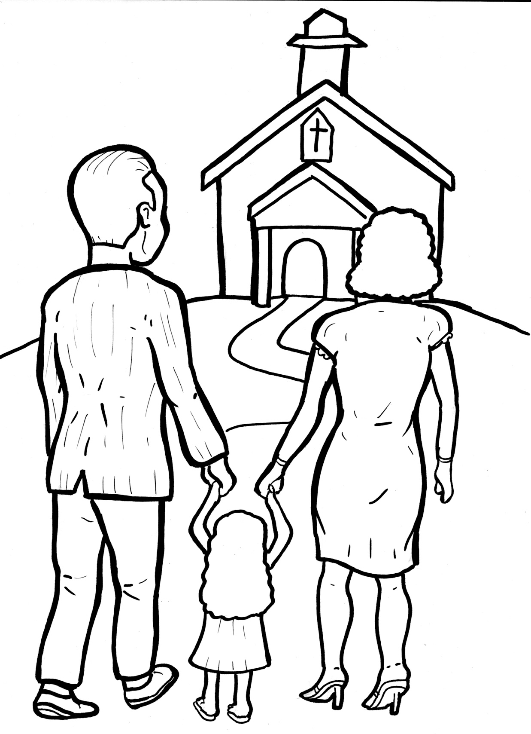
Timing
Box
52. I Am Alive: Church
Part 5
Vocabulary
Original Bible Story

Slide 2
Vocabulary
Timing
Box

Slide 3
Timing
Box
steadfastly
(STEAD - fast - ly):
constant, continuing

Slide 4
Timing
Box
possesions
(po - SSES - sions):
things a person owns

Slide 5
Timing
Box
distribute
(dis – TRIB - ute):
to give things to others

Slide 6
Timing
Box
breaking of bread
(break) (bread):
communion: Christians
remember the death of
Jesus by sharing bread

Slide 7
Timing
Box
singleness of heart
(SING - le):
everyone feeling the same way

Slide 8
Timing
Box
prevail
(pre - VAIL):
to win over

Slide 9
Timing
Box
I am Alive: Church
Acts 2:41-47; Matthew 16:8b; 18:20
World English Bible (WEB)

Slide 10
Timing
Box
Jesus said, “For where two or three are gathered
together in my name, there I am in the middle of
them.”

Slide 11
Timing
Box
Then those who gladly received his word were
baptized.
There were added that day about three
thousand souls.

Slide 12
Timing
Box
They continued steadfastly in the apostles’
teaching and fellowship, in the breaking
of bread, and prayer.

Slide 13
Timing
Box
Fear came on every soul, and many wonders
and signs were done through the apostles.

Slide 14
Timing
Box
All who believed were together and had all
things in common.

Slide 15
Timing
Box
They sold their possessions and goods, and
distributed them to all, according as anyone
had need.

Slide 16
Timing
Box
Day by day, continuing steadfastly with one
accord in the temple, and breaking bread
at home, …

Slide 17
Timing
Box
…they took their food with gladness and
singleness of heart, praising God, and having
favor with all people.

Slide 18
Timing
Box
The Lord added to the assembly day by day
those who were being saved.

Slide 19
Timing
Box
Jesus said, “I will build my church, and the
gates of hell will not prevail against it.”

