Slide 1
Sad, Old Sarah
Genesis 18:1-15; 21:1-7
Part 4 ...GO!...Read
Story in Easy Read English
Fluency Builder

Slide 2
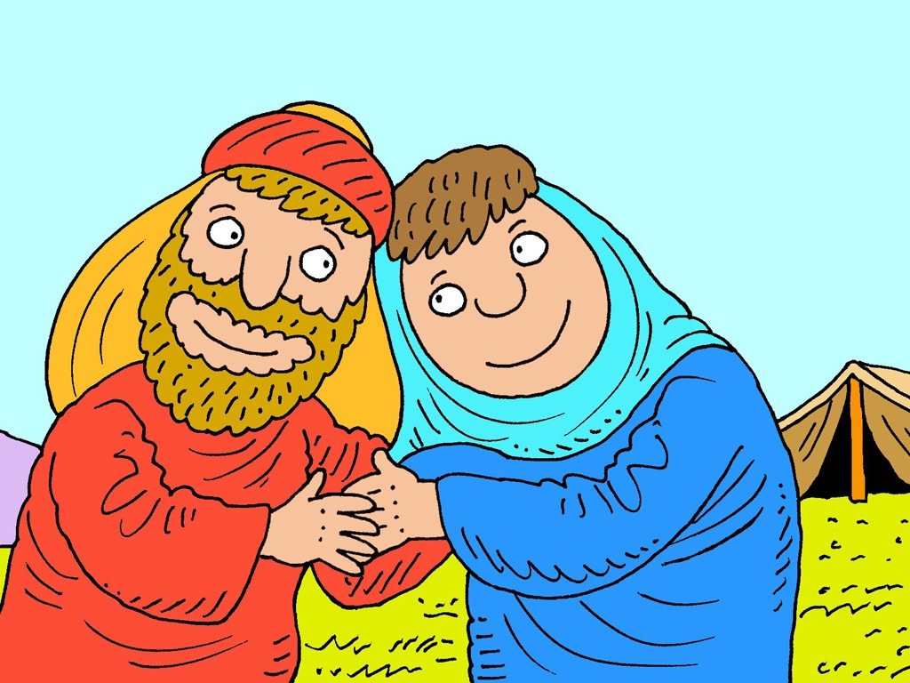
I love you.

Slide 3
I love you too.
But I am sad.

Slide 4
I wish I had a baby to hold.

Slide 5
I wish we had a baby too.

Slide 6
But...when?
I am too old.
I am 99.

Slide 7
I am too old too.
I am 90.

Slide 8
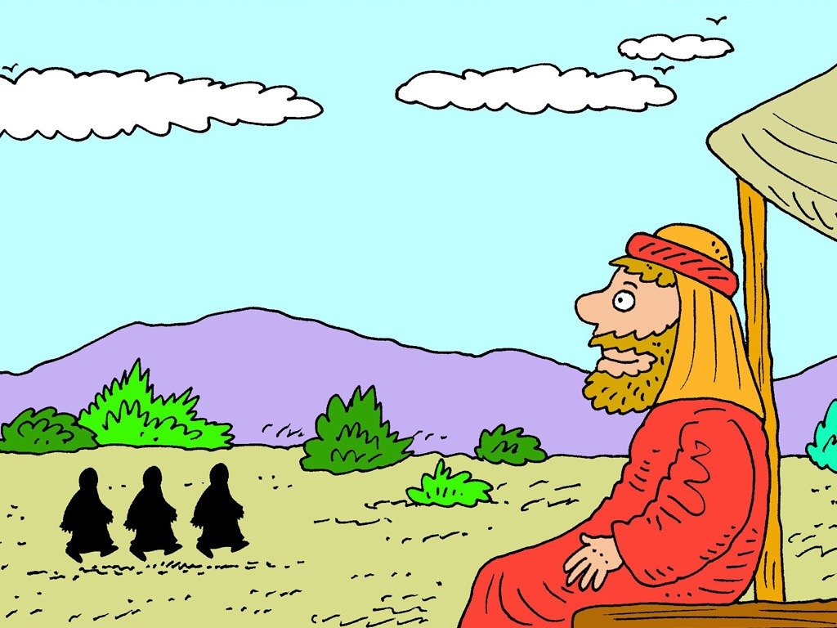
“I see three men," he told her.
The
men came from God.

Slide 9
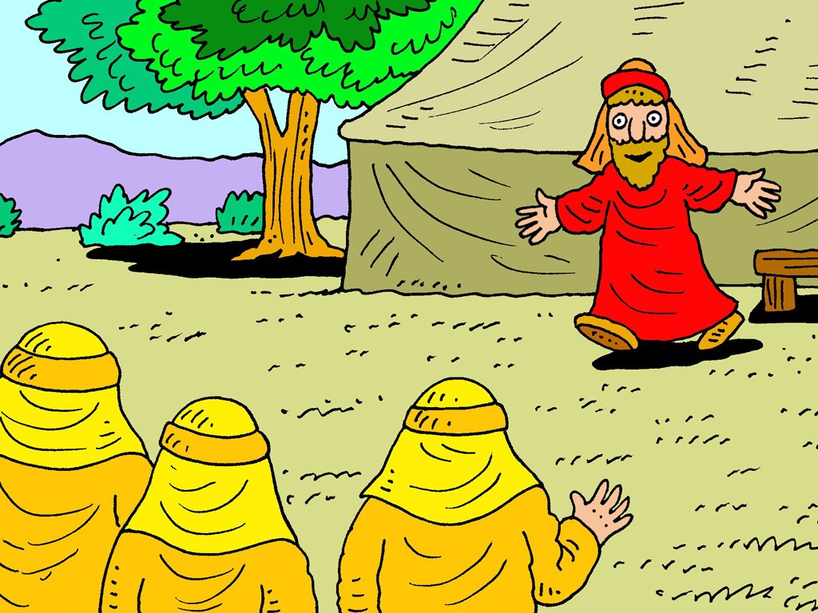
Come. Sit by the tree. It is hot.

Slide 10
Quick, we have some men.

Slide 11
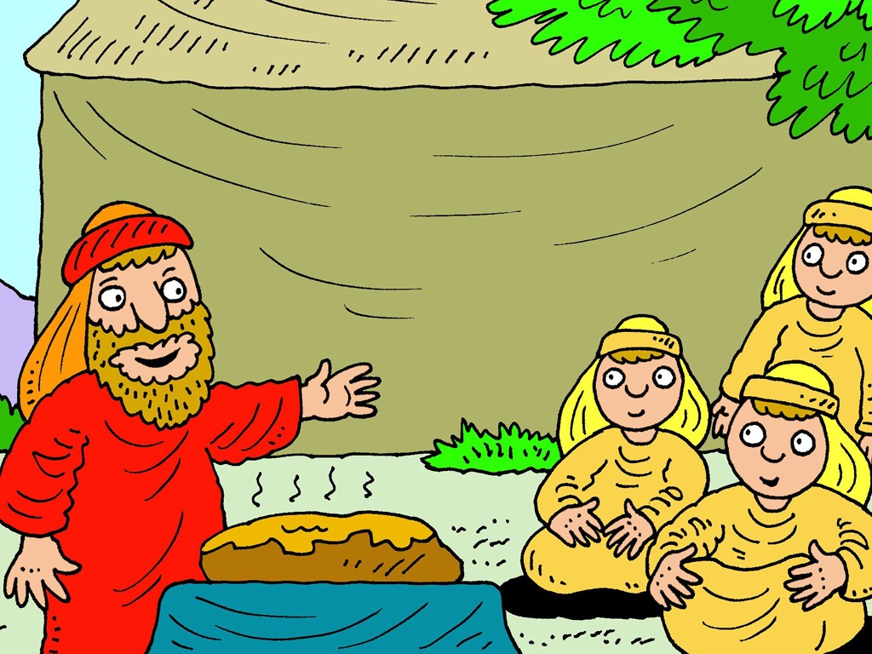
Get some bread.

Slide 12
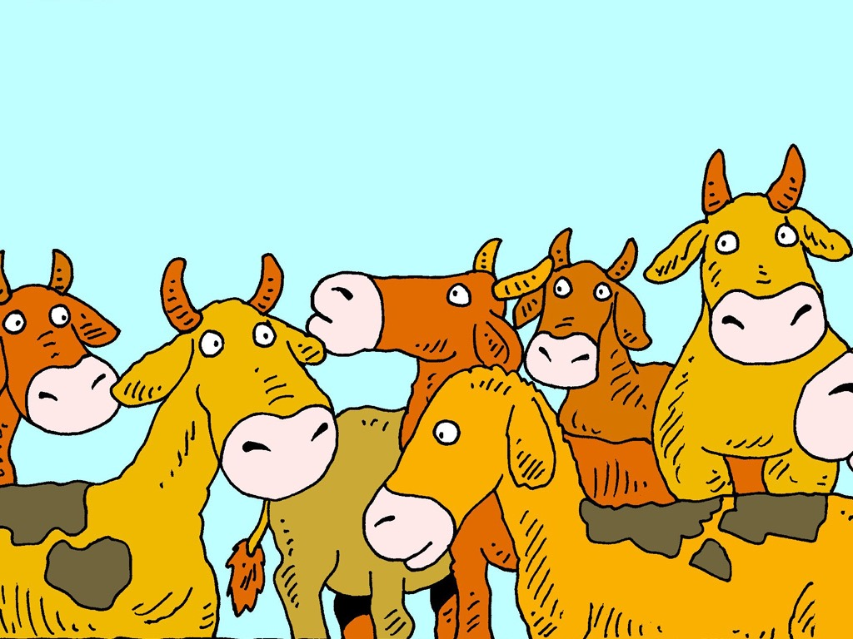
Get much milk for them.
Get some cups too.

Slide 13
We will tell you something good.

Slide 14
Sarah will have a baby.

Slide 15
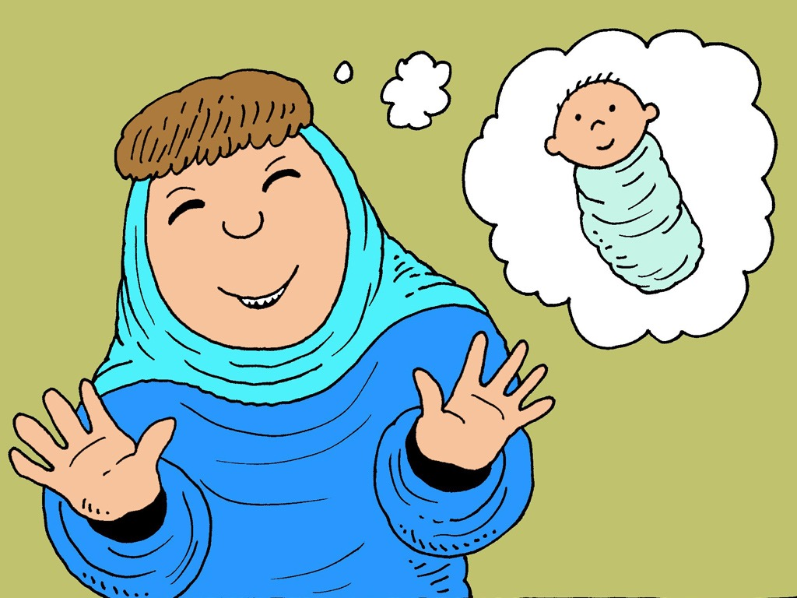
No. No. Not me. I am too old.

Slide 16
Why did Sarah laugh?

Slide 17
"God can do this," he told her.

Slide 18
I did not laugh.

Slide 19
Yes, you did.

Slide 20
"Yes, I did,"
she told him.
Will God still give me a baby?

Slide 21
Yes,
God will still give you a baby.

Slide 22
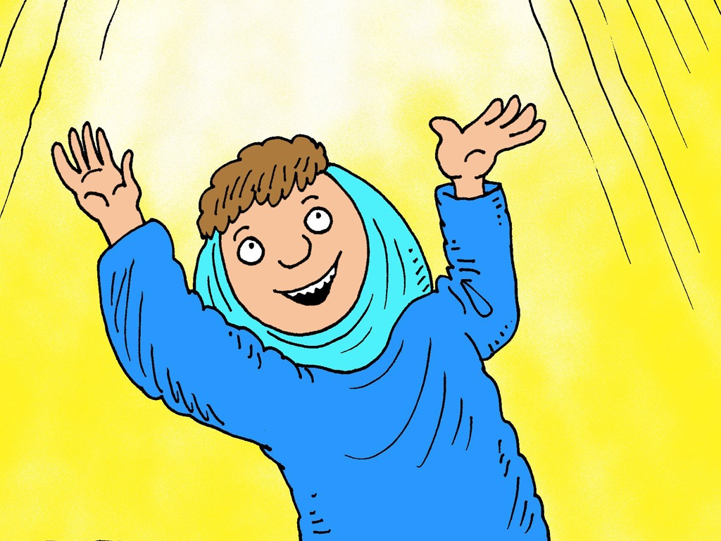
God is good!
God is good to me.

Slide 23
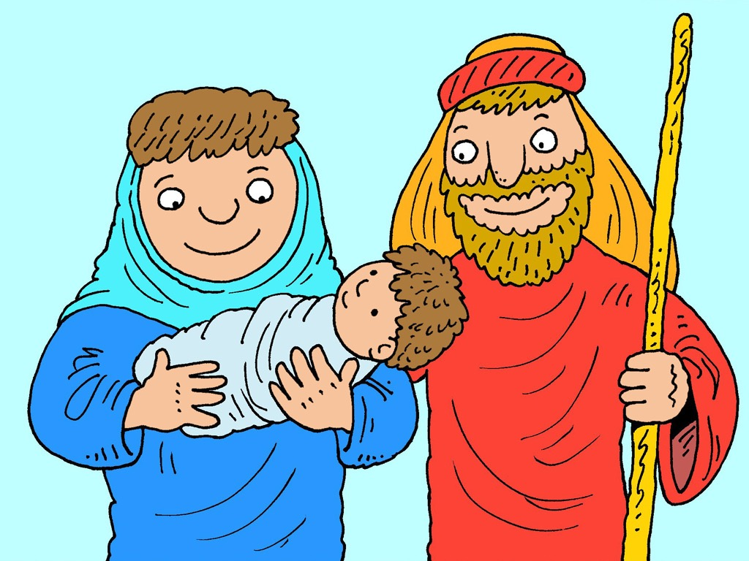
Sarah did have a baby.
She had a baby to hold.

Slide 24
I am a mom!
She was glad.

Slide 25
I am
the dad!
Her husband was glad too.

Slide 26
The baby laughed too...
...goo, goo!

Slide 27
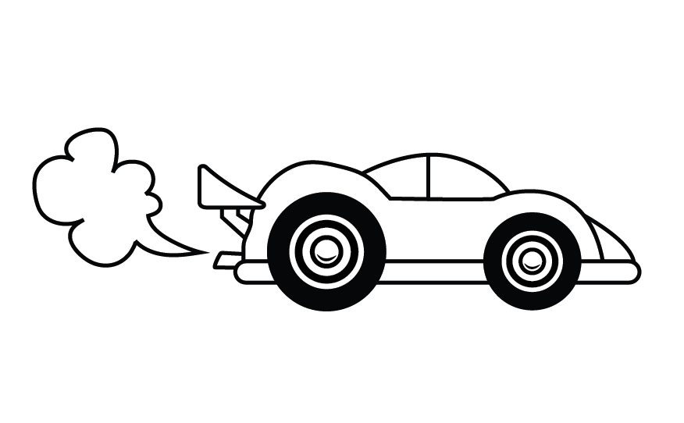
Part 4
GO! READ
Story in Easy Read English
Fluency Builder

Slide 28
Sad, Old Sarah
Genesis 18:1-15; 21:1-7

Slide 29
I love you.
I love you too. BUT, I am sad.

Slide 30
I wish I had a baby to hold.

Slide 31
I wish we had a baby too.

Slide 32
BUT...when?
I am too old. I am 99.

Slide 33
I am too old too. I am 90.

Slide 34
"I see three men," he told her.

Slide 35
The men came from God.

Slide 36
Come. Sit by the tree.
It is hot.

Slide 37
Quick, we have some men.

Slide 38
Have some bread.

Slide 39
Get much milk for them.
Get some cups too.

Slide 40
We will tell you something good.

Slide 41
Sarah will have a baby.

Slide 42
No. No. Not me. I am too old.

Slide 43
Why did Sarah laugh?
"God can do this," he told her.

Slide 44
I did not laugh.
Yes, you did.
"Yes, I did," she told him.

Slide 45
Will God still give me a baby?

Slide 46
Yes. God will still give you a baby.

Slide 47
God is good!
God is good to me.

Slide 48
Sarah did have a baby.
She had a baby to hold.

Slide 49
I am a mom! She was glad.

Slide 50
I am the dad!
Her husband was glad too.

Slide 51
The baby laughed too...
goo, goo!

Slide 52
The End

Slide 53
Story by Carol Hale
www.EasyReadEnglish.com
With many thanks to
www.FreeBibleImages.org
and
Richard Gunther for his
amazing illustrations.
www.RichardGunther.org

