Slide 1


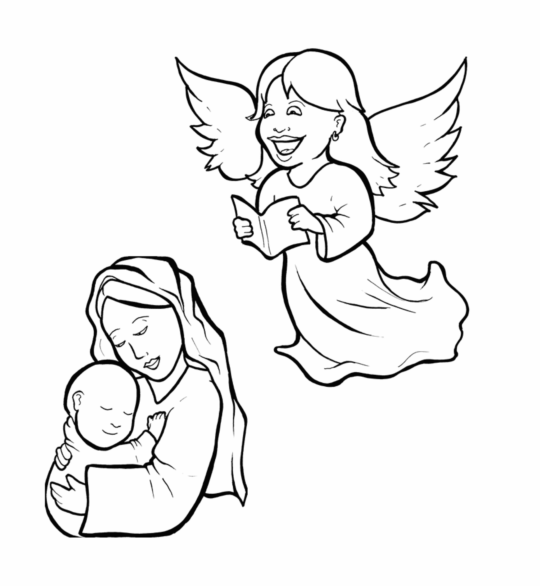
1.Will Mary Say Yes to God?
Part 3
Syllable Divisions

Slide 2
Dividing Words
Into Syllable Types

Slide 3
Rabbit Words
When you see two consonants
between two vowels,
divide between the consonants.
ra it
bb
rab bit

Slide 4
hap py
happy

Slide 5
won der ful
wonderful

Slide 6
im pos si ble
impossible

Slide 7
Tiger Words
When you see one consonant
between two vowels,
divide after the first vowel.
Try this pattern first.
ti er
g
ti ger

Slide 8
Je sus
Jesus

Slide 9
Jo seph
Joseph

Slide 10
o beyed
obeyed

Slide 11
re joice
rejoice

Slide 12
ba by
baby

Slide 13
Ho ly
Holy

Slide 14
o ver
over

Slide 15
Ga bri el
Gabriel

Slide 16
Camel Words
When you see one consonant
between two vowels,
divide after the first consonant.
Try this pattern second.
ca el
m
cam el

Slide 17
Naz a reth
Nazareth

Slide 18
nev er
never

Slide 19
Spir it
Spirit

Slide 20
Turtle Words
When you see consonant-l-e,
count back three and divide.
tur
t
l
e
tur tle

Slide 21
im pos si ble
impossible

Slide 22
Lion Words
If a word has two vowels together
that make two different sounds,
divide between the two vowels.
lion
li on

Slide 23
Ga bri el
Gabriel

Slide 24

Anteater Words
These compound words are made up of two smaller words.
ant
eater
1
2
ant eater

Slide 25
up set
upset

Slide 26
no thing
nothing

Slide 27
in side
inside

Slide 28

Foxes Suffixes
Focus on your base word.
fox es
fox es

Slide 29
wonder ful
wonder ful

Slide 30
blessed
blessed

Slide 31
asked
asked

Slide 32
obeyed
obeyed

Slide 33
called
called

Slide 34
king dom
kingdom

Slide 35
go ing
going

Slide 36
might y
mighty

Slide 37
Other Syllable Divisions
Some words don’t fit so neatly
into standard syllable division patterns.
a way
away

Slide 38
a bout
about

Slide 39
a fraid
afraid

Slide 40
Naz a reth
Nazareth

Slide 41
marr ied
married

