Slide 1
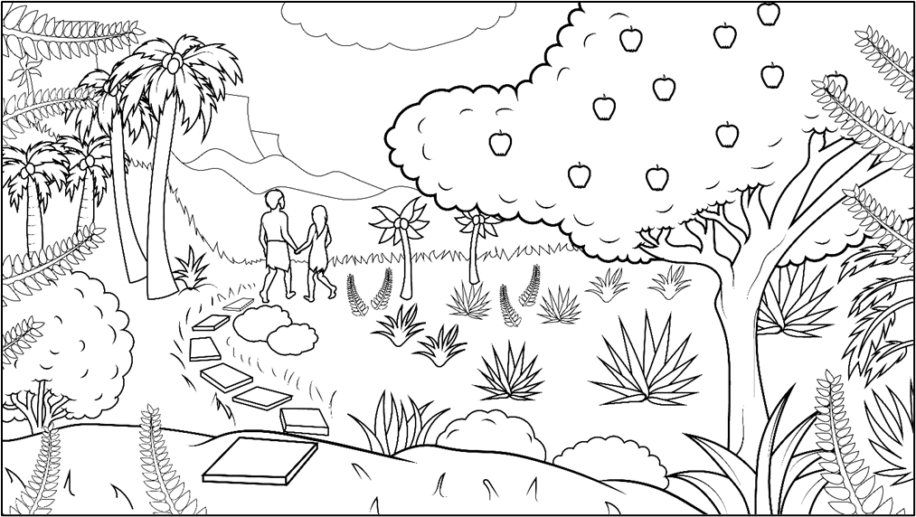
1.1 Story: Bad, Mad, Sad
Genesis 2:15-17;
3:1-13, 21-24
(Adam and Eve,
Part One)

Slide 2
New Words to Read
am, Adam
mad, sad, bad, had
an, man
at

Slide 3
Rule Breakers
the
to, do

Slide 4
Sight Words
I
not
and

Slide 5
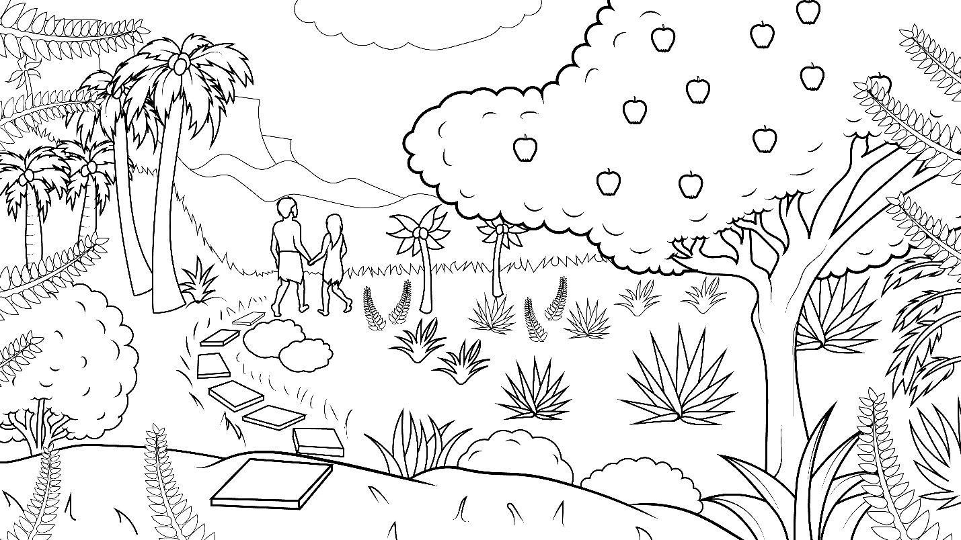
1.1 Bad, Mad, Sad
I Read, You Read Bible
Story

Slide 6
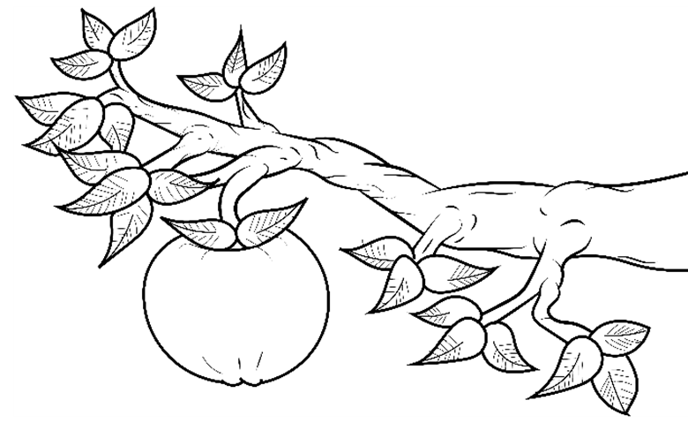
God said, “Do not have an apple.”

Slide 7
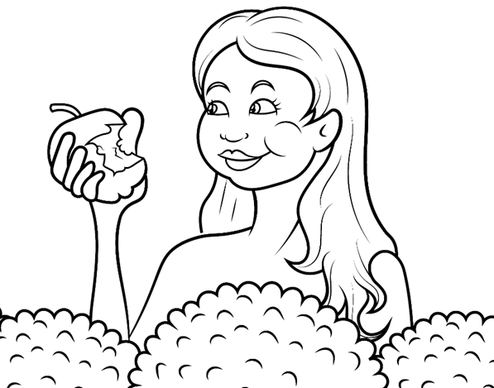
But the woman
had an
apple.

Slide 8
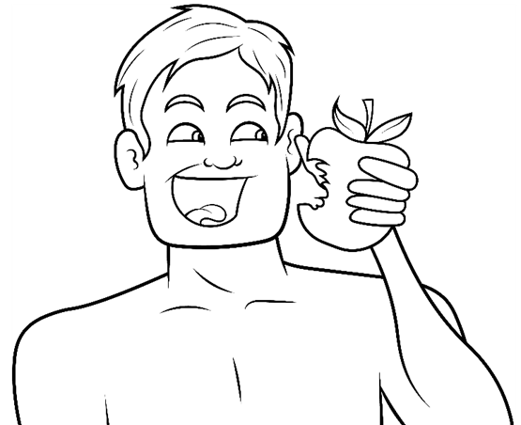
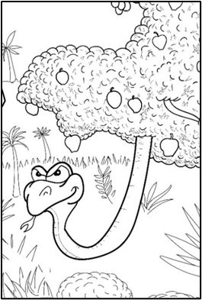
And the man had an apple too.

Slide 9
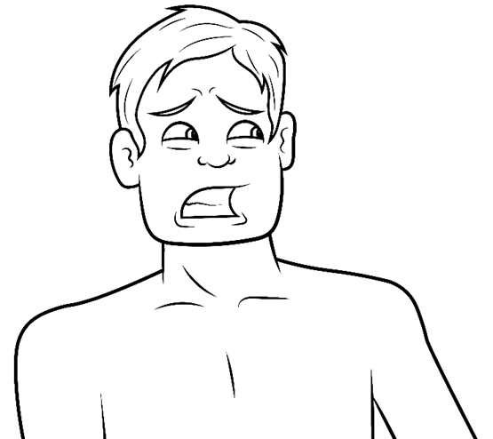
God said, “Oh, no. That is bad, bad, bad.”

Slide 10
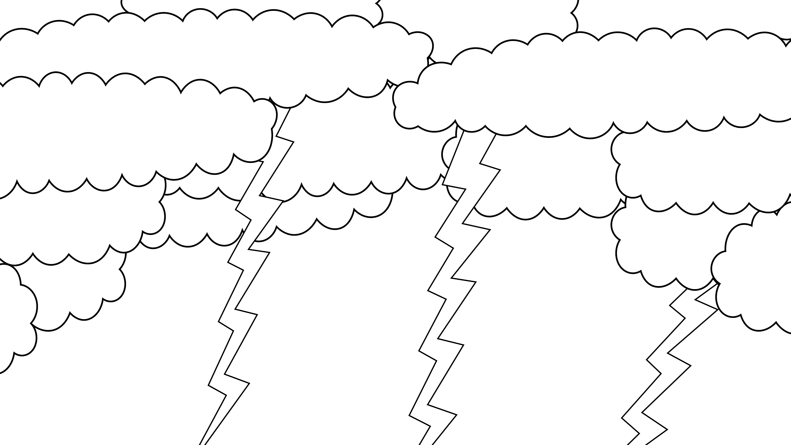
I am mad. I am mad at Adam.”

Slide 11
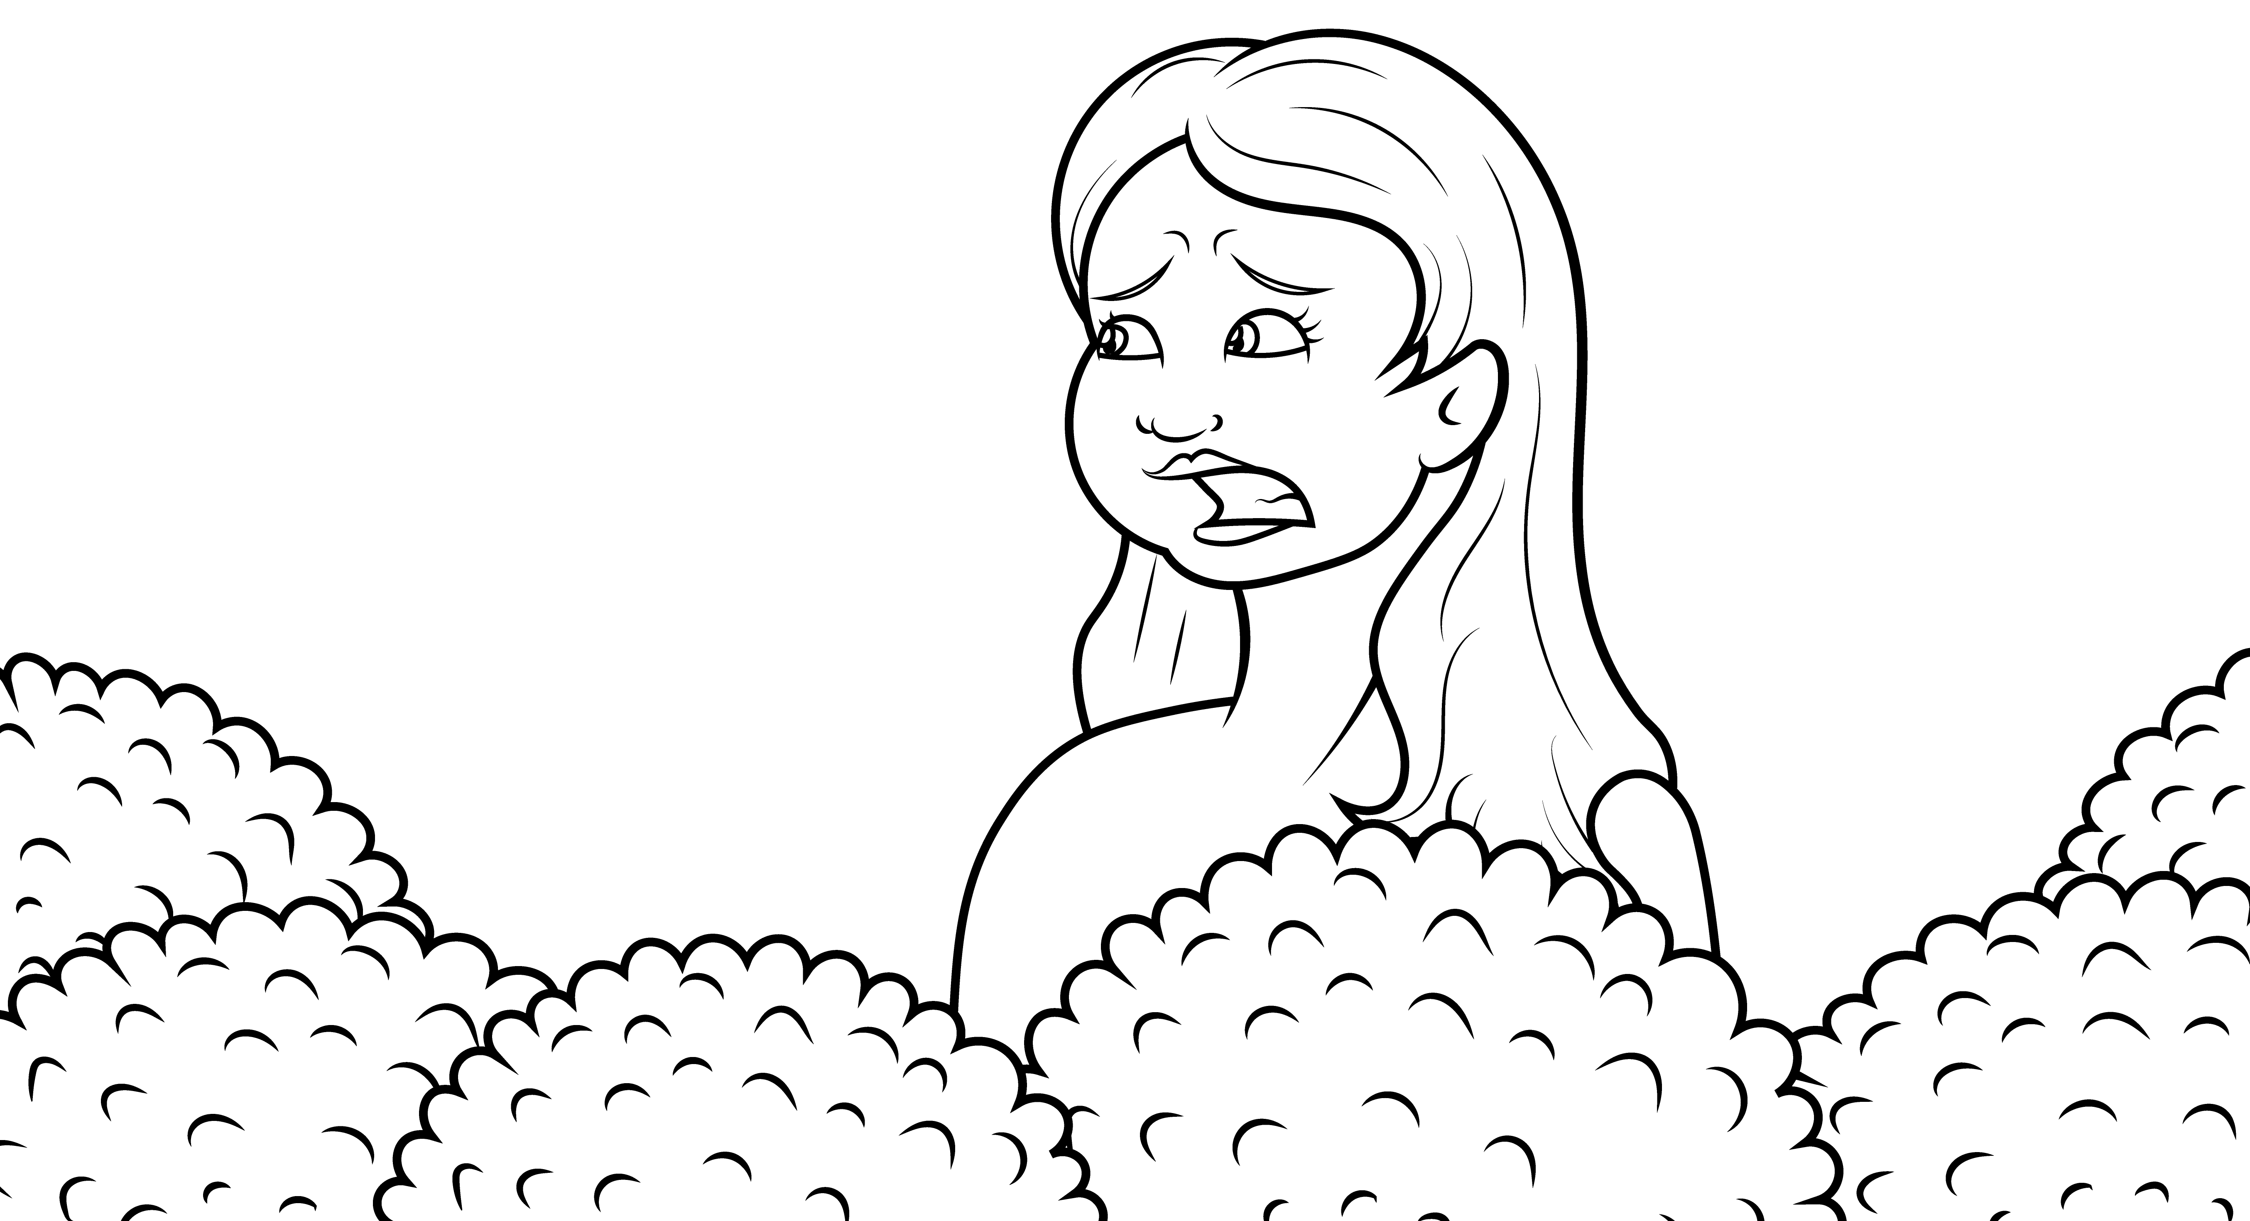
I am mad at
Eve.
I am sad.

Slide 12
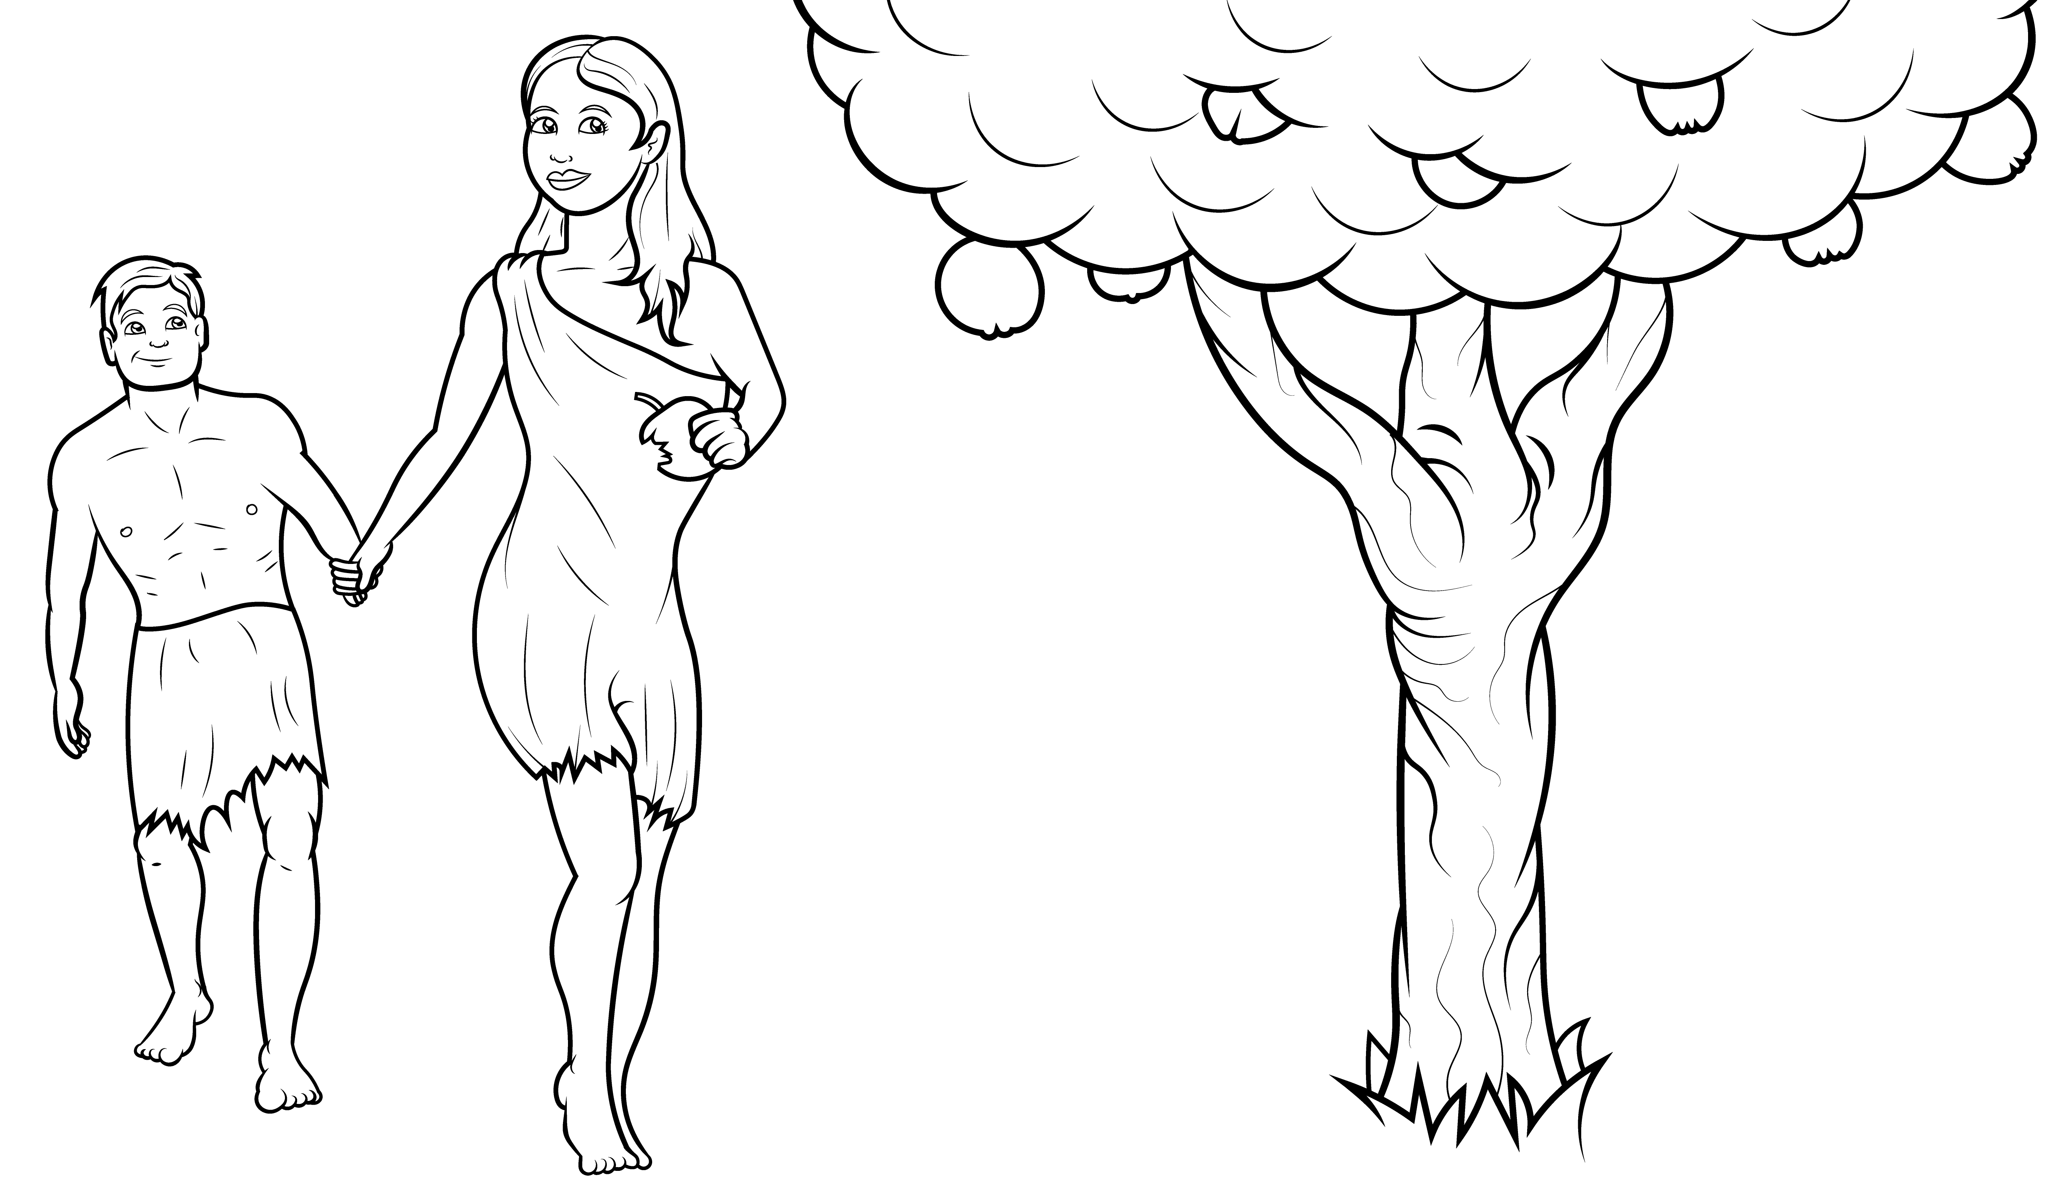
So, they
had to
go.

Slide 13
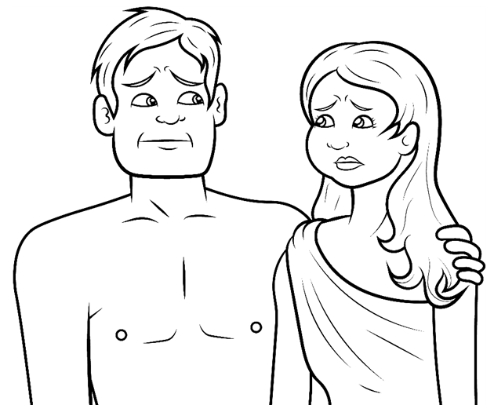
They were bad, and
so God was mad and sad.

Slide 14
And now they were all sad.

Slide 15
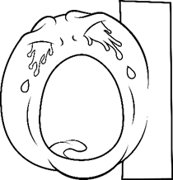
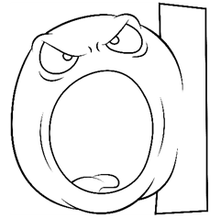
Sin makes us bad, mad, and sad.
s
b
d
m
d
d

Slide 16
The End

Slide 17
1.1 Story Without Illustrations
Bad, Mad, Sad

Slide 18
God said, “Do not have an apple.”
But the woman had an apple.
And the man had an apple too.

Slide 19
God said, “Oh, no. That is bad, bad,
bad. I am mad. I am mad at Adam.”

Slide 20
“I am mad at Eve. I am sad.”
So, they had to go.

Slide 21
They were bad, and so
God was mad and sad,
and now they were all sad.

Slide 22
Sin makes us bad, mad, and sad.

Slide 23
The End

