Slide 1
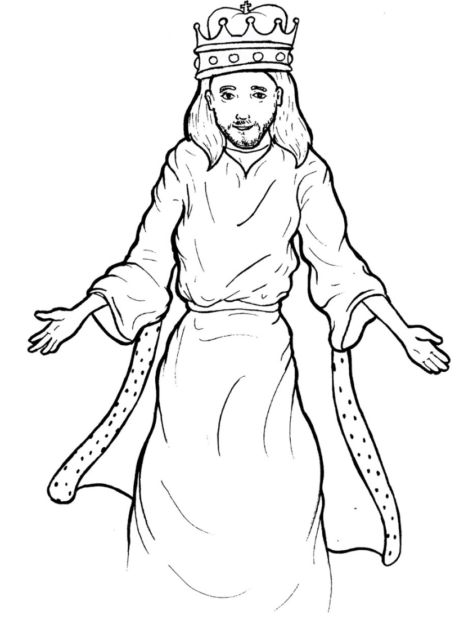
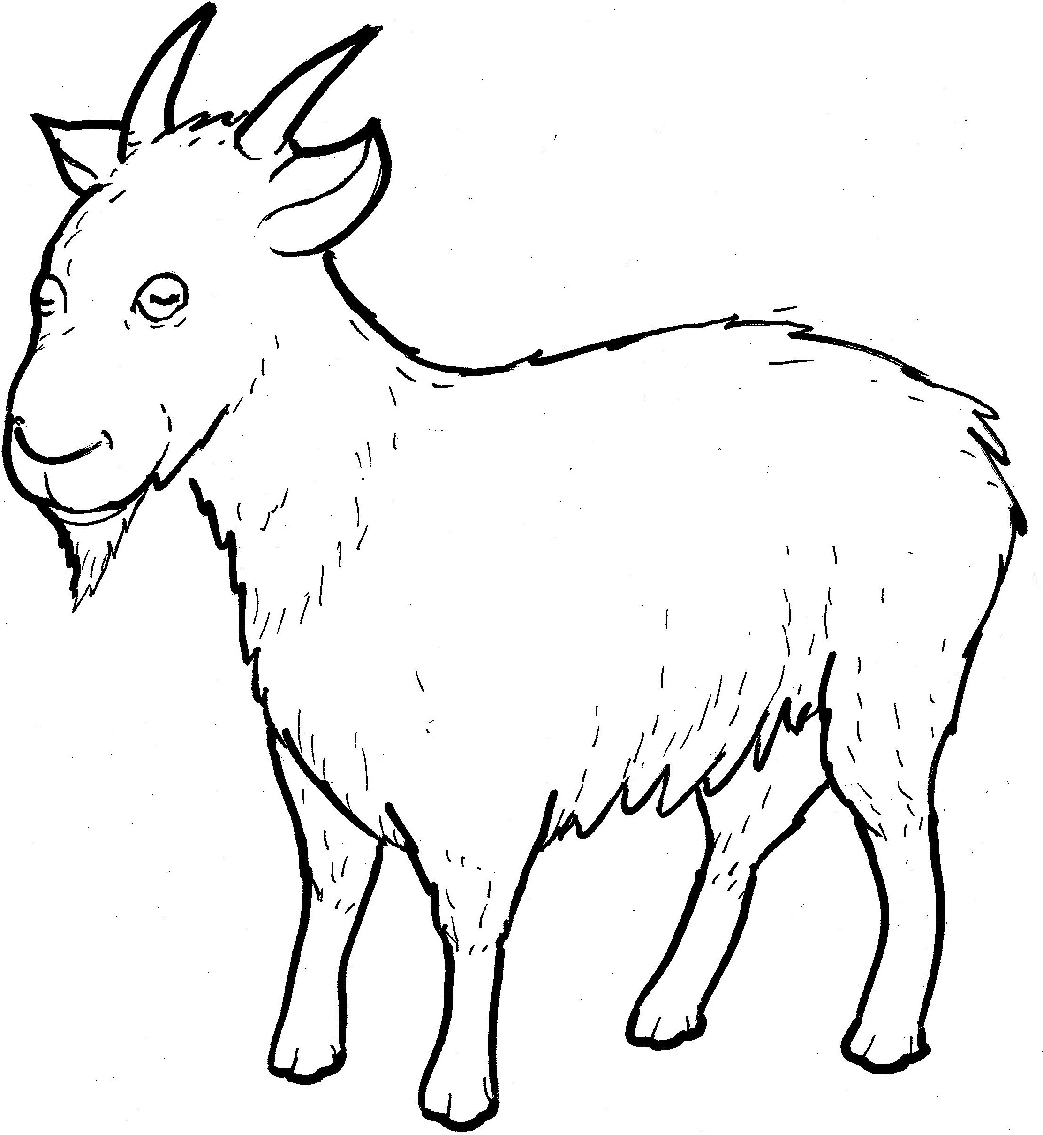
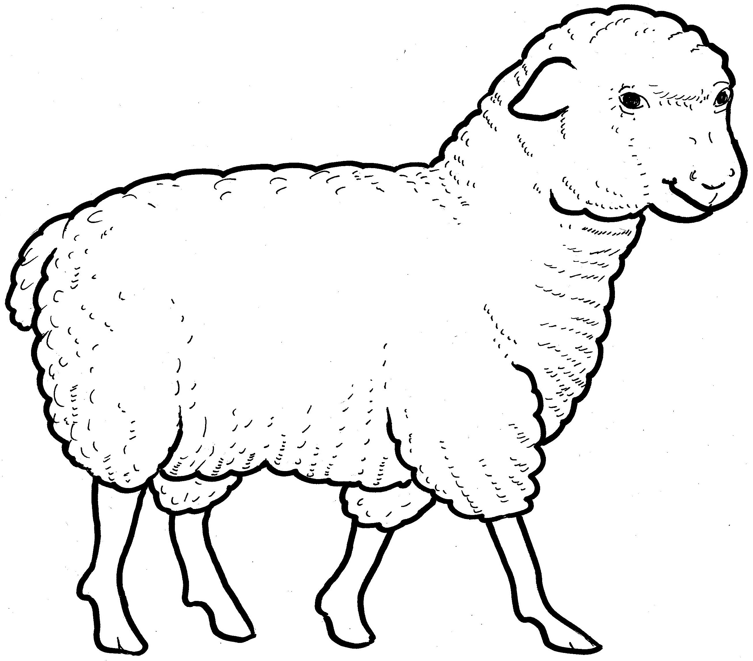
Part 2
27. The Sheep and Goats
New Words
Rule Breakers

Slide 2
Other Sounds – Soft G
ge, gi, gy often make the soft sound
gentle
giant
gym

Slide 3
Timing
Box
angels
strangers

Slide 4
New Words
prison
punishment
stranger

Slide 5
Rule Breakers
Words like these do not follow phonetic patterns.
to
you
said
could
two
f
from

Slide 6
to
the
of
put
his
was

Slide 7
who
what
you
from
ones
said

Slide 8
come
brothers
clothes
something
angels

