Slide 1
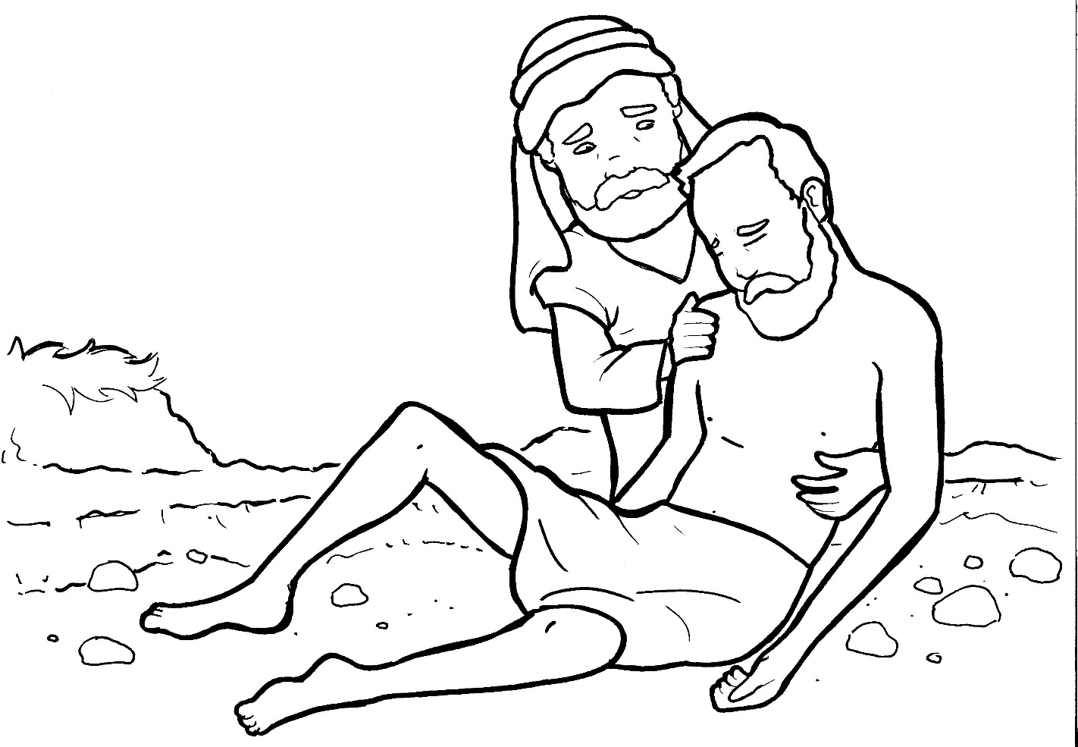
Part 2
25. The Good Samaritan
New Words
Rule Breakers

Slide 2
Silent letters
neighbor

Slide 3
New Words
Jericho
Samaritan
priest
neighbor

Slide 4
Rule Breakers
Words like these do not follow phonetic patterns.
to
you
said
could
two
f
from

Slide 5
is
do
his
who
was
to

Slide 6
of
there
said
put
the
clothes

Slide 7
other
Jericho
money
walked

