Slide 1

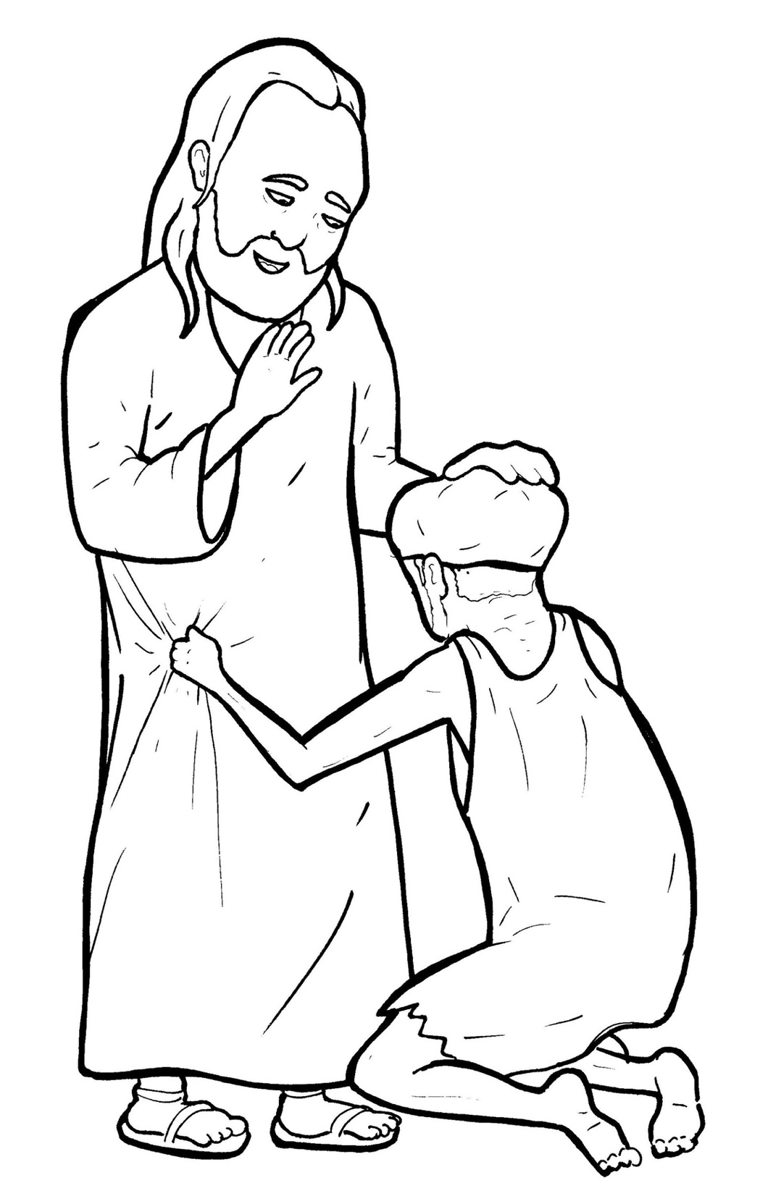
Part 5
31. A Blind Man Asks to See
Vocabulary
Original Bible Story

Slide 2

Vocabulary

Slide 3
multitude
(MUL - ti - tude)
a crowd

Slide 4
mercy
(MER - cy)
kindness

Slide 5
rebuke
(re - BUKE)
to scold

Slide 6
receive
(re - CEIVE)
to accept something
(get)

Slide 7
immediately
(im - ME - di - ate - ly)
right away

Slide 8
glorify
(glor - i - FY)
to praise

Slide 9
A Blind Man
Asks to See
Luke 18:35-43
World English Bible (WEB)

Slide 10
As he came near Jericho,
a certain blind man sat
by the road, begging.

Slide 11
Hearing a multitude going by,
he asked what this meant.

Slide 12
They told him that Jesus
of Nazareth was passing by.

Slide 13
He cried out,
“Jesus, you son of David,
have mercy on me!”

Slide 14
Those who led the way
rebuked him,

Slide 15
that he should be quiet;
but he cried out all the more,

Slide 16
“You son of David,
have mercy on me!”

Slide 17
Standing still, Jesus commanded
him to be brought to him.

Slide 18
When he had come near,
he asked him,
“What do you want me to do?”

Slide 19
He said,
“Lord, that I may see again.”

Slide 20
Jesus said to him,
“Receive your sight.

Slide 21
Your faith has healed you.”

Slide 22
Immediately he received
his sight and followed him,
glorifying God.

Slide 23
All the people,
when they saw it,
praised God.

