Slide 1
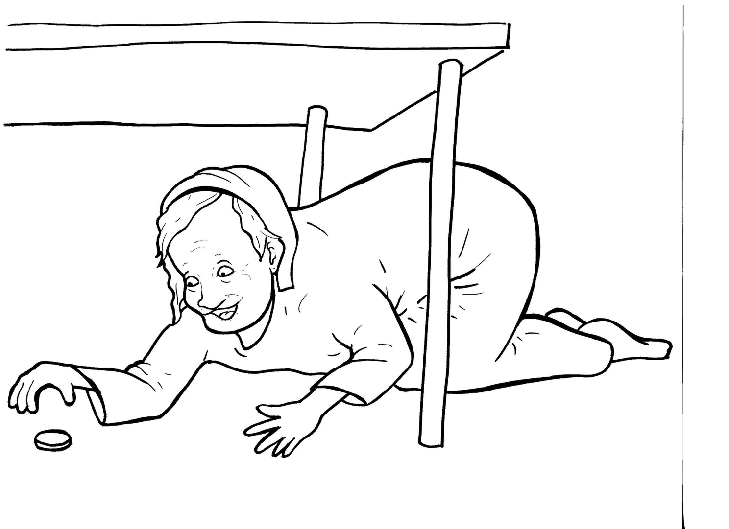
Part 4
23. The Lost Coin
Story in Easy Read English
Questions
Story in Phrases

Slide 2
Jesus told a story about money that
was missing.

Slide 3
A woman had ten silver coins, but she
lost one.

Slide 4
What will she do?

Slide 5
Will she forget about it?
No way.

Slide 6
Will she look for it?
Yes!

Slide 7
She will light a lamp to help her see.

Slide 8
She will sweep every corner of her
house.

Slide 9
That woman will search until she
finds her one special coin.

Slide 10
When she finds it, she will call her
friends and her neighbors.

Slide 11
“Rejoice with me!” she will shout.
“I have found my lost coin.”

Slide 12
In the same way, there is joy in
heaven when one sinner repents
and is found.

Slide 13
The angels throw a huge party when
each sinner is sorry, …

Slide 14
… turns from sin, and comes home
to God.

Slide 15
Question 1
What did the woman do when she found her lost coin?

Slide 16
Question 2
The woman in the story is like God who searches for the lost. How are people like the lost coin?

Slide 17
Question 3
Do you know someone who has just come to God? How can you rejoice with him or her?

Slide 18
Question 4
Have you been found by God? When did you repent and come home to Jesus?

Slide 19
Prayer
Dear Jesus,
You never forget us. You look until you find us. We only need to repent. I am sorry for my sins and want to come home to your loving arms.
Amen

Slide 20
The Lost Coin
Phrased for Fluency

Slide 21
Jesus
told a story
about money
that was missing.

Slide 22
A woman
had
ten silver coins,
but
she lost one.

Slide 23
What will she do?

Slide 24
Will she
forget about it?
No way.

Slide 25
Will she
look for it?
Yes!

Slide 26
She will
light a lamp
to help her see.

Slide 27
She will sweep
every corner
of her house.

Slide 28
That woman
will search
until she finds
her one
special coin.

Slide 29
When she finds it,
she will call
her friends
and her neighbors.

Slide 30
“Rejoice
with me!”
she will shout.

Slide 31
my lost coin.”
“I have found

Slide 32
In the same way,
there is joy
in heaven
when one sinner repents
and is found.

Slide 33
The angels
throw
a huge party…

Slide 34
…when each sinner is sorry,
turns from sin,
and comes
home to God.

