Slide 1

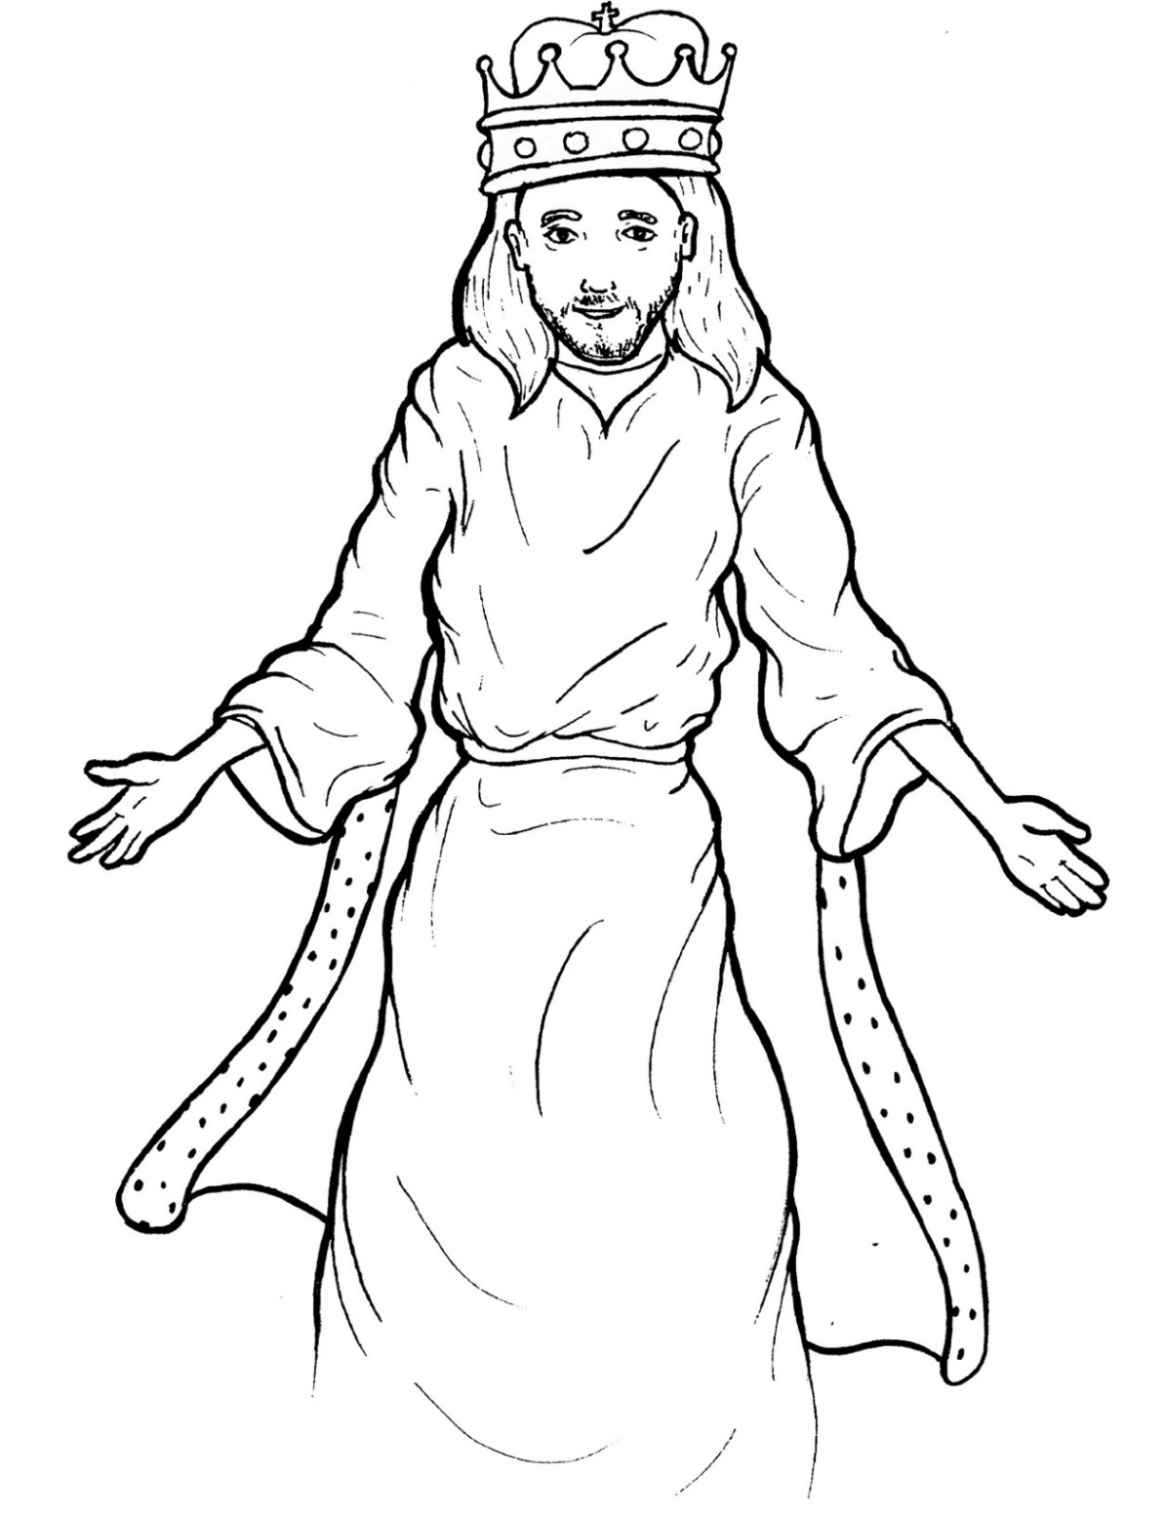
Part 3
45. Jesus Lives as King
Syllable Divisions

Slide 2

Dividing Words
Into Syllables

Slide 3
Rabbit Words
When you see two consonants
between two vowels,
divide between the consonants.
ra it
bb
rab bit

Slide 4
per son
person

Slide 5
com fort
comfort

Slide 6
wis dom
wisdom

Slide 7
be gin ning
beginning

Slide 8
fol low er
follower

Slide 9
Tiger Words
When you see one consonant
between two vowels,
divide after the first vowel.
Try this pattern first.
ti er
g
ti ger

Slide 10
na tion
nation

Slide 11
e ven
even

Slide 12
be gin
begin

Slide 13
re turn
return

Slide 14
Je sus
Jesus

Slide 15
be fore
before

Slide 16
be liev er
believer

Slide 17
o bey
obey

Slide 18
o ver
over

Slide 19
Ho ly
Holy

Slide 20
a men
amen

Slide 21
Camel Words
When you see one consonant
between two vowels,
divide after the first consonant.
Try this pattern second.
ca el
m
cam el

Slide 22
ev er y
every

Slide 23
heav en
heaven

Slide 24
Turtle Words
When you see consonant-l-e,
count back three and divide.
tur
t
l
e
tur tle

Slide 25
Bi ble
Bible

Slide 26
peo ple
people

Slide 27
Lion Words
If a word has two vowels together
that make two different sounds,
divide between the two vowels.
lion
li on

Slide 28
be ing
being

Slide 29
Hamster Words
When you see three consonants between two vowels,
divide after the first consonant.
ha
mst
er
ham ster

Slide 30
wor ship
worship

Slide 31

Anteater Words
These compound words are made up of two smaller words.
ant
eater
1
2
ant eater

Slide 32
in to
into

Slide 33
rain bow
rainbow

Slide 34
in side
inside

Slide 35
Other Syllable Divisions
Some words don’t fit so neatly
into standard syllable division patterns.

Slide 36
ang els
angels

Slide 37
a bove
above

Slide 38

Foxes Suffixes
Focus on your base word.
fox es
fox es

Slide 39
skies
skies

Slide 40
high est
highest

Slide 41
be ing
being

Slide 42
com ing
coming

Slide 43
begin ning
beginning

Slide 44
rul er
ruler

Slide 45
follow ers
followers

Slide 46
believ er
believer

Slide 47
lift ed
lifted

Slide 48
died
died

Slide 49
stared
stared

Slide 50
obeyed
obeyed

Slide 51
amazed
amazed

