Slide 1
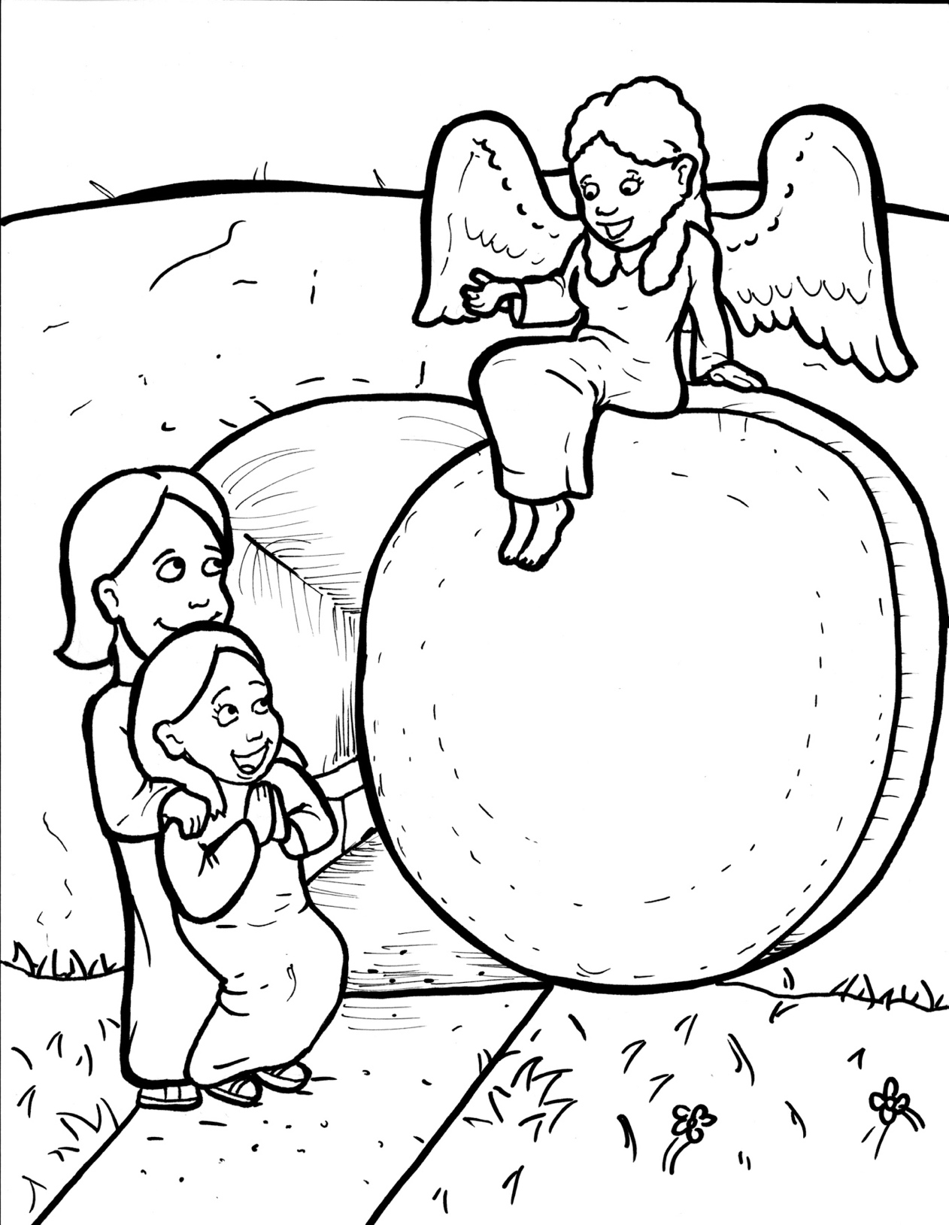
Part 2
41. Jesus is Alive!
New Words
Rule Breakers

Slide 2
Other Sounds – Soft C
ce, ci, cy make the soft sound
cent
city
fancy

Slide 3
spices

Slide 4
disciples

Slide 5
Other Sounds – Soft G
ge, gi, gy often make the soft sound
gentle
giant
gym

Slide 6
huge
angel

Slide 7
Silent Letters
tomb
guards

Slide 8
Contractions
The first word stays the same,
and the apostrophe takes the place
of the missing letters in the second word.
do
n’t
=
do
not

Slide 9
New Words
tomb
worshipped
linens

Slide 10
Rule Breakers
Words like these do not follow phonetic patterns.
to
you
said
could
two
f
from

Slide 11
is
do
as
to
of
you

Slide 12
the
was
his
who
has
were

Slide 13
said
tomb
from
would
been
could

Slide 14
thought
guards
women
they
brothers
full

Slide 15
among
also
don’t
angels
living

