Slide 1
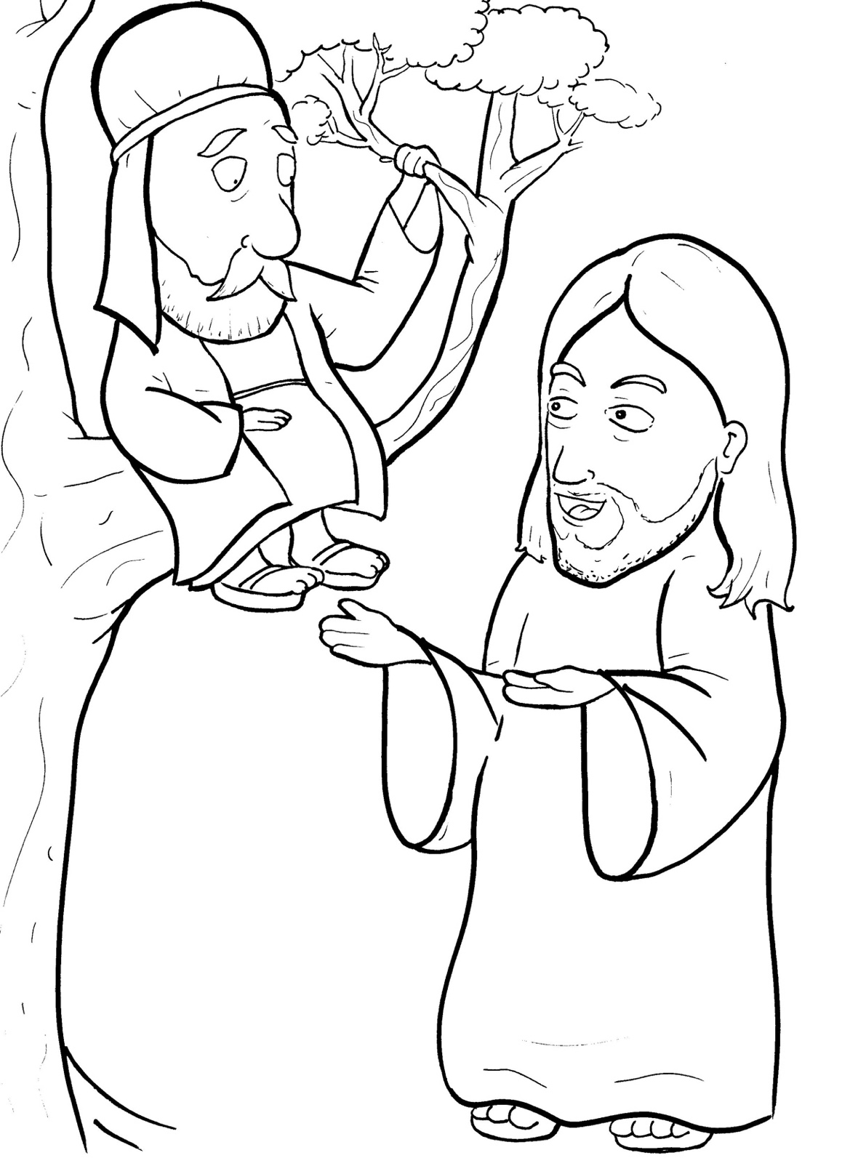
11. Jesus Loves a Short, Bad Man
Part 1
Syllable Charts

Slide 2
Words in Syllable Types

Slide 3
Closed – Short Vowel
A closed syllable has one vowel
followed by one or more consonants,
and the vowel is short.
st
o
p
˘

Slide 4
tax
hap-
than
back

Slide 5
sel-
-ted
-lect-

Slide 6
sin-
-fish
quick
rich

Slide 7
col-
soft
fol-

Slide 8
but
grum-
jump
-sus

Slide 9
Open – Long Vowel
An open syllable has one vowel
with no consonant after it,
and the vowel is long.
−
go

Slide 10
ha ted

Slide 11
he
be came
Je sus
be lieve

Slide 12
go ing
o ver

Slide 13
my

Slide 14
hap py
hur ry
quick ly

Slide 15
Silent e – Long Vowel
A silent e syllable has one vowel,
followed by one consonant
and a silent e at the end.
The vowel is long.
−
ca
e
v

Slide 16
hate
save
be came

Slide 17
times

Slide 18
Vowel Teams – Long Vowel
Many vowel teams follow this rule:
When two vowels get together,
the first one names its letter.
So the first vowel will make its long sound,
and the second vowel is silent.
−
e
a
t

Slide 19
pay
stay

Slide 20
see
tree
seek

Slide 21
cheat

Slide 22
be lieve

Slide 23
tried

Slide 24
fol low
own

Slide 25
Vowel Teams – Other Sounds
Sometimes vowel teams make other sounds.
oil

Slide 26
all

Slide 27
now
down
crowds

Slide 28
house

Slide 29
took
look

Slide 30
joy

Slide 31
saw

Slide 32
R - Controlled
R-controlled syllables have one or more vowels
followed by an “r.”
The “r” changes the sound of the vowel.
o
r
ange

Slide 33
charge

Slide 34
o ver
sin ner

Slide 35
hur ry

Slide 36
for
short
Lord

Slide 37
more

Slide 38
collectors

Slide 39
Consonant – l-e
When you see consonant l-e at the end of a word,
count back three.
The “l-e” makes the /–le/ sound.
pur
p
l
e

Slide 40
grum ble

Slide 41
peo ple

Slide 42
Other Sounds – Long Vowel
These syllables or words are closed,
so the vowel should be short,
but the vowel is long.
−
cold

Slide 43
most

Slide 44
Other Sounds – -nk/-ng
The “-nk” and “-ng”
change the sound of the vowel.
bank
thing

Slide 45
go ing

