Slide 1
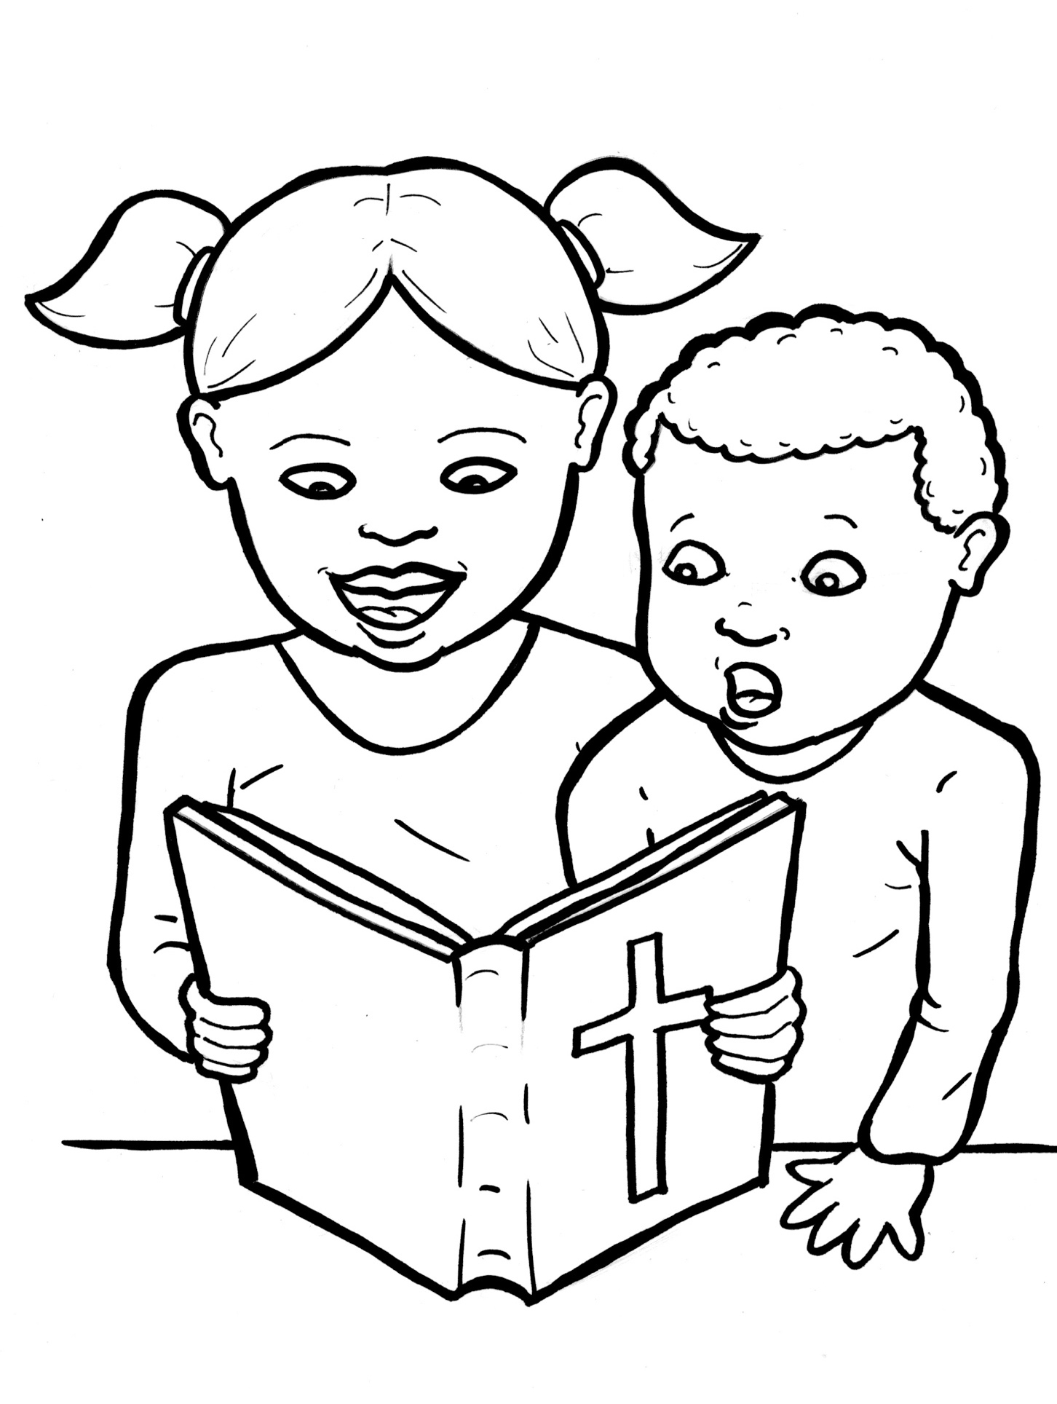
51. I am Alive:
the Bible
Part 5
Vocabulary
Original Bible Story

Slide 2
Vocabulary

Slide 3
liken
(LI – ken):
to compare; this is like that

Slide 4
founded
(FOUND - ed):
started

Slide 5
multitude
(MUL - ti - tude):
a crowd

Slide 6
astonished
(a – STON - ished):
greatly surprised

Slide 7
authority
(au- THOR – it - ty):
power to make decisions

Slide 8
scribe
(scribe):
a writer and teacher
in the days of Jesus

Slide 9
I am Alive: the Bible
Matthew 7:24-28
World English Bible (WEB)

Slide 10
“Everyone therefore who hears these words of mine and does them, I will liken him to a wise man who built his house on a rock.

Slide 11
The rain came down, the floods came, and the winds blew and beat on that house; and it didn’t fall, for it was founded on the rock.

Slide 12
Everyone who hears these words of mine and doesn’t do them will be like a foolish man who built his house on the sand.

Slide 13
The rain came down, the floods came, and the winds blew and beat on that house; and it fell - and its fall was great.”

Slide 14
When Jesus had finished saying these things, the multitudes were astonished at his teaching,

Slide 15
When Jesus had finished saying these things, the multitudes were astonished at his teaching,

Slide 16
for he taught them with authority, and not like the scribes.

